Slide 1
Moms Clean Air Force
Fighting to protect our children’s health
Impacts to children’s health from oil and gas operations
Patrice Tomcik
Project Manager, State Campaigns
Moms Clean Air Force
Notes:
Thank you PSR for inviting me to speak today. My name is Patrice Tomcik and I am the Project Manager of State Campaigns for Moms Clean Air Force living in Southwestern PA with gas development in my community. Moms Clean Air Force is a community of more than 100,000 moms and dads in Pennsylvania united against air pollution and climate change to protect our children’s health.

Slide 2
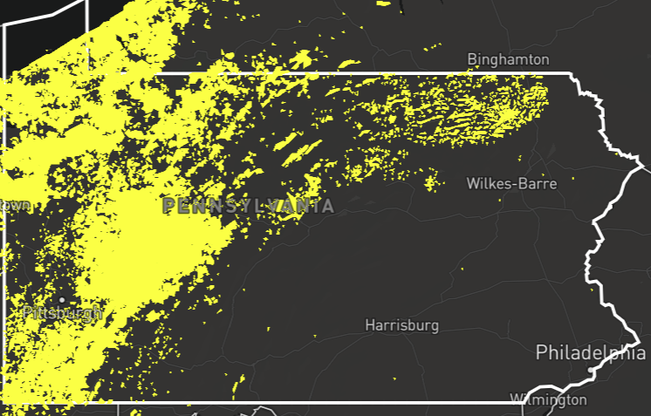
1.5 Million Pennsylvanians Live​ ​Within​ ​
a​ ​half mile of oil and gas facilities​ ​
Notes:
In Pennsylvania, 1.5 million people live within a half-mile of an active oil or gas facility and 300,000 students attend schools and daycares within a half mile of an oil and gas facility that puts their health and safety at risk. Yellow dots represent a half mile radius from oil or gas facilities.
[note: map of conventional & unconventional facilities]

Slide 3
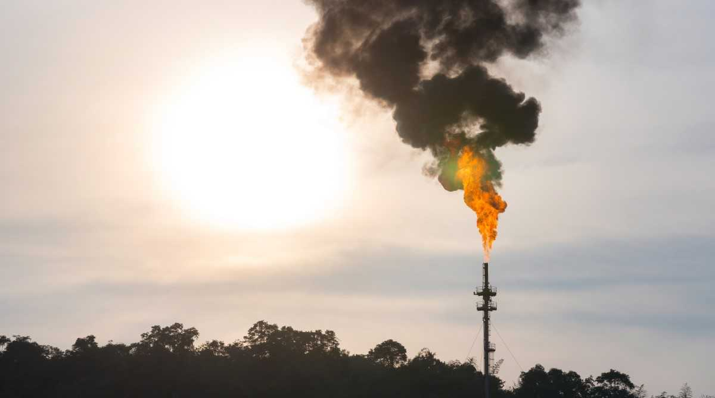
Air pollution from oil and gas operations
can travel hundreds of miles
Notes:
Pennsylvania is the second largest producer of natural gas in the nation and thus a significant contributor of natural gas pollution that can travel long distances. A 2015 study by the University of Maryland found unconventional oil and gas air pollution from Pennsylvania and West Virginia in Maryland and Washington DC.

Slide 4
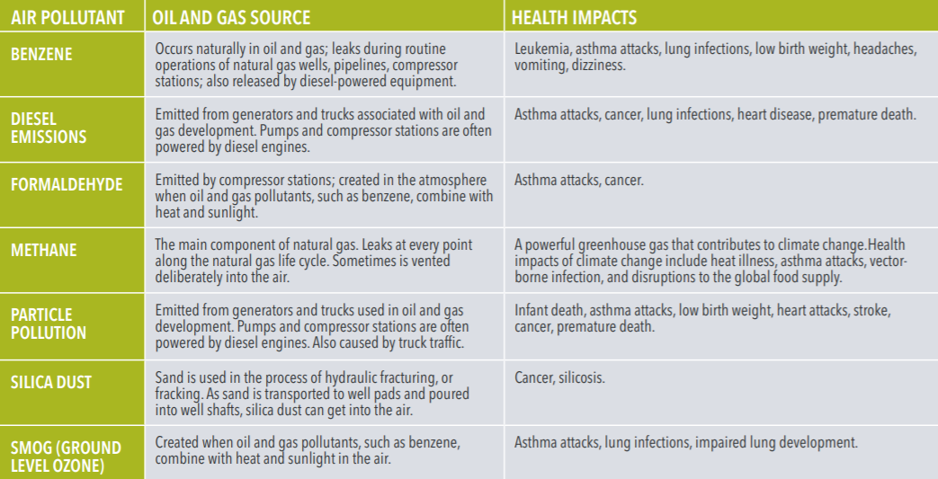
AIR POLLUTION OCCURS AT EVERY PHASE OF OIL & GAS OPERATIONS
Notes:
This chart lists just some of the air pollutants, the source, and health impacts that are associated with unconventional oil and gas operations. Air pollutants listed are benzene, diesel emissions, formaldehyde, methane, particle pollution, silica dust, and smog.
[Reference chart on back of Moms Clean Air Force Fact Sheet “How Oil and Gas Operations Impact Your Baby’s Health”.]

Slide 5
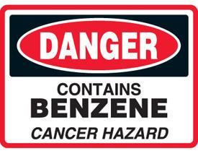
Hazardous air pollutants
Notes:
Benzene is a potent neuro toxin and causes childhood leukemia a blood cancer. A study from Colorado found average benzene concentrations 41 times higher in air samples and a lifetime cancer risk eight times higher within 500 feet of an oil and gas facility compared to a mile away.

Slide 6
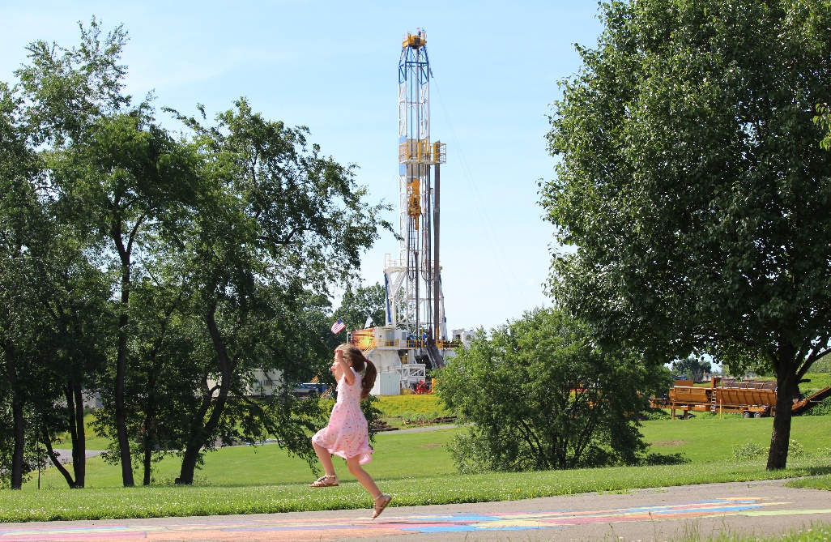
PUBLIC HEALTH RISKS
Notes:
Oil and gas operations are associated with increased risks of adverse birth outcomes, asthma exacerbation, health symptoms, explosions & fires, metal health. This photo was taken from the Summit Elementary playground in Butler County where the school building is 700ft from the gas wells and the playground is closer.

Slide 7
DEVELOPING BABIES & CHILDREN ARE VULNERABLE TO ENVIRONMENTAL POLLUTION EXPOSURES
Drill rig
Summit Elementary playground, Butler county
Notes:
We have long known that developing babies and children are vulnerable to environmental pollution exposures. They drink more water and breathe more air per unit of body weight than adults and therefore can receive a higher dose of pollution than adults.

Slide 8
Children’s activities makes them more vulnerable
to environmental pollutants
Drill rig
Dimmock, PA
Notes:
Children’s activities makes them more vulnerable to environmental pollutants because they engage in vigorous activity outdoors and often play close to the ground where pollution can settle. Note the girl in the picture is barefoot. In addition, children don't clear toxins from their bodies as efficiently as adults due to reasons related to growth and development.

Slide 9
Children are still developing until their early twenties
Drill rig
Bjornson family, Washington County
Notes:
It is important to note that children’s brains and lungs are still developing until their early twenties and children have a longer time to live with pollution exposures that can cause diseases later in life. The Bjornson family in this photo live with 40+ well pads, 2 compressor stations, multiple pipelines all within a 3 mile radius. The mother reports that members of the family have had bloody noses and unexplained rashes coinciding with activity at the nearby gas wells.

Slide 10
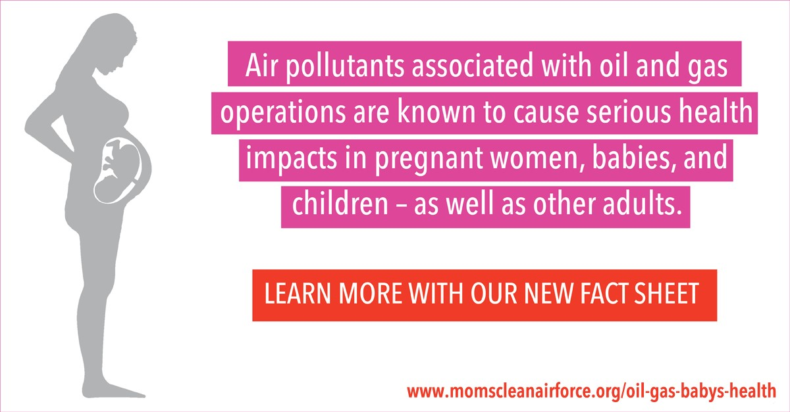
HOW OIL AND GAS OPERATIONS IMPACT YOUR BABY’S HEALTH
Notes:
There is increasing evidence that the fetus is vulnerable to a range of maternal pollution exposures. Retrospective studies of birth data from pregnant mothers, and their proximity to oil and gas operations gives us insight to the associations between oil & gas operations and maternal-infant health in a very short time span.

Slide 11
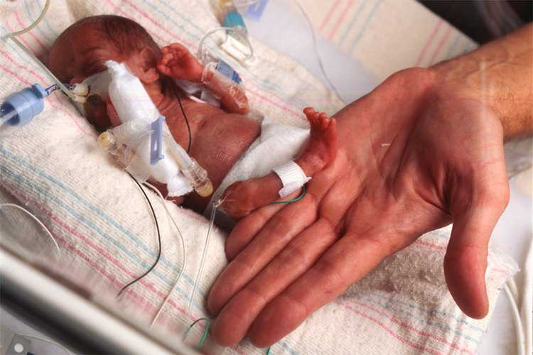
Adverse birth outcomes of babies in oil and gas regions
Notes:
Peer reviewed studies from Pennsylvania, Colorado, and Texas have found associations between pregnant women living near oil and gas operations and an increase in adverse birth outcomes like low birth weight, preterm birth, high-risk pregnancies, congenital heart defects, and infant mortality.

Slide 12
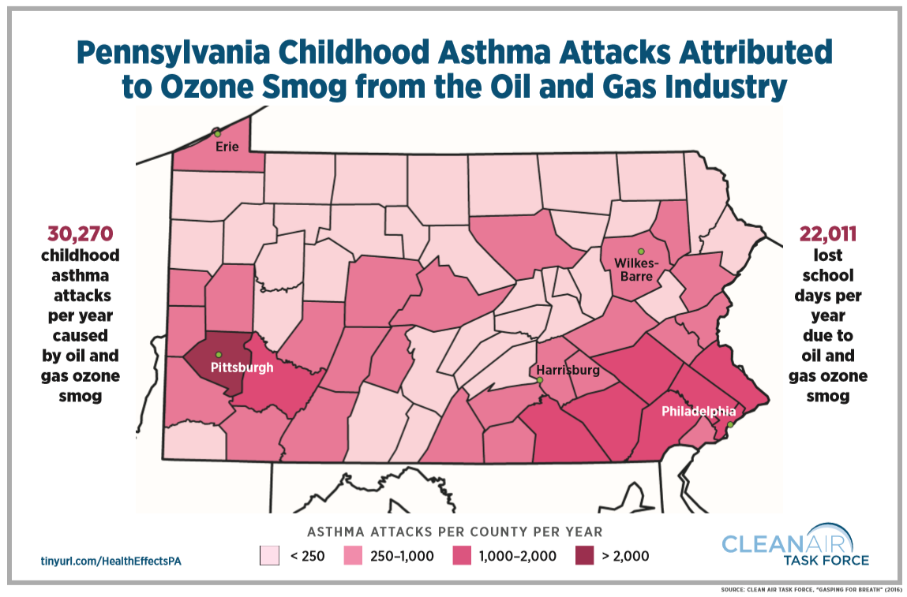
Notes:
Smog pollution created by oil and gas facilities can have a significant impact on public health – even in areas far from oil and gas production. It is estimated that Pennsylvania children suffer over 30,000 summertime asthma attacks and over 22,000 lost school days each year due to smog caused by oil and gas pollution.
[Note: This map is based on EPA air pollution modeling of industry self reported emissions.]

Slide 13
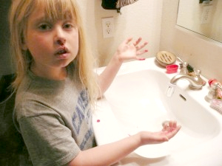
HEALTH SYMPTOMS ASSOCIATED WITH OIL AND GAS OPERATIONS
Notes:
Health symptoms associated with oil and gas operations are nosebleeds, rashes, fatigue, nausea, dizziness, vomiting, headaches, itching, coughing, sleep disruption, shortness of breath. Photo is of Emma Parr at 7 years of age who began having nosebleeds and rashes after moving into a home surrounded by 21 gas wells in Texas.

Slide 14
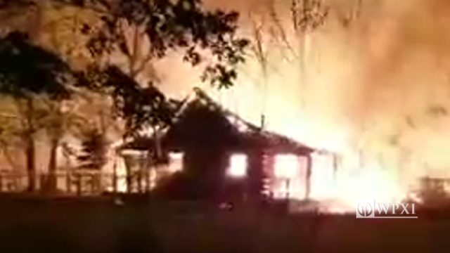
ARE CURRENT SETBACKS FROM OIL AND GAS OPERATIONS PROTECTIVE OF PUBLIC HEALTH & SAFETY?
Pipeline explosion in Beaver County
Notes:
Science and real life experiences reveal that setbacks from oil and gas operations are in many cases inadequate to protect public health in the event of a blowout, explosion, fire, gas cloud, or elevated hazardous air pollutants such as benzene. There is no defined setback that assures protection of human health and safety but distance from source does decrease risks.

Slide 15
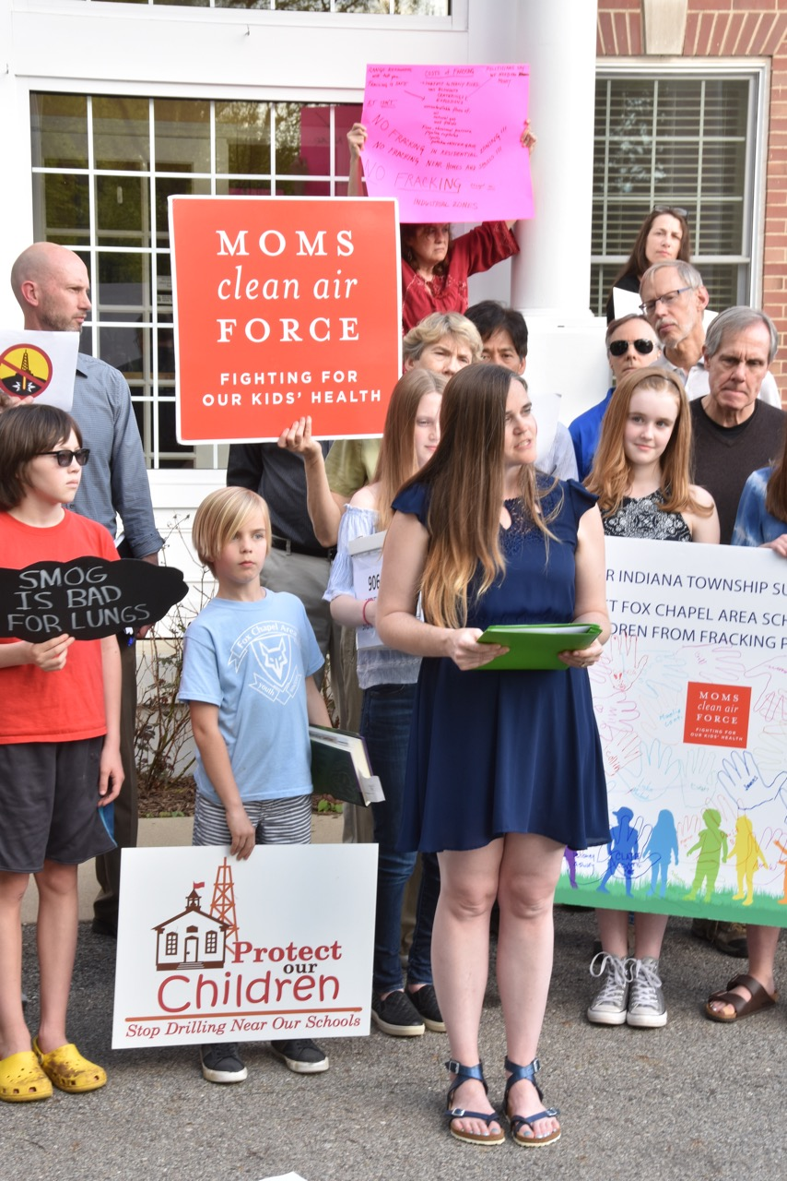
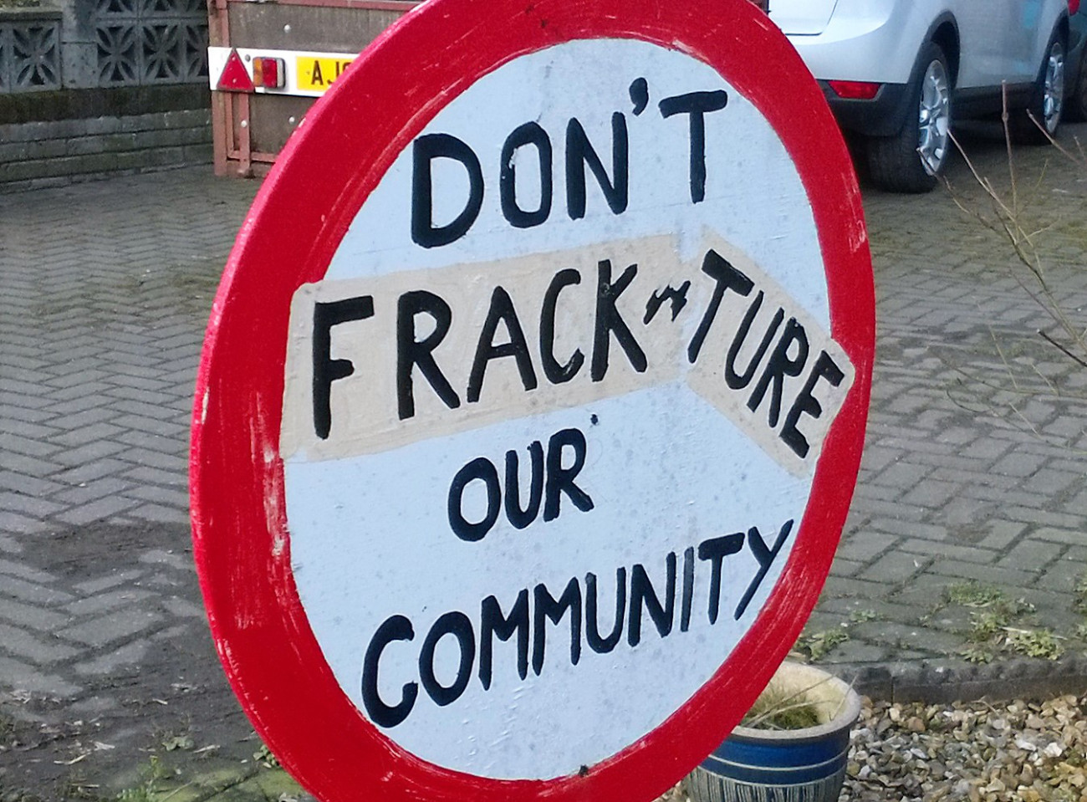
Mental Health
Notes:
Impacts from oil and gas operations can exact an emotional toll on the entire family and community. People living near oil and gas operations have reported feelings of stress, anxiety, depression, anger, distrust, and feelings of powerlessness. Communities are often divided between those who want oil and gas operations and those who do not.

Slide 16
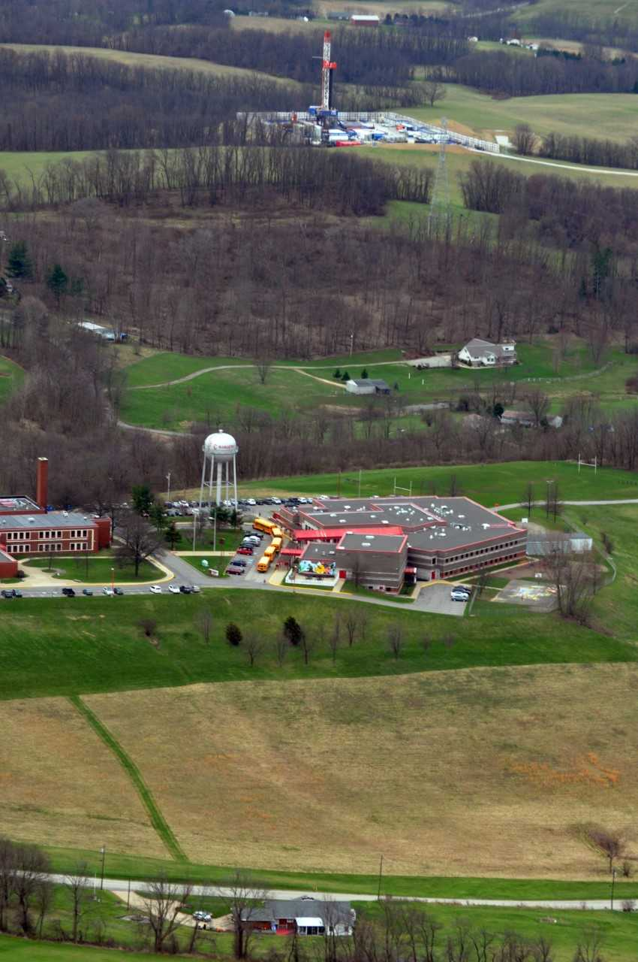
well pad
“I worry every day that my daughter's health has suffered because of her proximity to the 22 gas wells approximately a half mile away from her school.” Jane Worthington
school
Ft. Cherry School District, Washington County
Notes:
Coinciding with well pad activity near her school, Jane Worthington (in this picture) reports that her daughter developed asthma-like symptoms, infected eyes, gastrointestinal problems, nosebleeds, rashes, joint swelling and pain, headaches, anxiety, and was subsequently diagnosed benzene-exposed.

Slide 17
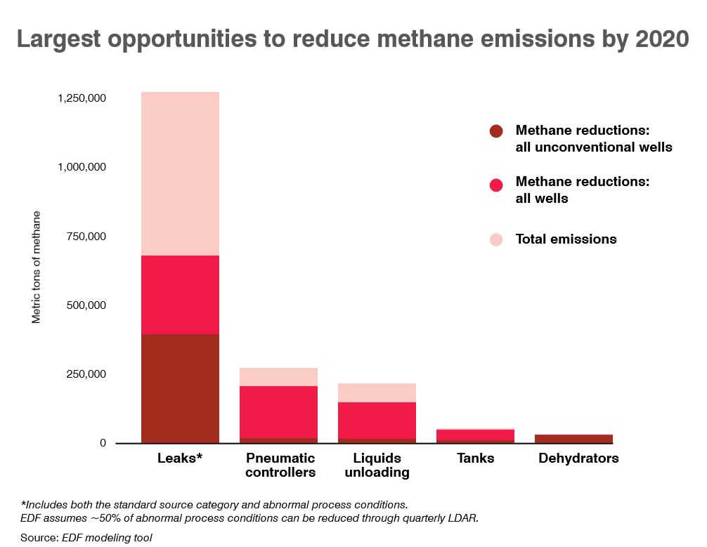
Technologies exist today to reduce
oil and gas air pollution
Notes:
Methane is both a powerful climate pollutant and the primary ingredient of natural gas. By requiring industry to find and fix leaky equipment quarterly, methane emissions can be cut by 60% which would also help reduce associated toxic pollutants such as benzene.

Slide 18
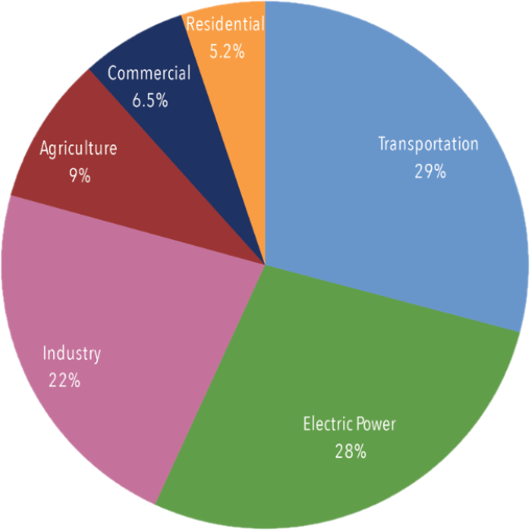
Solution: 100% clean energy by 2050
Source of Greenhouse Gas Emissions
Inventory of U.S. Greenhouse Gas Emissions and Sinks 1990-2017 (EPA, 2019)
Notes:
Clean energy means getting energy from sources that don’t emit carbon, methane, or other climate-warming pollution. It also means energy that is renewable, and safer for our health.
It’s time for our leaders to set a goal: Eliminate the pollution causing climate change by 2050.

Slide 19
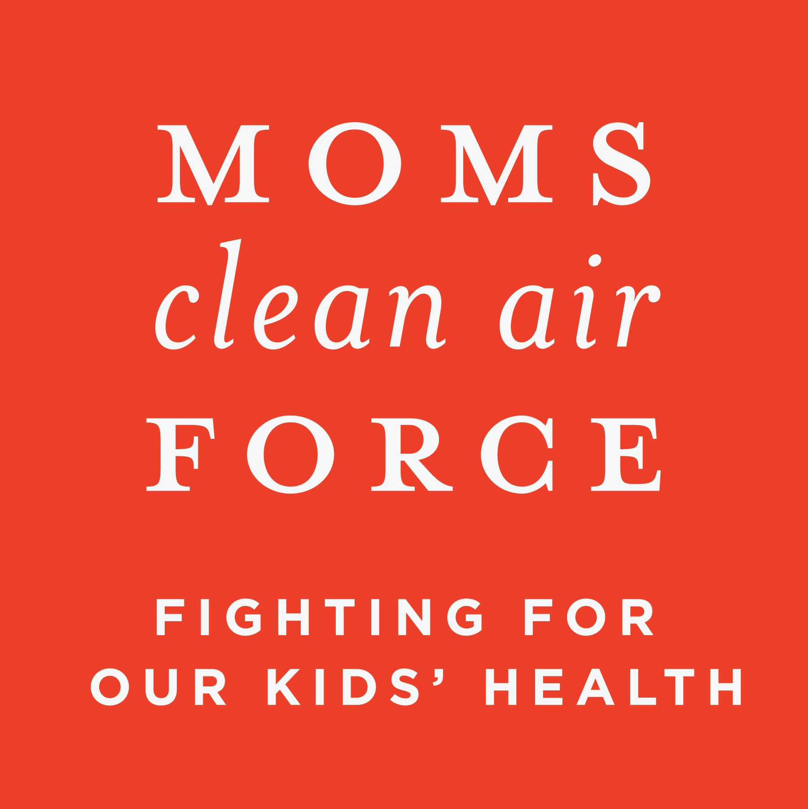
“In 2050, I will be 41 years old. What will my life, and my friends’ lives, look like by then if we don’t stop burning fossil fuels & move to clean, renewable energy? I think about this every day, & I’m just a kid.” - Caia, age 10
MOMS CLEAN AIR FORCE
www.momscleanairforce.org
Facebook: www.facebook.com/MomsCleanAirForcePA
Twitter: www.twitter.com/CleanAirMoms_PA
Notes:
Thank you!

