Slide 1
Current Legal Atmosphere: Act 13’s Unconstitutional Medical Gag Rule and the Limits of Non-disclosure Agreements
Jordan B. Yeager
Curtin & Heefner LLP

Slide 2
OIL AND GAS (58 PA.C.S.) - OMNIBUS AMENDMENTS Act of Feb. 14, 2012, P.L. 87, No. 13 Session of 2012 No. 2012-13
AN ACT
Amending Title 58 (Oil and Gas) of the Pennsylvania Consolidated Statutes, providing for an unconventional gas well fee and for transfers from the Oil and Gas Lease Fund; providing for distribution of fees and transfers; establishing the Natural Gas Energy Development Program; consolidating the Oil and Gas Act with modifications and additions relating to definitions, well permits, permit objections, comments by municipalities and storage operators, well location restrictions, well site restoration, protection of water supplies, notification to public drinking water systems, containment for...
Cl. 58
HB 1950
Notes:
Act 13 was enacted in 2012, to create uniform state regulation of the fracking industry.
Yet it did so at the expense of Pennsylvania residents’ health and well being, overriding local municipal regulations and silencing physicians.

Slide 3
Notes:
For the health care profession, Act 13 instituted what became known as the medical gag rule.
To access information about the chemicals in fracking fluids,
Required healthcare providers to show
the information was needed to treat an individual;
patient may have been exposed to a fracking fluid;
information will assist in diagnosis or treatment

Slide 4
Notes:
Additionally, it made the healthcare provider agree to a non-disclosure agreement.
Which mandated they “maintain the information as confidential” and only use it for the “health needs asserted”
The vague language of this agreement, effectively silenced the communication of any health issues concerning fracking

Slide 5
Notes:
Placed medical professionals in a position where they had to choose between following the legally mandated provisions of Act 13 and
adhering to other ethical and legal duties requiring them to report these findings and make them public.

Slide 6
Notes:
The Delaware Riverkeeper Network, Maya van Rossum, the Delaware Riverkeeper, 7 municipalities, and a physician, Dr. Khan, challenged the constitutionality of specific provisions of Act 13, including the medical gag rule.

Slide 7
Notes:
In 2016, the Pennsylvania Supreme Court declared the “physician’s gag rule” unconstitutional
It held that it showed special treatment to the fracking industry placing unique burdens on the medical community.

Slide 8
Notes:
Healthcare providers are no longer subject to Act 13’s unconstitutional effort to limit the disclosure of information about fracking-related toxic chemical exposures

Slide 9
Notes:
Questions remain about the extent to which non-disclosure agreements (“NDAs”) limit the ability of patients and healthcare providers to discuss information about fracking-related toxic exposure.
In particular, there have been questions raised about whether residents who have been exposed to contaminated water supplies or airborne toxins as a result of fracking-related activities – and who have signed NDAs -- can disclose information about their exposure to their health care providers.

Slide 10
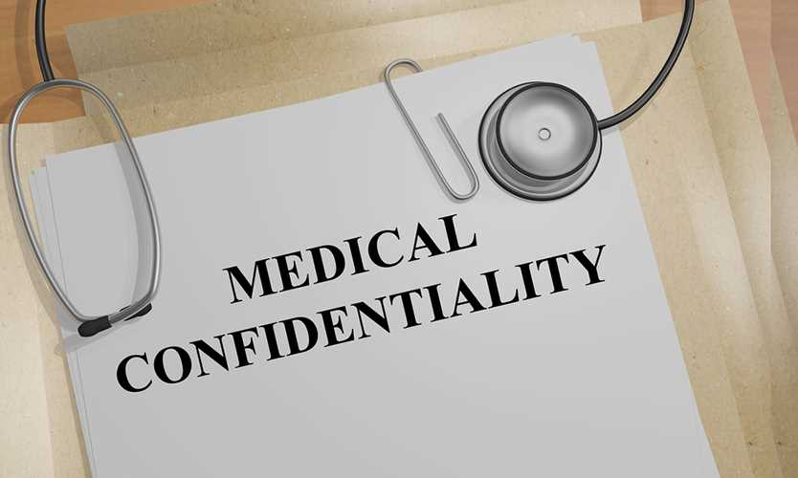
Notes:
NDAs are commonly included in contracts when legal disputes are settled, particularly when one of the parties has an economic interest to keep the terms of the agreement, or the facts leading up to the agreement, confidential.
NDAs are more likely to prohibit disclosure of the terms of a settlement than they are to prohibit the facts or allegations underlying the dispute between the parties.

Slide 11
Notes:
It is hard to imagine any court preventing confidential communications between a patient and her physician and interfering with the patient’s ability to share critical information about potential toxic exposure if such information is shared for purposes of obtaining medical diagnosis and treatment. That said, we will explore the issues further.

Slide 12
Notes:
First, we must recognize that it is hard, if not impossible, to generalize about any potential legal dispute. In cases involving contracts – including NDAs – the starting point for any analysis is the language of the actual contract.
Every contract can contain unique language. Without reviewing the specific contract language at issue – and the specific NDA terms -- one cannot analyze to what extent it can be reasonably interpreted to either prevent or allow any specific disclosure or action.

Slide 13
Notes:
While the general rule is that courts will enforce contracts according to their terms, including NDAs, there are exceptions, including when a contract violates public policy.

Slide 14
Notes:
The courts apply a balancing test for determining whether a contract provision is against public policy. A contract term should not be enforced if it is contrary to relevant legislation, or if the interests in enforcement are clearly outweighed by the public welfare.

Slide 15
Notes:
In assessing the enforceability of an NDA that seeks to limit patient disclosures to health care providers, the courts will consider the ethical rules surrounding the physician-patient relationship.

Slide 16
Notes:
Physicians have an ethical duty to address the cause of a medical problem and prevent potential threats to the health and safety of patients.
Physicians also have an ethical obligation to gather relevant information and make relevant information available to patients, colleagues, and the public.

Slide 17
Notes:
A doctor should explain the cause of an illness to the patient and advise the patient to the best of his ability regarding how to avoid the health risks.
In order to be able to do this, physicians need to know what environmental exposure the patient is facing.

Slide 18
Notes:
Physicians have a similar duty to share information about the cause of illness with a patient’s family and to educate them about specific risks in order to mitigate subsequent health concerns

Slide 19
Notes:
13. Physicians have an ethical duty to advance the study of medical science by providing relevant information to colleagues and researchers, to share information with regulatory authorities, and in some situations, provide broader public warning.

Slide 20
Notes:
The Pennsylvania Board of Medicine has the statutory authority to discipline physicians for failure to conform to the “standard of the profession.” Under state law, this include the ethical principles adopted by the professional community, including those adopted by the American Medical Association.

Slide 21
Notes:
Licensed and certified healthcare practitioners must report certain diseases, infections, outbreaks, or conditions to the Department of Health or other local offices, sometimes within 24 hours of discovery

Slide 22
Notes:
Pennsylvania law requires health practitioners to report any unusual conditions or diseases capable of being spread to others through direct or indirect contact with a toxic source, including through environmental exposure.

Slide 23
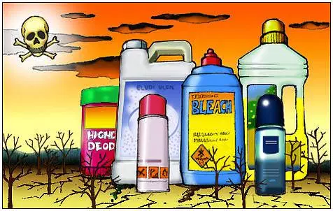
Notes:
17. In order to carry out all of these ethical duties, healthcare providers must be able to inquire about and be aware of their patients’ exposure to environmental toxins.

Slide 24
Notes:
Similar, experts have recognized that physicians have an ethical duty to know the communities in which they practice. This obligation encompasses the need to understand environmental hazards prevalent in the local community.

Slide 25
Notes:
19. While fracking companies might assert an interest in protecting their trade secrets, a trade secret’s only legally cognizable value is the advantage it gives over competitors. A patient who shares trade secret information with a health care provider, who, in turn, must keep her patient’s information confidential – would not harm the trade secret holder’s competitive advantage.

Slide 26
Notes:
Thus, a fracking company has less interest in preventing the disclosure of chemical information than the patient has in being able to make the disclosure to her healthcare provider.
Thus, as it is unlikely that any court would prevent confidential communications between a patient and her healthcare provider.
It is unlikely that any court would interfer with the patient’s ability to share critical information about potential toxic exposure if such information is shared for purposes of obtaining medical diagnosis and treatment.

