Slide 1
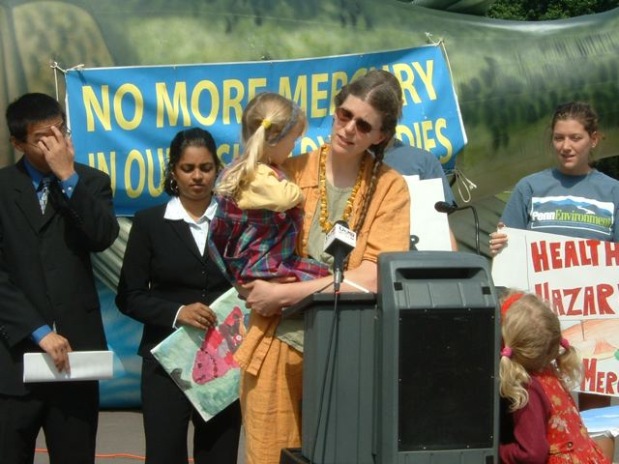
Group Against Smog and Pollution, Inc.
We work to improve air quality to ensure human, environmental, and economic health.
Notes:
Good morning and thank you to Physicians for Social Responsibility for the invitation to present today. My name is Rachel Filippini and I’m the executive director of the Group Against Smog and Pollution (or GASP). For fifty years we’ve worked to improve air quality in southwestern Pennsylvania through education, advocacy, policy-making, and legal work. Today, I’ll be discussing air quality and health.

Slide 2
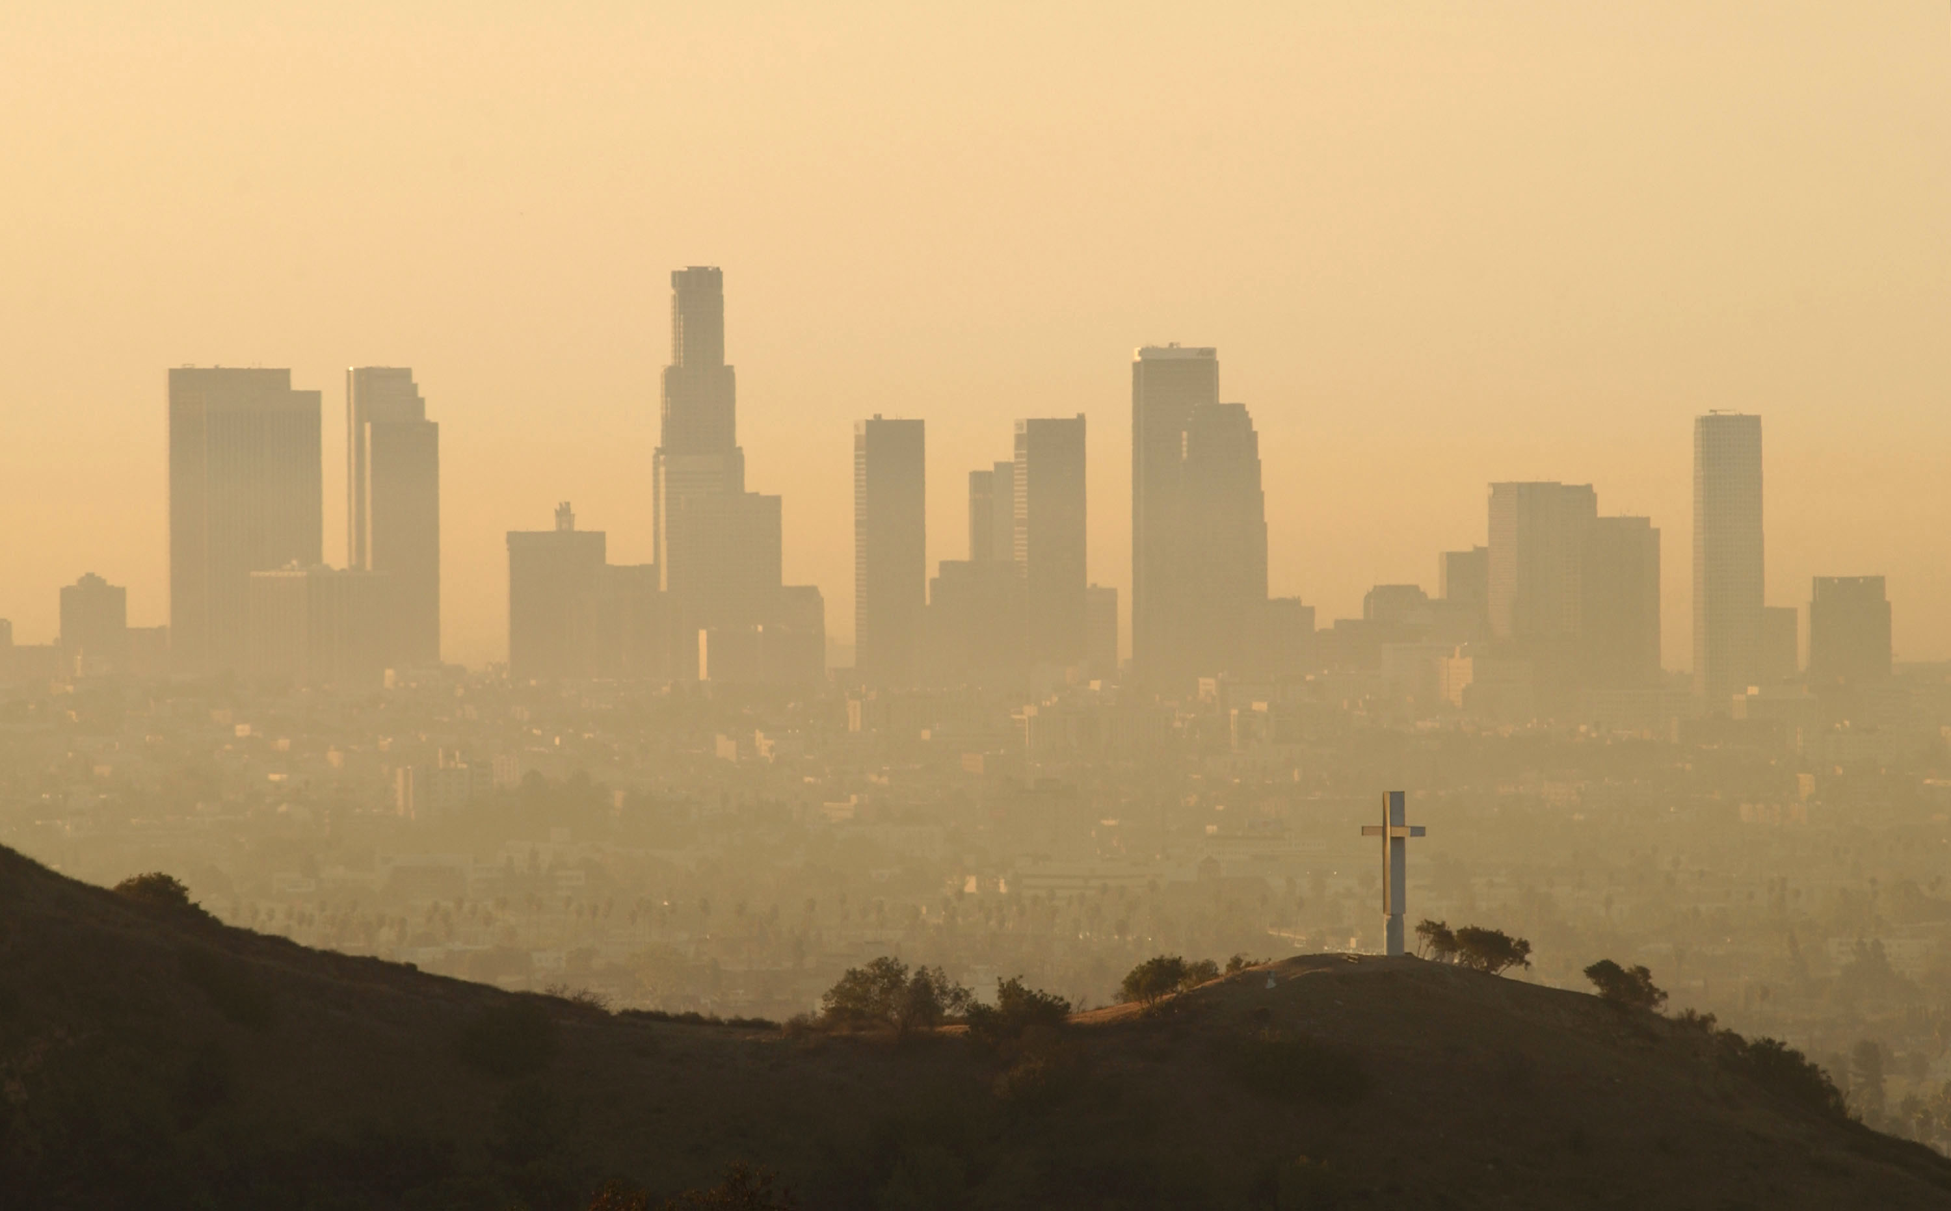
Air Pollution is a Significant U.S. Public Health Concern
Notes:
Thanks to the Clean Air Act we have made progress on reducing harmful air pollution across the United States. However air pollution remains a significant public health concern. Far too many people live in areas where the air they breathe poses a health risk and can even shorten their life.

Slide 3
Notes:
According to the Environmental Protection Agency over 20 million school days and work days are lost each year due to air pollution. The estimated excess mortality is 125,000 deaths/year.
More than 122 million people are living in counties with one or more pollutants exceeding the National Ambient Air Quality Standards.

Slide 4
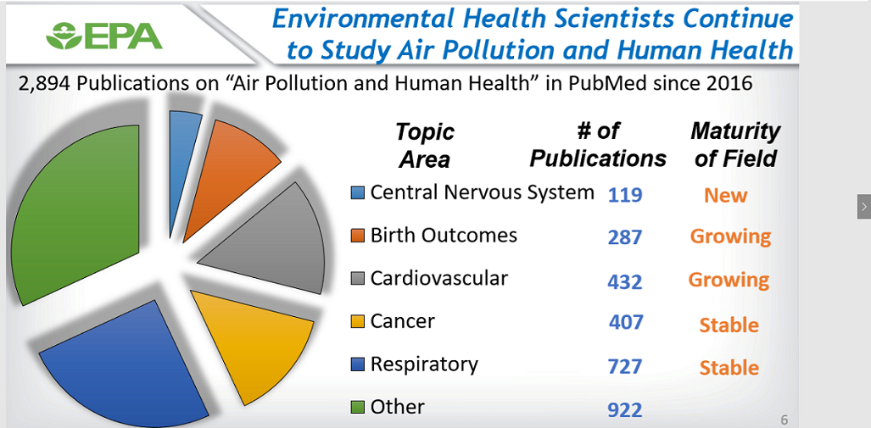
Notes:
Air pollution is linked to many health problems – everything from asthma, to various cancers, heart attacks, diabetes, and dementia. There have been more than 2800 publications on air pollution and human health in PubMed since 2016.

Slide 5
Carbon Monoxide
Lead
Nitrogen Dioxide
Ozone
Particulate Matter
Sulfur Dioxide
Notes:
So, when we say air pollution what are we really concerned about? For one, we are concerned with exposure to these six criteria air pollutants. Theses pollutants are ubiquitous, they can harm your health, and the EPA has set federal standards that must be met for them.

Slide 6
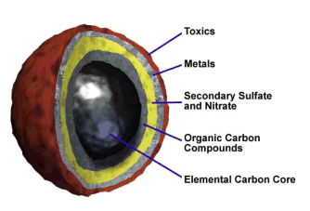
What is particulate matter?
Notes:
Particulate matter (PM) includes solid and liquid droplets of various sizes suspended in air.
These particles range in size. Particles between 10 µm and 2.5 µm are often described as coarse PM (PM10) and are associated with road dust and salt.

Slide 7
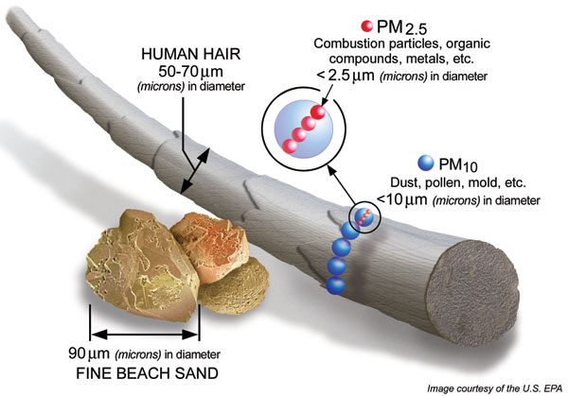
Notes:
Particles with diameter equal to or less than 2.5 µm are referred to as fine particles(PM2.5) and they commonly result from combustion. Some particles might be more harmful than others – it depends on composition and oxidative potential…but I want to reinforce the message that there is really no safe level of PM2.5 pollution.
Particles with diameter less than 0.1 μm are referred to as ultrafine particles (UFP). Diesel emissions are a significant source of ultrafine particles in the atmosphere.

Slide 8
Health impacts of PM
Notes:
Size matters. Larger particles are linked to inflammation of the respiratory system, bronchitis, asthma, allergies, coughing, and reduced lung capacity
PM2.5 is linked to heart attacks, strokes, arrhythmias, lung cancers
And ultrafine particles are associated with brain damage and organ cancers
Slide source: http://urbanemissions.blogspot.com/2017/01/infographic-penetration-of-particulate.html

Slide 9
Notes:
Ozone is created by reactions of oxides of nitrogen (NOx) and volatile organic compounds (VOCs) from vehicle exhaust, industrial emissions, gasoline vapors, chemical solvents, and natural sources in the presence of sunlight.
ALA’s most recent SoTA report gave Erie County a C for ozone pollution

Slide 10
Ground level ozone
Notes:
Breathing ozone can trigger a variety of health problems including chest pain, coughing, throat irritation, and congestion. It can worsen bronchitis, emphysema, and asthma.
Ground-level ozone also can reduce lung function and inflame the linings of the lungs. Repeated exposure may permanently scar lung tissue.

Slide 11
Notes:
There are only 2 air quality monitoring sites in Erie County. One in the City of Erie, which monitors for ozone, CO, NO2, PM2.5 and PM10 and another on Presque Isle which monitors for VOCs and metals.
This means there isn’t a robust network of monitors in the area.

Slide 12
Air Pollutants Associated with Unconventional Gas Drilling
Notes:
What are the air pollutants associated with unconventional gas drilling? Nitrogen Oxides (NOx), Volatile Organic Compounds (VOCs), Sulfur Oxides (SOx), Particulate Matter, Methane, Formaldehyde, Benzene, and others

Slide 13
Air pollution comes from…
Notes:
The air pollution comes from many parts of the process. From constructing well pads, to
Truck traffic
Well drilling, fracking, venting, and flaring
Natural gas processing, transmission, and storage

Slide 14
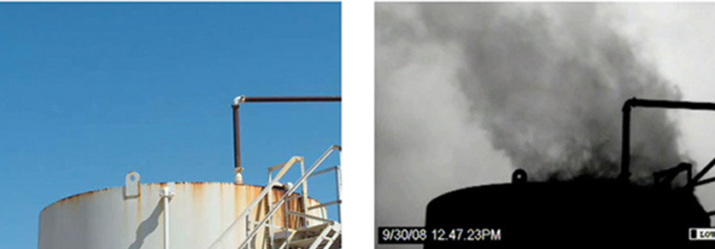
Methane
Notes:
In 2014 Pennsylvania’s gas industry leaked enough methane to heat nearly 65,000 homes, and recent studies have shown that official measures of methane leakage rates are vastly underestimated by regulatory agencies.
Methane isn’t the only thing leaking throughout oil and gas operations. Many air pollutants, potentially harmful for our families and communities, are emitted along with heat-trapping methane.

Slide 15
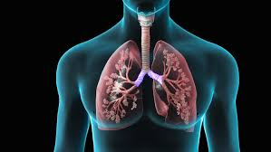
Air pollution & your lungs
Notes:
Air pollution makes infections worse and makes lungs more susceptible to getting infections in the first place. Pollution causes your airways to narrow, decreasing airflow, and amps up the production of mucus. It also may prevent the lungs from effectively filtering out bacteria and viruses.
According to PennEnvironment, Erie experienced 71 days in 2016 in which air pollution reached levels that posed at least a moderate health concern to people with lung diseases.

Slide 16
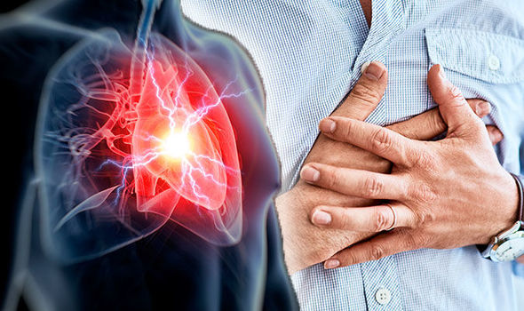
Air pollution and cardiovascular health
Notes:
Air pollution can trigger heart attacks, stroke, and irregular heart rhythms, especially for those that are already susceptible.
Air pollution not only exacerbates existing heart conditions but it also appears to have a role in the development of the disease with particularly strong evidence for an adverse effect from particulate matter compared with gaseous pollutants

Slide 17
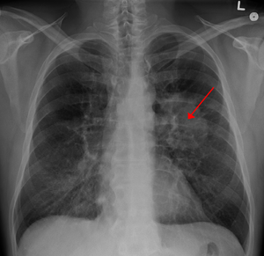
Cancer
Notes:
The International Agency for Research on Cancer (IARC) has classified outdoor air pollution – as a whole -- as a carcinogen. In its evaluation, they concluded that outdoor air pollution causes lung cancer and is also linked to an increased risk for bladder cancer.
The IARC also classified another major component of outdoor air pollution – particulate matter – as a carcinogen on its own.

Slide 18
Brain Health
Notes:
Air pollution is linked with cognitive decline and accelerated brain aging
Neurological impacts include neuro-inflammation, stroke and neuro-degenerative disorders
Some studies have linked long-term exposure to high PM2.5 levels to smaller gray and white matter volumes in important areas such as the frontal lobe, which carries out thinking, decision-making and planning -- https://keck.usc.edu/air-pollution-may-lead-to-dementia-in-older-women/

Slide 19
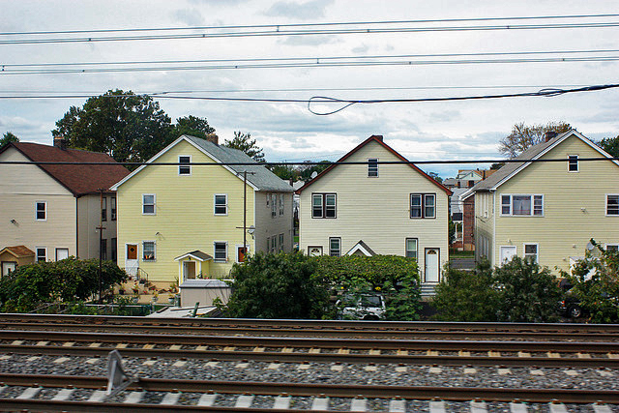
Especially vulnerable
Notes:
No one is immune to air pollution but some populations are especially vulnerable. This includes the elderly and those with underlying health conditions, children, athletes who may be active outdoors, pregnant women and their unborn children, those that work in settings that put them in close to proximity to pollution sources, and those that live closer to pollution sources.

Slide 20
Get Involved and Learn More
Rachel Filippini, Director
Group Against Smog and Pollution
rachel@gasp-pgh.org
412-924-0604
www.gasp-pgh.org
Facebook/Twitter: @GASPPgh
@rachelgasp

