Slide 1
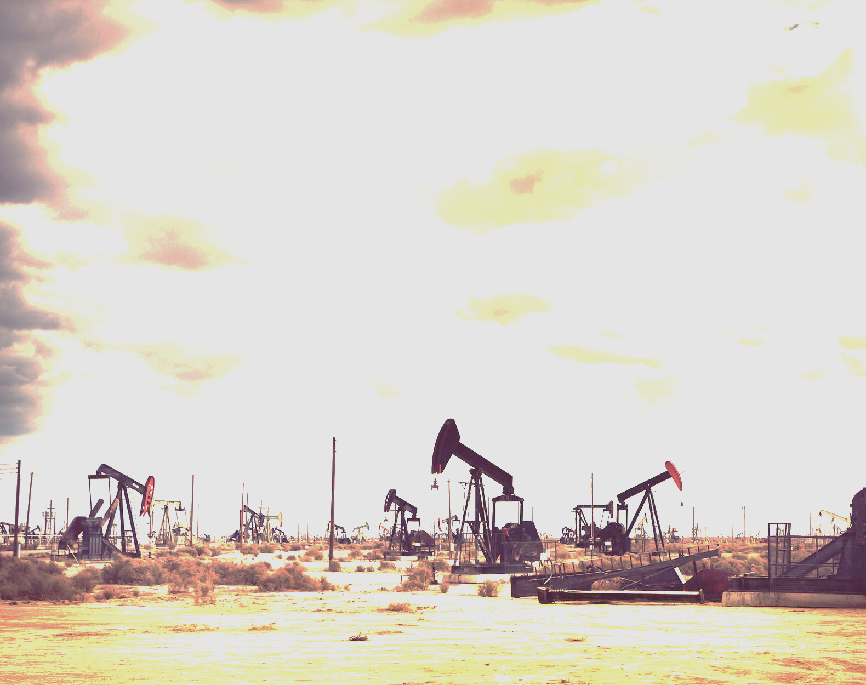
Health Impacts of Unconventional Gas Development
Physicians for Social Responsibility
Pennsylvania
Notes:
I am Tammy Murphy, the Medical Advocacy Director of PSR Pennsylvania. My colleague, Laura Dagley will be present in Pittsburgh today. Together, we thank for joining the first of our three-part, speed-learning and advocacy training series. We also thank our hosts at Drexel University and Chatham University.

Slide 2
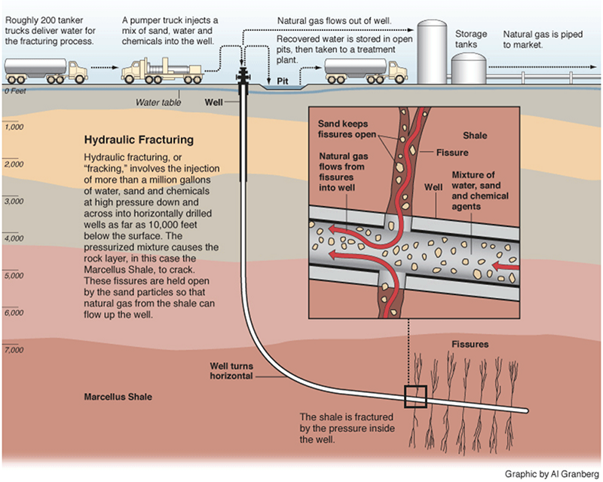
Notes:
Hydraulic fracturing involves injecting millions of gallons of water, sand and dangerous chemicals at high pressure down and across into horizontally drilled wells to fracture the earth to release gas.
Symptoms reported by residents living near gas drilling sites, include… (deep breath)

Slide 3
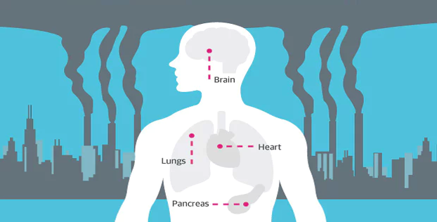
Notes:
…increased skin rashes, nausea and vomiting, abdominal pain, difficulty breathing, coughs, nosebleeds, anxiety and stress, headaches, dizziness, eye and throat irritation and increased rates of hospitalization and numbers of patients with heart and skin conditions, tumors, urological conditions, chronic rhinosinusitis, fatigue symptoms and asthma exacerbations.

Slide 4
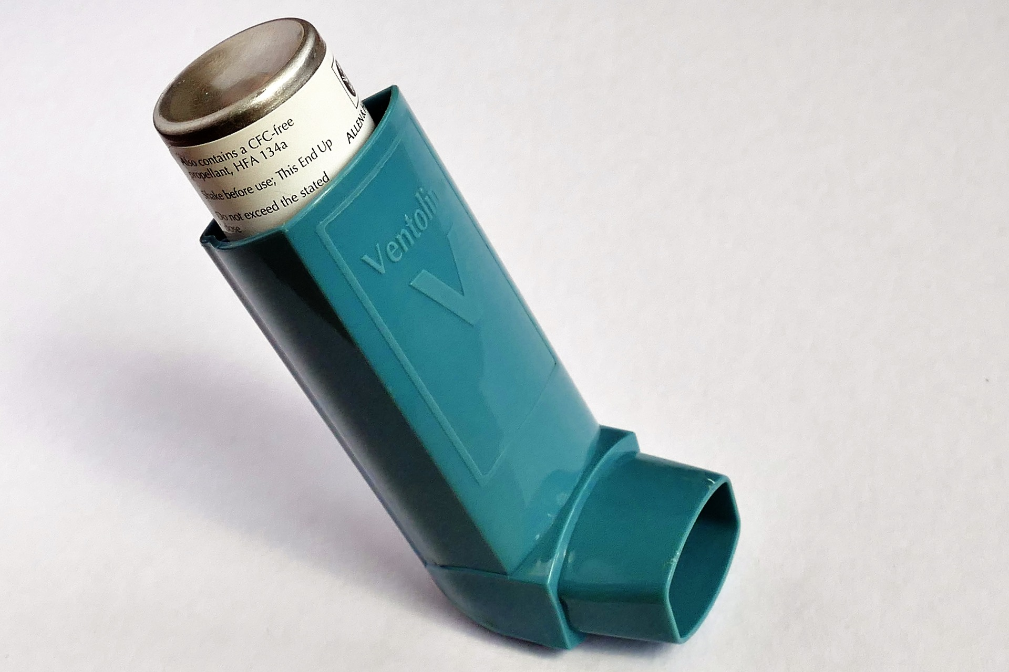
Notes:
People who lived near many active natural gas wells are more likely to suffer from asthma attacks.
The association between asthma exacerbations and proximity to fracking activity occurred in all four phases of well development — pad preparation, drilling, stimulation, and production.

Slide 5
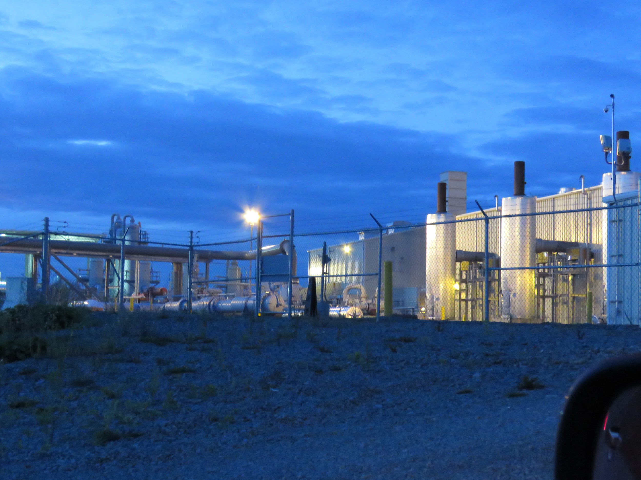
Notes:
Analyzed medical records of over 35,000 asthma patients, ages five to 90 found a statistically significant association between proximity to active fracking operations and mild to severe asthma exacerbations.
Airborne chemicals leaked throughout the industry are considered a cause of many of the reported health symptoms.

Slide 6
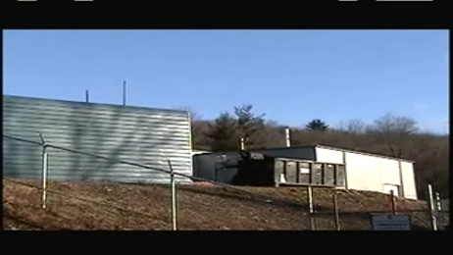
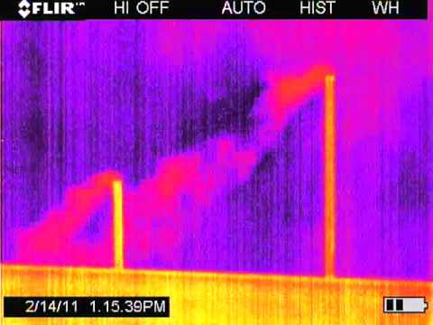
Notes:
These images are from a compressor station on Button Rd. in Dimock, PA, with and without Forward Looking InfraRed (FLIR) camera, which reveal methane in the atmosphere that is undetectable by the naked eye.

Slide 7
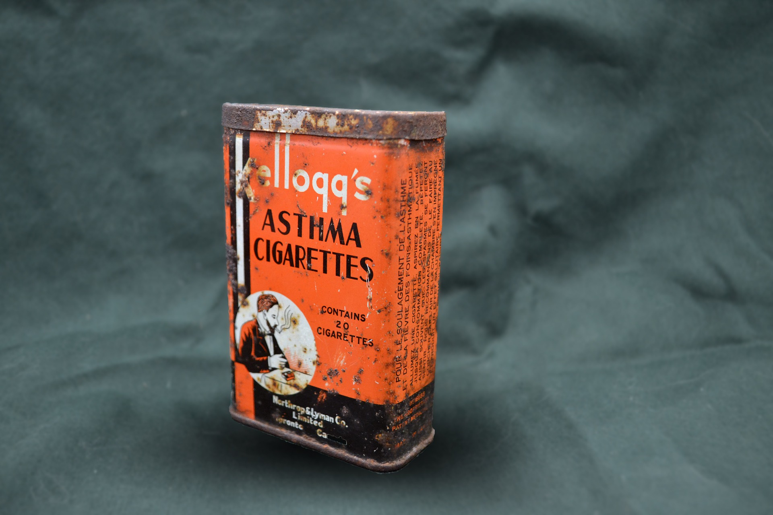
Notes:
Radon levels register higher in buildings near unconventional gas development, suggesting that it has opened new pathways for radon to enter people’s homes. Exposure to secondhand tobacco smoke with high levels of this radon is extremely dangerous, especially for the developing lungs of children.

Slide 8
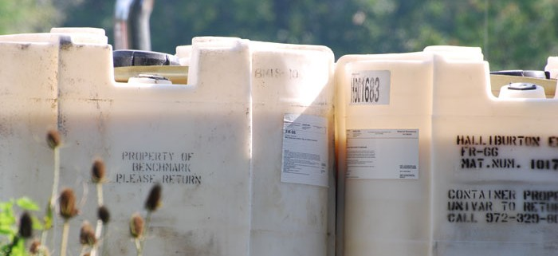
Notes:
As an example of reported evidence of widespread and persistent contamination of water and soils with toxic materials associated with unconventional oil drilling, in North Dakota over 3,900 incidents of spilled fracking wastewater were documented, more than one for every three wells drilled.

Slide 9
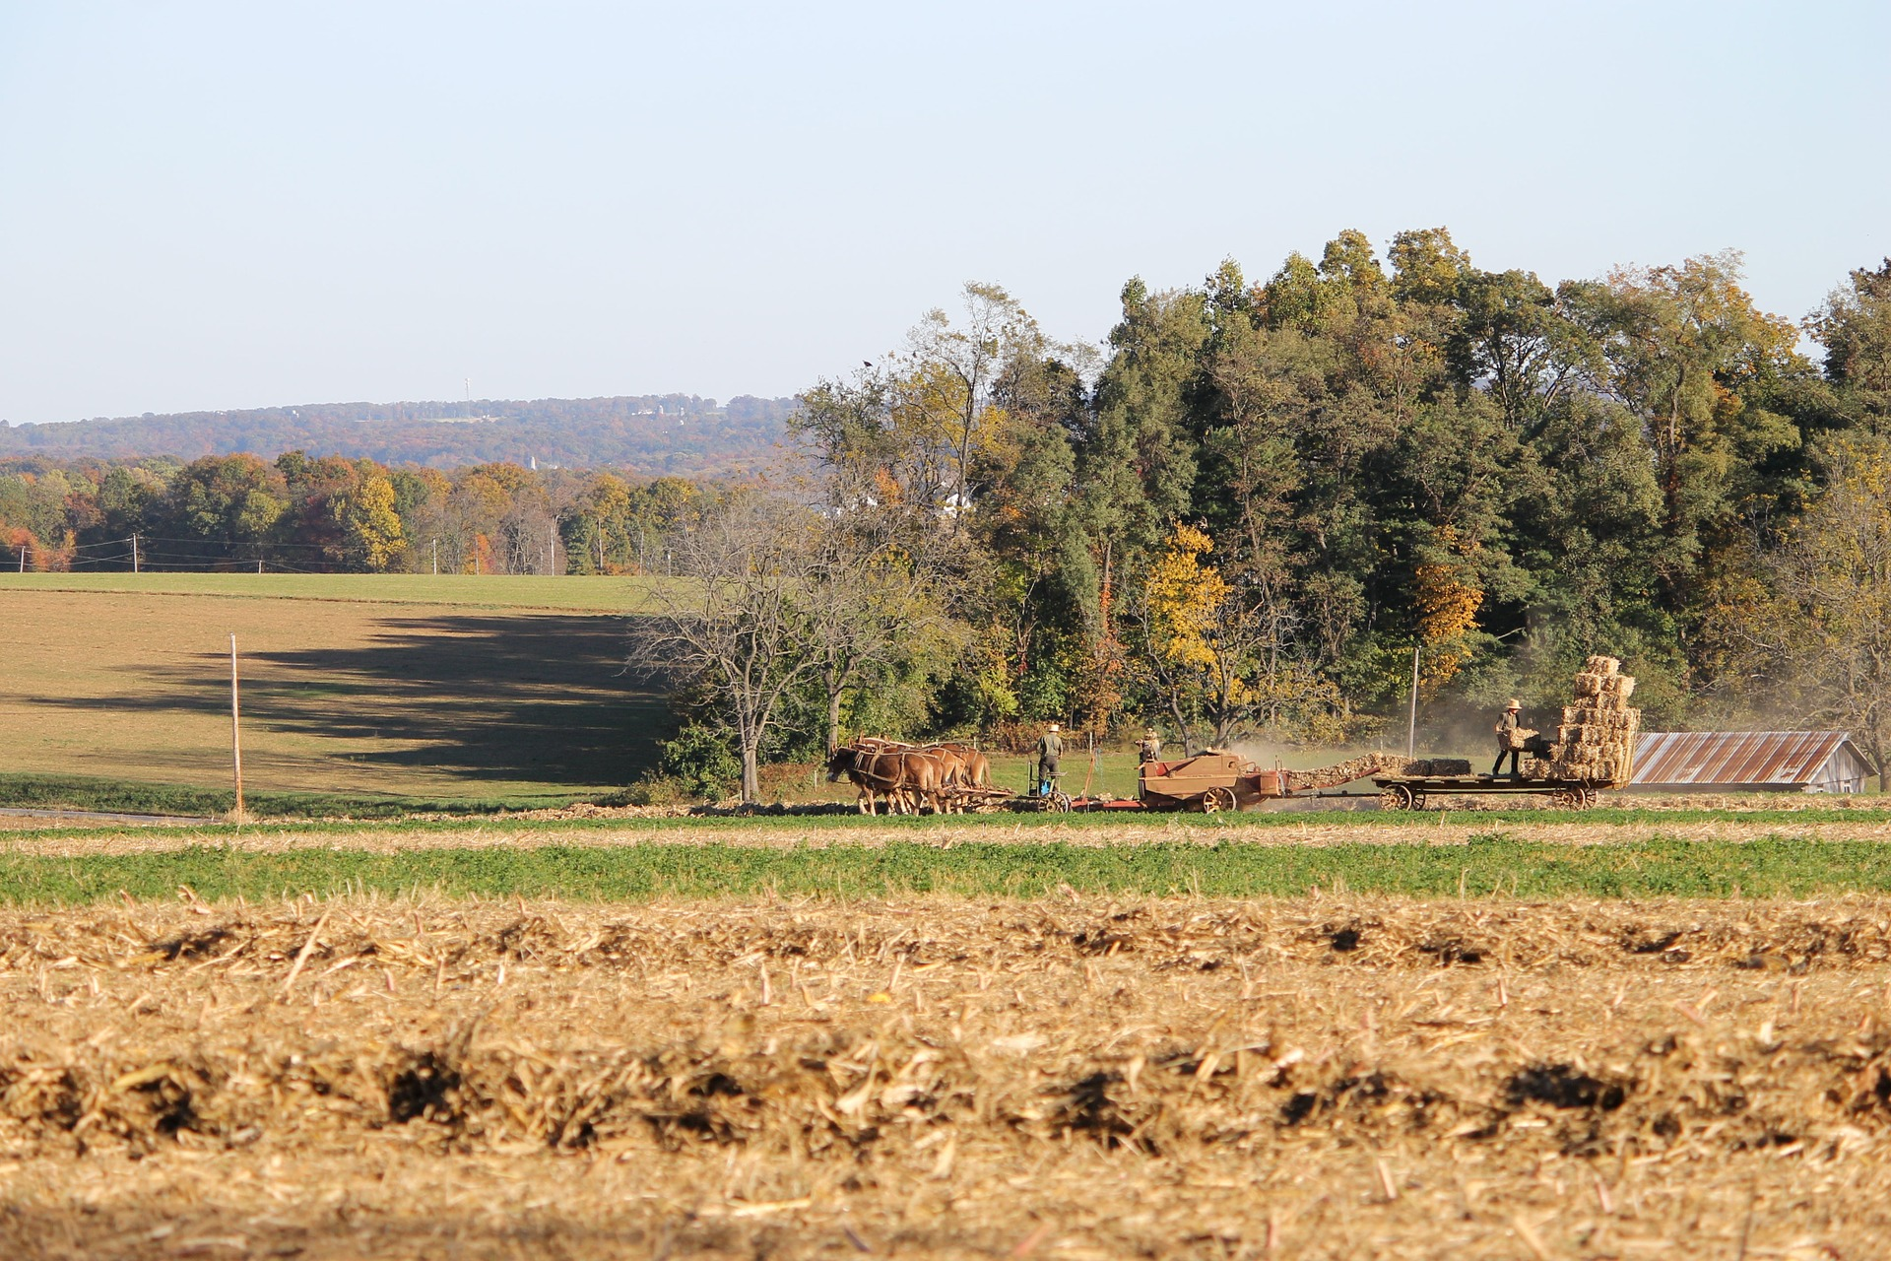
Notes:
Pennsylvania Department of Environmental Protection Air Inventory Data Report used data derived from industry-provided information from 2014 shows that air pollutants emitted have increased at all points of natural gas operations, including: Sulfur dioxide, Nitrogen oxides, Volatile Organic Compounds, Fine particulate matter, Carbon monoxide, Carbon dioxide and Methane emissions.

Slide 10
Notes:
Adverse health outcomes in babies born to mothers living in the vicinity of well pads, include increases in low birth weights, premature births, high-risk pregnancies, congenital heart defects, increased infant mortality.

Slide 11
Notes:
Hospitalizations for heart conditions increased more than 25% over five years among residents in zip codes with more wells than those in zip codes with the least. Likewise, neurology admissions increased in zip codes with more wells. Higher environmental stress is considered the cause of the cardiology increases.

Slide 12
Notes:
Endocrine-disrupting chemicals detected in surface waters near hydraulic fracturing wastewater disposal can have potent effects on human development at exceedingly low concentrations during critical developmental windows.
High concentrations of endocrine disrupters in air and water around drilling sites are linked to sperm abnormalities, reduced fetal growth, cardiovascular disease, respiratory dysfunction and asthma and possibly reduced fertility.

Slide 13
Notes:
Mental illness is an adverse side effect of environmental degradation and destruction. ADHD has been associated with exposure to air pollution.
Mental health disorders — especially anxiety and depression — have also been shown to be associated with pollution exposure.
Studies have reported that the most common concern cited by 76% of residents living in proximity to natural gas wells was “stress.”
Stress can be caused by a number of factors associated with the gas industry as the next four slides will show.

Slide 14
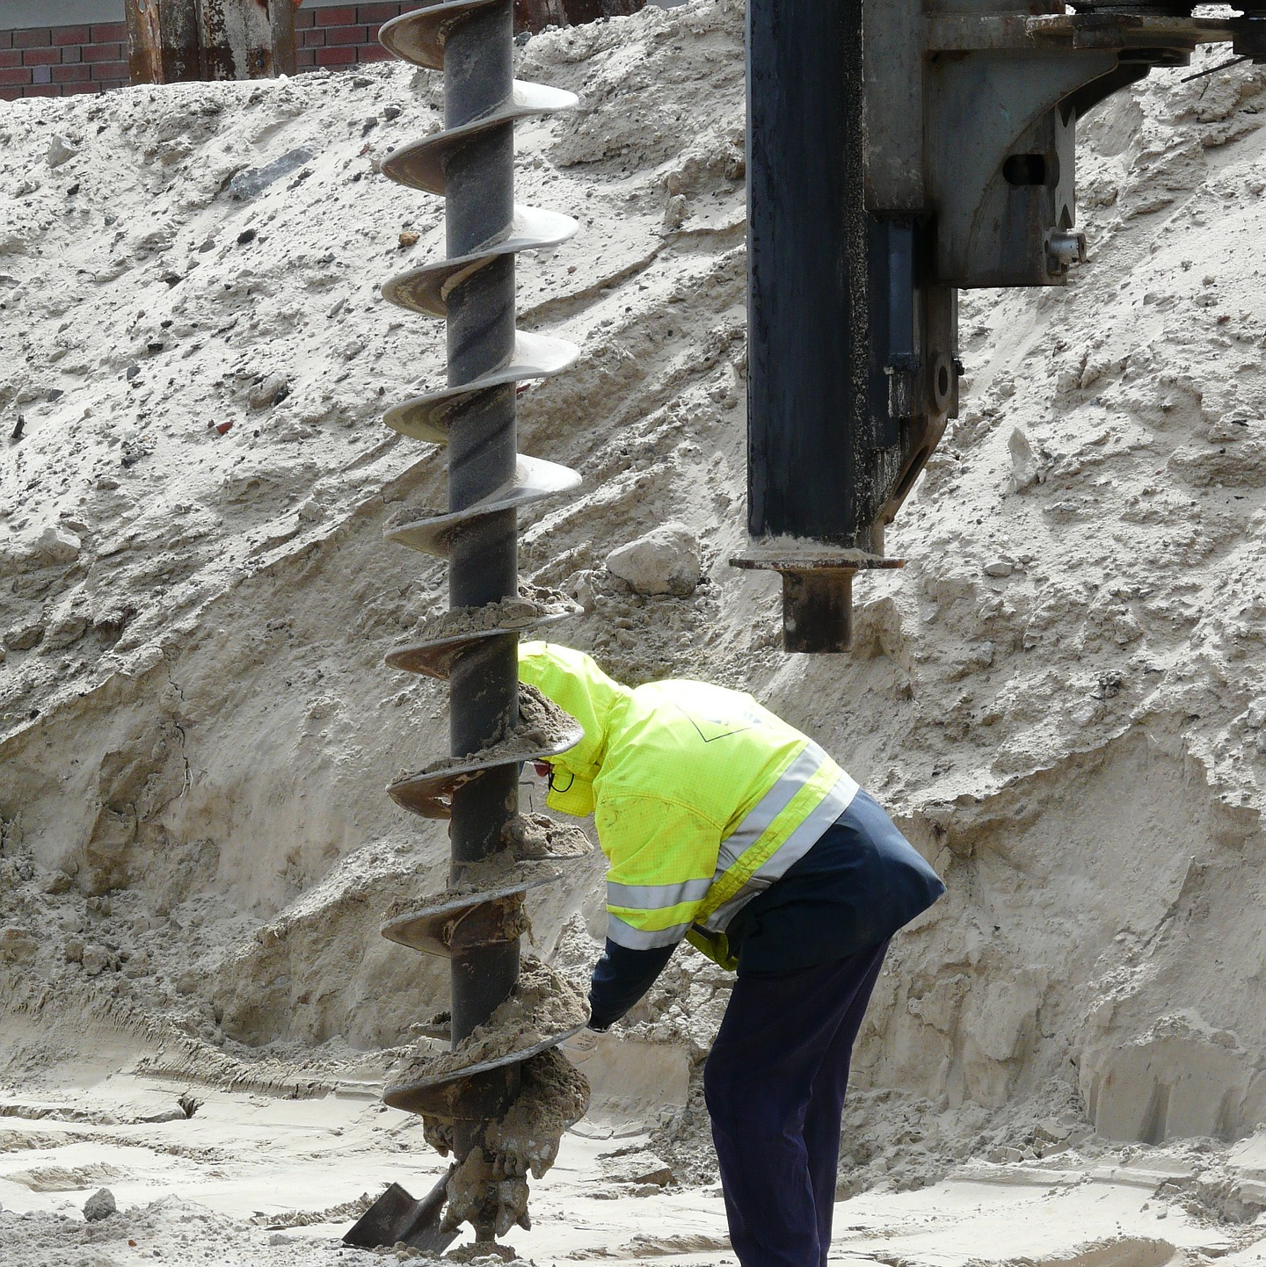
Notes:
Noise from gas drilling, fracturing, flaring, maintenance and truck traffic keeps people awake at night and on edge during the day. Sleep deprivation is a known and powerful trigger of anxiety and depression.

Slide 15
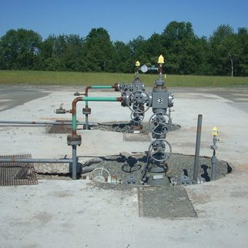
Notes:
Odors: The diesel fumes produced throughout the many-year life cycle of a natural gas well creates a pervasive industrial stench.
Likewise, traffic, wastewater, and spills throughout the unconventional gas development industry are some of the other sources of odor irritants.

Slide 16
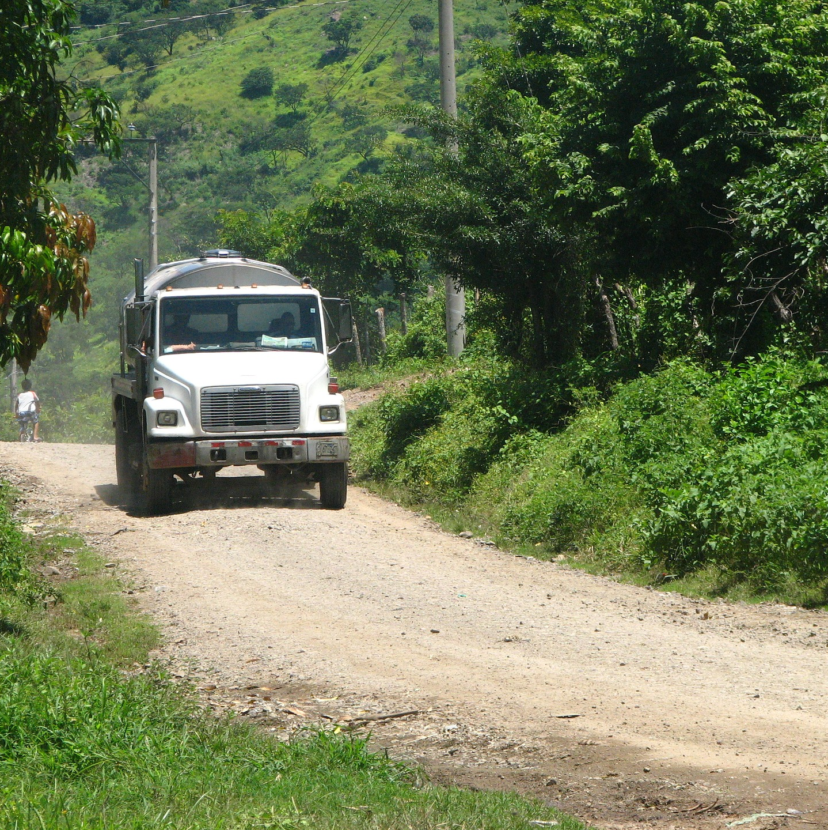
Notes:
Traffic: Residents in townships that allow unconventional gas extraction have testified that they are often terrified to drive on the same narrow country roads as the huge trucks involved in the process.
Large truck traffic also increases on residential streets.
A study has found a statistically significant increase of truck-related traffic fatalities in communities with unconventional gas extraction.

Slide 17
Notes:
Crime: Drilling operations, with their increase in a transient outside population, can increase social tensions, violent crime, property crime, drug and alcohol abuse, and sexually-transmitted diseases.

Slide 18
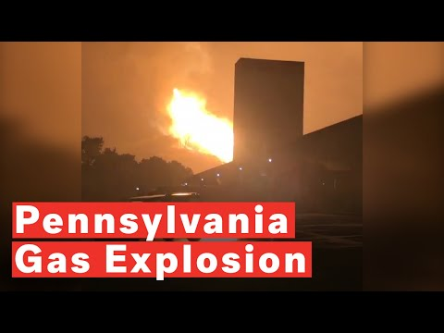
https://youtu.be/FEXpW2l9e5E
Notes:
Pipelines can and do explode with intense fires that usually need to be allowed to burn out. Causes typically involve erosion, accidents, or material failures. Energy Transfer Partners, the same company behind the Dakota Access and Bayou Bridge pipelines — also owned the pipeline that exploded in Pennsylvania last month (Sept.).
The expansive increase in pipeline infrastructure is mainly for import, much of it used to profit from the production of plastic.

Slide 19
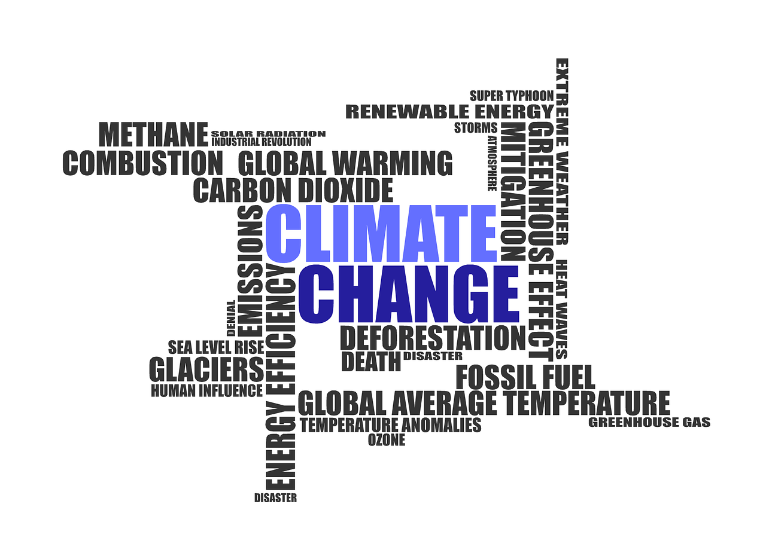
Notes:
Large amounts of methane — a greenhouse gas 86 times more potent than CO2 in the 20-year timeframe — leak into the atmosphere throughout the entire unconventional gas development industry, which is at least as bad if not worse for climate change compared to coal or oil to societal and global security.

Slide 20
Tammy Murphy, M.A., L.M.M
Medical Advocacy Director
tammy@psrphila.org
215.749.0960
Laura Dagley, BSN, RN
Medical Advocacy Coordinator
laura@psrphila.org
540.556.0132
www.facebook.com/PhilaPSR
@PhilaPSR
Notes:
Thank you for joining us today! Please be sure to stay in touch with us!

Slide 21
Resources
1. Steinzor, N., Subra, W., & Sumi, L. (2013). Investigating Links between Shale Gas Development and Health Impacts through a Community Survey Project in Pennsylvania. NEW SOLUTIONS: A Journal of Environmental and Occupational Health Policy, 23(1), 55-83. doi:10.2190/ns.23.1.e
2. Rabinowitz, P. M., Slizovskiy, I. B., Lamers, V., Trufan, S. J., Holford, T. R., Dziura, J. D., . . . Stowe, M. H. (2014). Proximity to Natural Gas Wells and Reported Health Status: Results of a Household Survey in Washington County, Pennsylvania. Environmental Health Perspectives. doi:10.1289/ehp.1307732
3. Tustin, A. W., Hirsch, A. G., Rasmussen, S. G., Casey, J. A., Bandeen-Roche, K., & Schwartz, B. S. (2016). Associations between Unconventional Natural Gas Development and Nasal and Sinus, Migraine Headache, and Fatigue Symptoms in Pennsylvania. Environmental Health Perspectives, 125(2). doi:10.1289/ehp281
4. Weinberger, B., Greiner, L. H., Walleigh, L., & Brown, D. (2017). Health symptoms in residents living near shale gas activity: A retrospective record review from the Environmental Health Project. Preventive Medicine Reports, 8, 112-115. doi:10.1016/j.pmedr.2017.09.002
5. Webb, E., Bushkin-Bedient, S., Cheng, A., Kassotis, C. D., Balise, V., & Nagel, S. C. (2014). Developmental and reproductive effects of chemicals associated with unconventional oil and natural gas operations. Reviews on Environmental Health, 29(4). doi:10.1515/reveh-2014-0057
6. Casey, J. A., Savitz, D. A., Rasmussen, S. G., Ogburn, E. L., Pollak, J., Mercer, D. G., & Schwartz, B. S. (2015). Unconventional Natural Gas Development and Birth Outcomes in Pennsylvania, USA. Epidemiology, 1. doi:10.1097/ede.0000000000000387
7. Stacy, S. L., Brink, L. L., Larkin, J. C., Sadovsky, Y., Goldstein, B. D., Pitt, B. R., & Talbott, E. O. (2015). Perinatal Outcomes and Unconventional Natural Gas Operations in Southwest Pennsylvania. Plos One, 10(6). doi:10.1371/journal.pone.0126425
8. Defranco, E., Hall, E., Hossain, M., Chen, A., Haynes, E. N., Jones, D., . . . Muglia, L. (2015). Air Pollution and Stillbirth Risk: Exposure to Airborne Particulate Matter during Pregnancy Is Associated with Fetal Death. Plos One, 10(3). doi:10.1371/journal.pone.0120594
9. Defranco, E., Moravec, W., Xu, F., Hall, E., Hossain, M., Haynes, E. N., . . . Chen, A. (2016). Exposure to airborne particulate matter during pregnancy is associated with preterm birth: a population-based cohort study. Environmental Health, 15(1). doi:10.1186/s12940-016-0094-3
10. Mckenzie, L., Guo, R., Witter, R., Savitz, D., Newman, L., & Adgate, J. (2015). Birth Outcomes and Maternal Residential Proximity to Natural Gas Development in Rural Colorado. Everyday Environmental Toxins, 111-130. doi:10.1201/b18221-11

Slide 22
Resources
11. Rasmussen, S. G., Ogburn, E. L., Mccormack, M., Casey, J. A., Bandeen-Roche, K., Mercer, D. G., & Schwartz, B. S. (2016). Association Between Unconventional Natural Gas Development in the Marcellus Shale and Asthma Exacerbations. JAMA Internal Medicine, 176(9), 1334. doi:10.1001/jamainternmed.2016.2436
12. Casey, J. A., Ogburn, E. L., Rasmussen, S. G., Irving, J. K., Pollak, J., Locke, P. A., & Schwartz, B. S. (2015). Predictors of Indoor Radon Concentrations in Pennsylvania, 1989–2013. Environmental Health Perspectives, 123(11). doi:10.1289/ehp.1409014
13. Jemielita, T., Gerton, G. L., Neidell, M., Chillrud, S., Yan, B., Stute, M., . . . Panettieri, R. A. (2015). Unconventional Gas and Oil Drilling Is Associated with Increased Hospital Utilization Rates. Plos One, 10(7). doi:10.1371/journal.pone.0131093
14. Ferrar, K. J., Kriesky, J., Christen, C. L., Marshall, L. P., Malone, S. L., Sharma, R. K., . . . Goldstein, B. D. (2013). Assessment and longitudinal analysis of health impacts and stressors perceived to result from unconventional shale gas development in the Marcellus Shale region. International Journal of Occupational and Environmental Health, 19(2), 104-112. doi:10.1179/2049396713y.0000000024
15. Smaldone, A., Honig, J. C., & Byrne, M. W. (2007). Sleepless in America: Inadequate Sleep and Relationships to Health and Well-being of Our Nations Children. Pediatrics, 119(Supplement 1). doi:10.1542/peds.2006-2089f
16. Owens, J. (2014). Insufficient Sleep in Adolescents and Young Adults: An Update on Causes and Consequences. Pediatrics, 134(3). doi:10.1542/peds.2014-1696
17. Price, M., et al —The Shale Tipping Point: The Relationship of Drilling to Crime, Traffic Fatalities, STDs, and Rents in Pennsylvania, West Virginia, and Ohio (The Multi-State Shale Research Collaborative December 2014) http://www.multistateshale.org/shale-tipping-point
18. Pennsylvania Department of Environmental Protection — 2015 Oil and Gas Report http://www.elibrary.dep.state.pa.us/dsweb/Get/Document-113887/8000-RE-DEP4621.pdf
19. PA-DEP Air Inventory Data http://www.dep.pa.gov/Business/Air/BAQ/BusinessTopics/Emission/Pages/MarcellusInventory.aspx
20. Hays, J., Shonkoff, SB. Toward an Understanding of the Environmental and Public Health Impacts of Unconventional Natural Gas Development: A Categorical Assessment of the Peer-Reviewed Scientific Literature, 2009-2015. Plos One, 2016, http://journals.plos.org/plosone/article?id=10.1371/journal.pone.0154164.

Slide 23
Resources
21. Bamberger, M and Oswald, R E, (2012) ‘Impacts of gas drilling on human and animal health’, New Solutions, 22(1).
22. Robin Stott et al., (2015). Public Health England’s draft report on shale gas extraction, Letter to the BMJ, http://www.bmj.com/content/348/bmj.g2728/rr
23. Jemielita T., et al., (2015), Unconventional gas and oil drilling is associated with increased hospital utilization rates. PLoS ONE 10, doi: 10.1371/journal.pone.0131093
24. Tustin, AW., Hirsch, AG., Rasmussen, SG., Casey, JA, Bandeen-Roche, K.,Schwartz, BS. Associations Between Unconventional Natural Gas Development and Nasal and Sinus, Migraine Headache, and Fatigue Symptoms in Pennsylvania. Environmental Health Perspectives, 2016.
25. Colborn, T. et al., (2011), Natural gas operations from a public health perspective. Human and Ecological Risk Assessment: An International Journal, 17 (5), 1039-1056.
26. Bienkowski, B., (2015). Scientists warn of hormone impacts from benzene, xylene, other common solvents. Environmental Health News. http://www.environmentalhealthnews.org/ehs/news/2015/apr/endocrine-disruption-hormones-benzene-solvents
27. Bolden, A. L., Kwiatkowski, C. F., & Colborn, T. (2015). New look at BTEX: are ambient levels a problem? Environmental Science & Technology, 49, 5261-76.
28. Kassotis, C. D., et al., (2016) Adverse Reproductive and Developmental Health Outcomes Following Prenatal Exposure to a Hydraulic Fracturing Chemical Mixture in Female C57Bl/6 Mice. Endocrinology.
29. Concerned Health Professionals of New York & Physicians for Social Responsibility. (2015). Compendium of scientific, medical, and media findings demonstrating risks and harms of fracking. See pp.16-51.
30. Kassotis,CD., Iwanowicz,LR., Akob,DM., Cozzarelli,IM., Mumford,AC., Orem, WH., Nagel, SC. Endocrine Disrupting Activity in Surface Water Associated with a West Virginia Oil and Gas Industry Wastewater Injection Disposal Site. Science of the Total Environment, 2016, http://www.sciencedirect.com/science/article/pii/S0048969716305356.

Slide 24
Resources
31. Kassotis, et. al. Endocrine-disrupting Activity of Hydraulic Fracturing Chemicals and Adverse Health Outcomes After Prenatal Exposure in Male Mice Endocrinology, 2015.
32. Kassotis, et.al. Adverse Reproductive and Developmental Health Outcomes Following Prenatal Exposure to a Hydraulic Fracturing Chemical Mixture in Female C57BI/6 Mice. Endocrinology, 2016.
33. ‘Meyer, D L, Fracking Linked to Cancer-Causing Chemicals, New YSPH Study Finds’, October 2016, http://publichealth.yale.edu/news/article.aspx?id=13714 .
34. Shaina, L. S., et al., (2015). Perinatal outcomes and unconventional natural gas operations in southwest Pennsylvania. PLoS One, 10.
35. McKenzie, L. M., et al., (2014). Birth outcomes and maternal residential proximity to natural gas development in rural Colorado. Environmental Health Perspectives, 122.
36. Solotaroff, P. (2015). What’s killing the babies of Vernal, Utah? Rolling Stone. http://www.rollingstone.com/culture/features/fracking-whats-killing-the-babies-of-vernal-utah-20150622 .
37. American Lung Association. (2013). American Lung Association state of the air 2013. http://www.stateoftheair.org/2013/states/utah/uintah-49047.html .
38. Casey, JA., Savitz, DA., Rasmussen, SG., Ogburn,EL., Jonathan Pollak, J., Mercer, DG., Schwartz, BS.. Unconventional Natural Gas Development and Birth Outcomes in Pennsylvania, USA. Epidemiology, 2015, http://www.ncbi.nlm.nih.gov/pubmed/26426945.
39. ‘Meyer, D L, Fracking Linked to Cancer-Causing Chemicals, New YSPH Study Finds’, October 2016, http://publichealth.yale.edu/news/article.aspx?id=13714 .
40. Drilling without fail: A review of empirical data on well failure in oil and gas wells, FoE EWNI 2014 https://www.foe.co.uk/sites/default/files/downloads/drilling-without-fail-review-empirical-data-well-failure-oil-gas-wells- 46473.pdf .

Slide 25
Resources
41. Lauer, NE., Harkness, JS., Vengosh,A. Brine Spills Associated with Unconventional Oil Development in North Dakota. Environmental Science & Technology, 2016. DOI: 10.1021/acs. est.5b06349
42. Pennsylvania Department of Environmental Protection. (2014). Water supply determination letters. http://files.dep.state.pa.us/OilGas/BOGM/BOGMPortalFiles/OilGasReports/Determination_Letters/Regional_Determination_Letters.pdf .
43. Rasmussen, SG., Ogburn, EL., McCormack, M., Casey, JA., Bandeen-Roche, K., Mercer, DG., Schwartz, BS. Association Between Unconventional Natural Gas Development in the Marcellus Shale and Asthma Exacerbations JAMA Internal Medicine, 2016, http://archinte.jamanetwork.com/article.aspx?articleid=2534153.
44. http://www.eia.gov/todayinenergy/detail.cfm?id=26112.
45. Howarth, RW. Methane emissions and climatic warming risk from hydraulic fracturing and shale gas development: implications for policy Energy and Emission Control Technologies, 2015, https://www.dovepress.com/methane-emissions-and-climatic-warming-risk-from-hydraulic-fracturing--peer-reviewed-articleEECT.
46. Olsen, L. (2014). Fatal truck accidents have spiked during Texas’ ongoing fracking and drilling boom. Houston Chronicle. http://www.houstonchronicle.com/news/article/Fracking-and-hydraulic-drilling-have-brought-a-5747432.php?cmpid=emailpremium&cmpid=email-premium&t=1a9ca10d49c3f0c8a9#/0 .
47. Shonkoff, S. B. C., et al., (2015, July 9). Volume II, Chapter 6: Potential impacts of well stimulation on human health in California. In: An Independent Scientific Assessment of Well Stimulation in California. California Council on Science and Technology, Sacramento, CA. Retrieved from http://ccst.us/publications/2015/vol-II-chapter-6.pdf .
48. Health Protection Scotland, (2016). A Health Impact Assessment of Unconventional Oil and Gas in Scotland. http://www.hps.scot.nhs.uk/resourcedocument.aspx?resourceid=3101 .
49. Morris, J., Hopkins, J. S., & Jameel, M. (2015). Unequal risk: Slow-motion tragedy for American workers. The Center for Public Integrity. http://www.publicintegrity.org/2015/06/29/17518/slow-motion-tragedy-american-workers .
50. Esswein, E., et al., (2014). Evaluation of some potential chemical risks during flowback operations in unconventional oil and gas extraction: Preliminary results. Journal of Occupational and Environmental Hygiene 11 .

Slide 26
Resources
51. Concerned Health Professionals of New York & Physicians for Social Responsibility. (2015). Compendium of scientific, medical, and media findings demonstrating risks and harms of fracking. See particularly p. 79 http://concernedhealthny.org/compendium/.
52. Huntley & Huntley Energy Exploration, LLC – Gaia Well Site Special Exception Application
53. Drilling without fail: A review of empirical data on well failure in oil and gas wells, FoE EWNI 2014 https://www.foe.co.uk/sites/default/files/downloads/drilling-without-fail-review-empirical-data-well-failure-oil-gas-wells- 46473.pdf .
54. Pennsylvania Department of Environmental Protection. (2014). Water supply determination letters. http://files.dep.state.pa.us/OilGas/BOGM/BOGMPortalFiles/OilGasReports/Determination_Letters/Regional_Determination_Letters.pdf .
55. Lauer, NE., Harkness, JS., Vengosh,A. Brine Spills Associated with Unconventional Oil Development in North Dakota. Environmental Science & Technology, 2016. DOI: 10.1021/acs. est.5b06349
56. Huntley & Huntley Energy Exploration, LLC – Gaia Well Site Special Exception Application
57. Concerned Health Professionals of New York & Physicians for Social Responsibility. (2016, November 17). Compendium of scientific, medical, and media findings demonstrating risks and harms of fracking (unconventional gas and oil extraction) (4th ed.). http://concernedhealthny.org/compendium/
Images all freely downloaded from Pixaby except:
https://www.fractracker.org/resources/oil-and-gas-101/fracking-fluid/
http://oregondeservesbetter.weebly.com/4-gas-facility-explosions-in-2014-by-williams-co-pipeline-builder.html

