Slide 1
Health Impacts of Shale Oil & Gas Development: Role of Health Care Providers
Physicians for Social Responsibility- PA
Presenter: Pouné Saberi, MD, MPH
Occupational & Environmental Medicine
Board of Directors, President

Slide 2
Notes:
In Pennsylvania at Zoning hearings, the township boards ask environmental and health experts to testify. They want to know about the Scientific evidence on fracking. But Frequently the conclusion is that there is inadequate evidence.
In this talk we will explore the question of data on dangers of fracking to health, safety and welfare

Slide 3
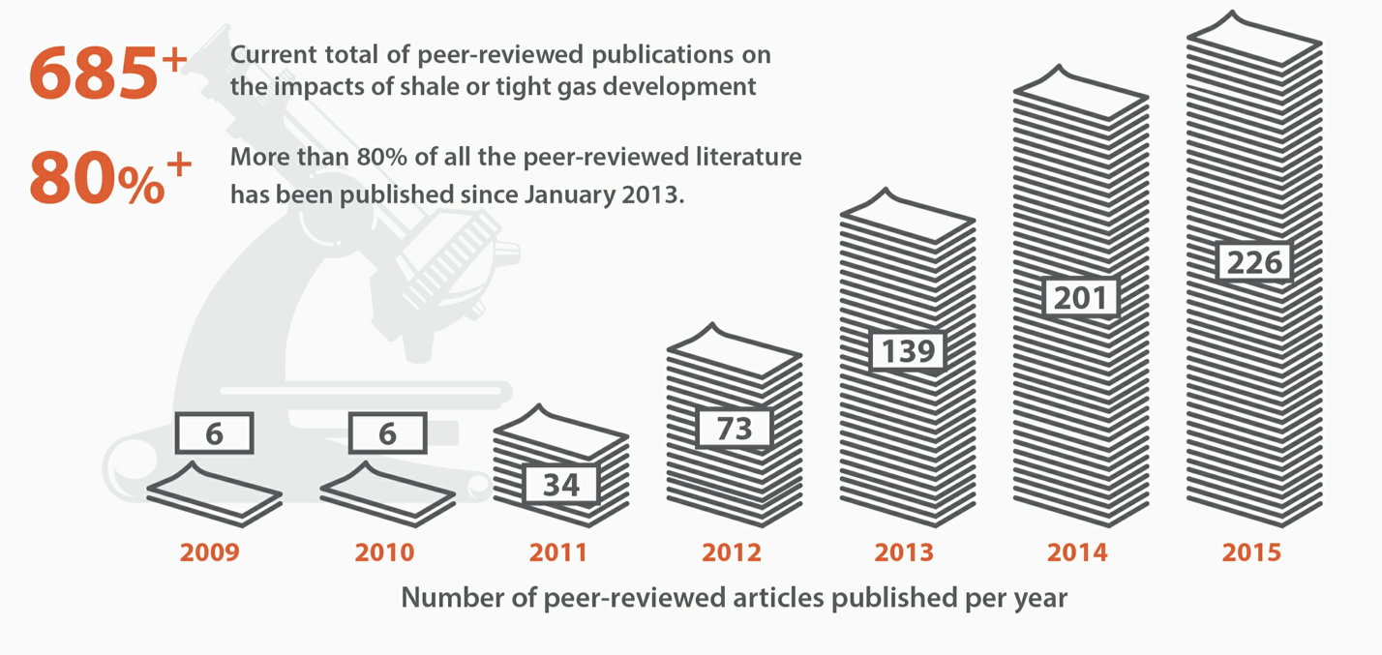
file://localhost/.file/id=6571367.47973693
Notes:
Health care providers have access to an increasing amount of research on environmental and health impacts of fracking.
But sorting through the scientific evidence in order to help evaluate and manage the health concerns of impacted communities is not easy.
Let’s unpack some of the evidence

Slide 4
1315 Studies
16 showed human
health effects
Wright, Rosemary; Muma, Richard D.
Journal of Occupational and Environmental Medicine60(5):424-429, May 2018.
doi: 10.1097/JOM.0000000000001278
Notes:
A Study done in May 2018 identified about 1300 citations on health and environment in relation to fracking
Of those they selected
Only Peer reviewed literature Published in academic journals
Only Direct human health effects
Only in English Only in USA
They were left with 18 studies of which 16 showed human health impacts

Slide 5
13 Studies on cognitive
impacts of marijuana
on motor vehicle
accidents
10 studies
Showed no difference
How to determine harm
based on evidence?
3 studies
Showed correlation
Notes:
For comparison Ben Chipkin a 2nd year med student at Jefferson did a literature review on impacts of marijuana on driving
He found 13 studies, 10 of which showed no correlation
Would anyone say there is inadequate data and therefore it is ok to drive after smoking MARIJUANA?
Despite a much higher weight of evidence that is exactly what is said about health impacts of fracking

Slide 6
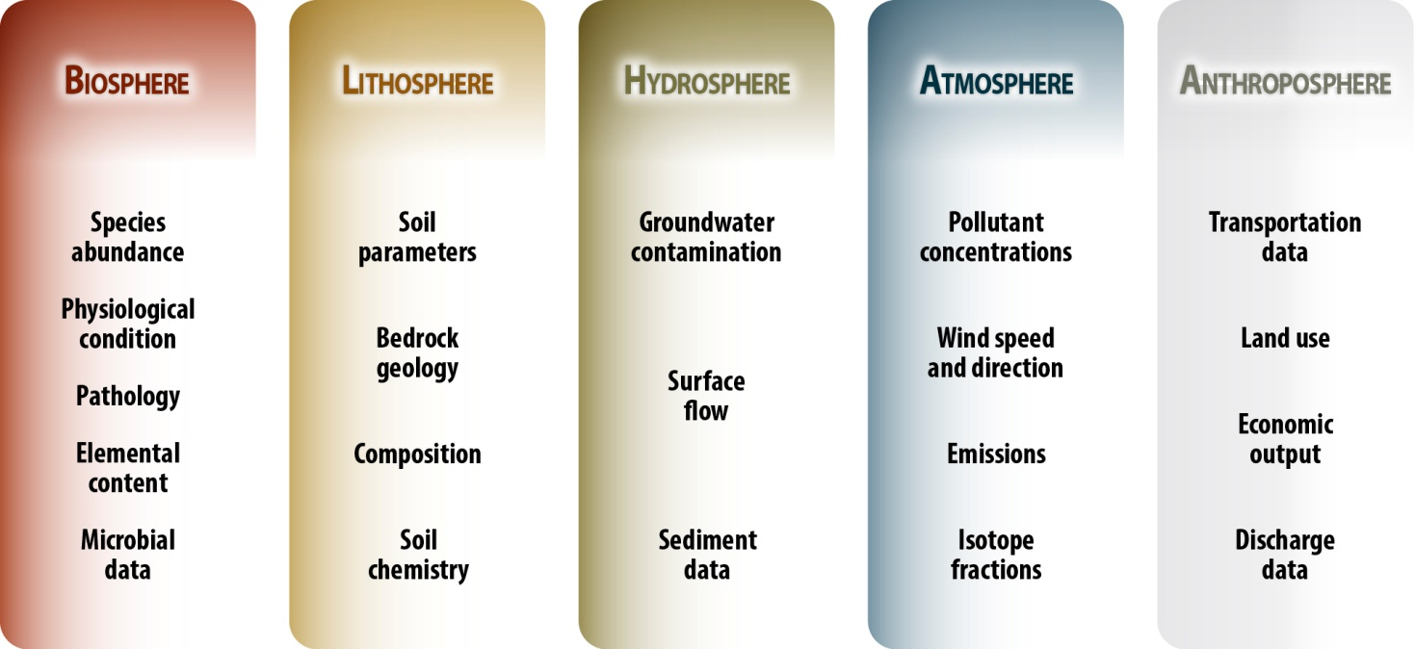
http://ees.elsevier.com/stoten/default.asp?acw=&utt=
Notes:
The politics of fossil fuel industry make providers afraid to address the health concerns of impacted people
Drawing out the doubt about weight of evidence on fracking health impacts make it easy for politicians to avoid taking a stand and protect the public
So the provider has a crucial role in helping government make the right choices

Slide 7
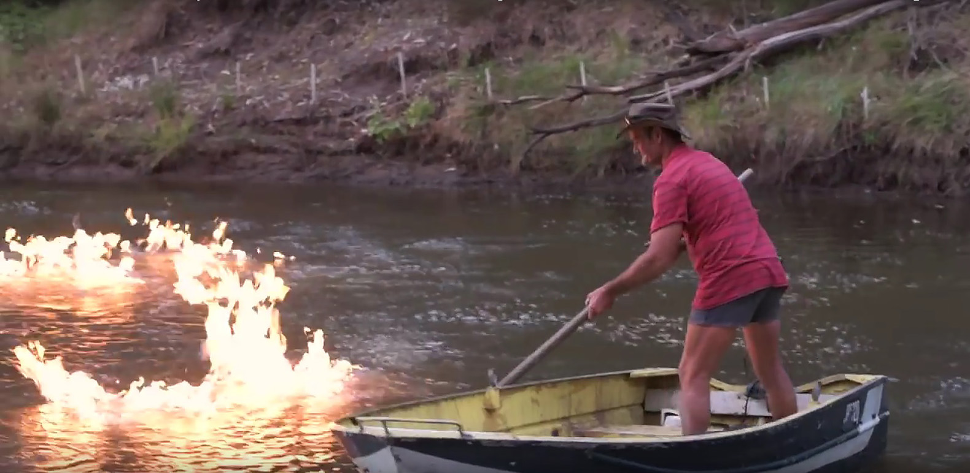
Notes:
There may be a long lag time between toxic exposures and appearance of serious health problems. Therefore health care providers will need to make clinical judgments based on best available information.
They need to understand a person’s exposure history and have some knowledge of outcomes of exposure to dangerous chemicals.

Slide 8
Notes:
One helpful mnemonic in taking an exposure history is CH2OPD2
Which means asking about exposures in the community, at home, as a hobby, in a person’s occupation, their personal habits, in their diet and medications they may take.

Slide 9
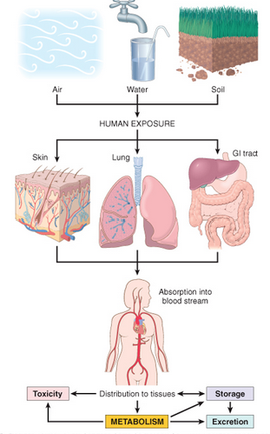
Health Risk = Hazard x Route of Exposure
Notes:
The core formula in environmental medicine is fairly simple. A hazard can be present but it will be a health risk only when there is an exposure pathway.
For example A bottle of pills can be a hazard but it will not cause problems unless the entire bottle is ingested.
What are some exposure pathways?

Slide 10
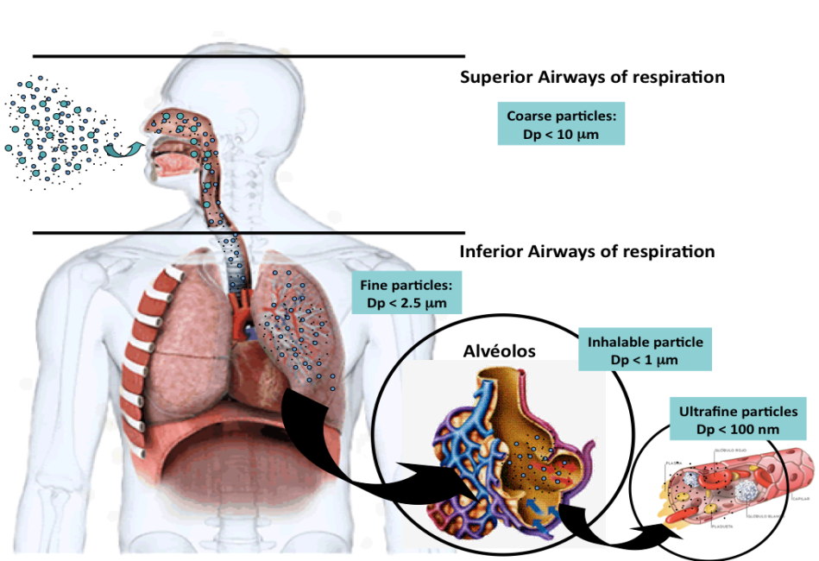
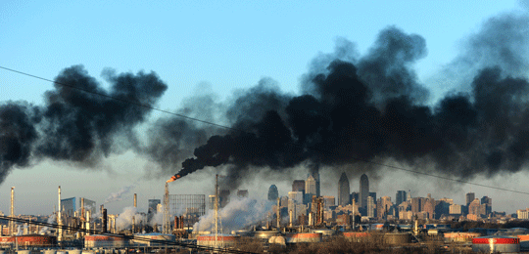
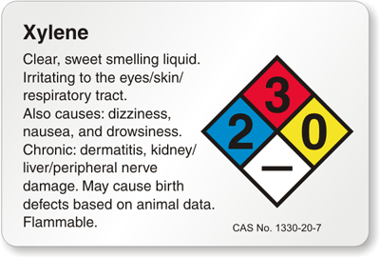
Notes:
The one that we’re most familiar with is inhalation.
When we inhale the hazardous air pollutants from power plant emissions, we are at risk of not just lung problems, but particles that are small enough pass through to our capillaries and land in other organs in our bodies and result in many other health issues.

Slide 11
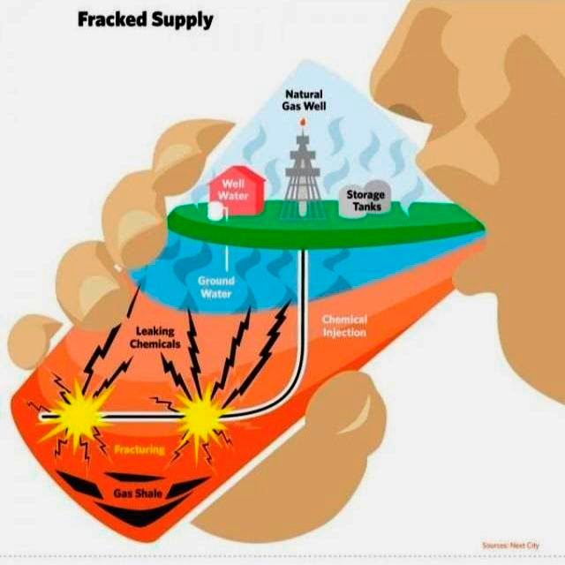
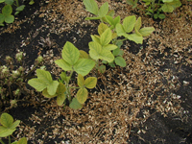
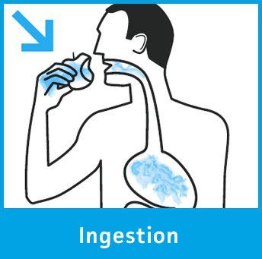
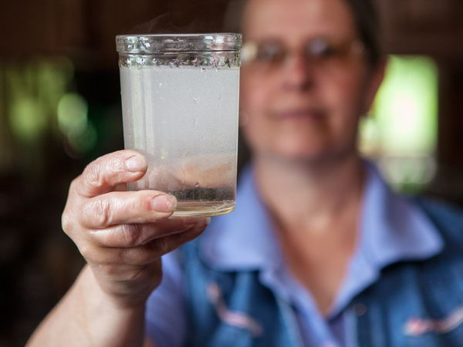
Notes:
Ingestion is another familiar exposure pathway. Many impacted communities find out that their water quality has been compromised and that they have been drinking contaminated water. Several studies have demonstrated pollution of well water as a result of neighboring oil and gas activities. Another source of ingestion is from contaminated soil.

Slide 12
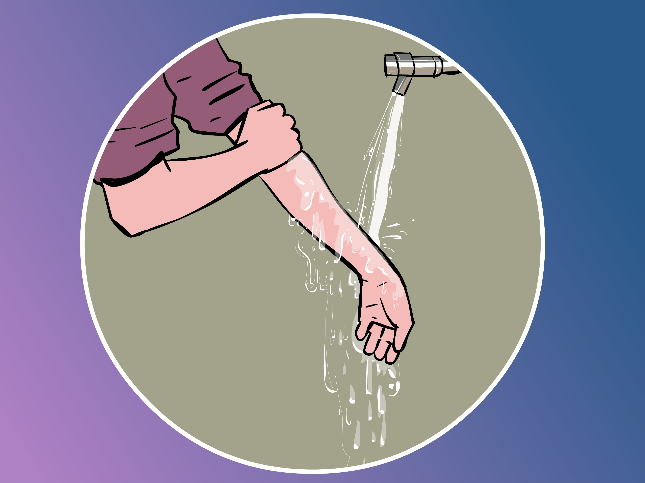
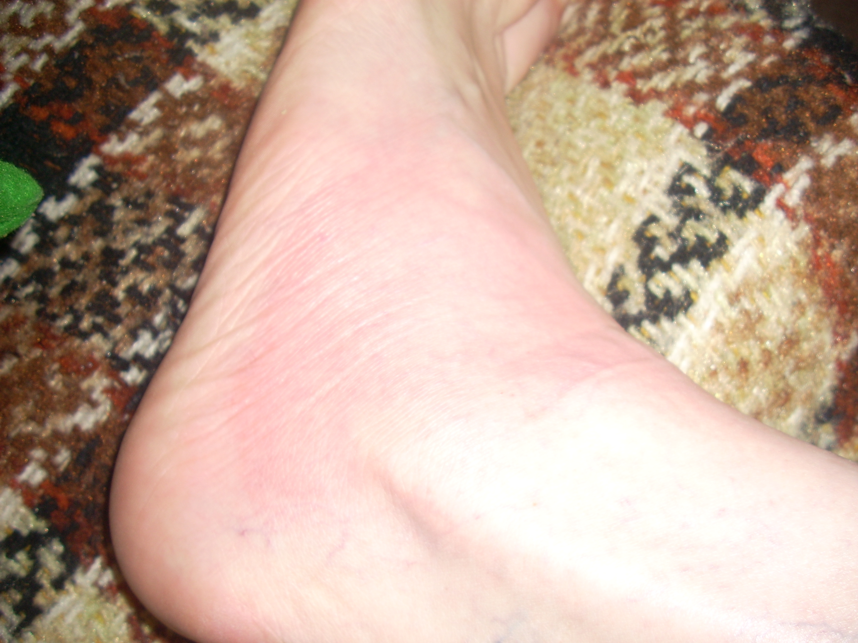
Route of Exposure
Dermal
Notes:
What we classify as hazards like carcinogens may cause health risks when they are exposed through the skin.
this is a picture of a rash on the foot of an oil and gas worker after they stood ankle deep in water mixed with frack waste.

Slide 13
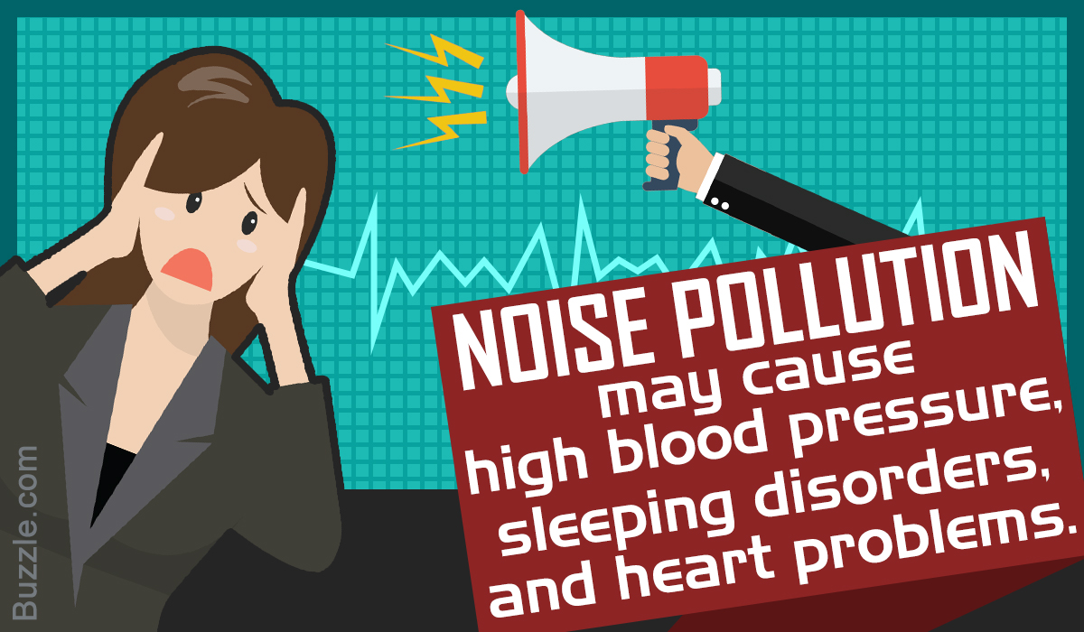
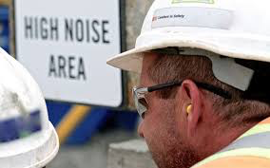
Notes:
There are other pathways of exposures that may not involve direct contact.
Noise is an example of what we call a physical hazard and it has been linked to short and long term health problems and studies show that oil and gas infrastructure are associated with significant amount of noise.

Slide 14
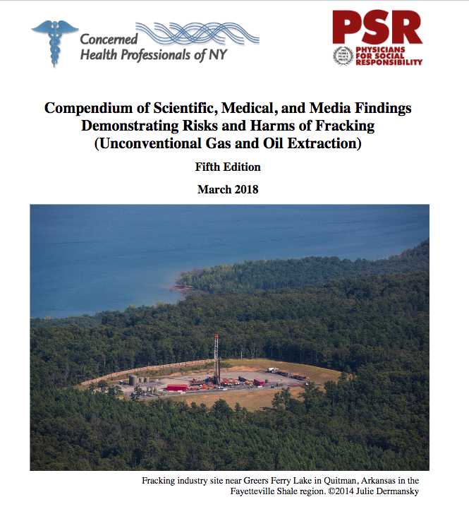
More info on health
Compendium
Notes:
A comprehensive document titled compendium of scientific, medical and media findings has been put together by concerned health professionals of NY and physicians for social responsibility has helped edit the last three versions. This is the 5th edition and it summarized the body of scientific literature on fracking.

Slide 15
Notes:
There are many barriers to utilizing this large body of research
Some are Patient-based like they may Feel they will not be heard
some are Provider-based for example they may feel pressure from the hospital if the industry has been funding equipment purchase or build out of that health care facility

Slide 16
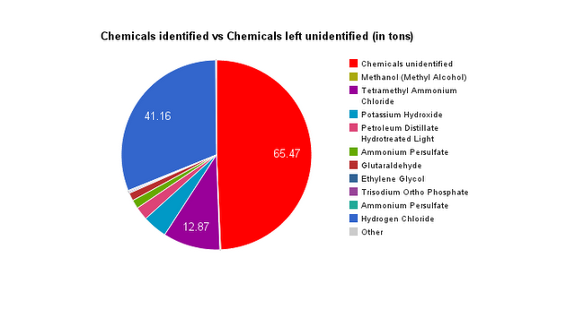
10% of these are known carcinogens
2,000-3,000 new chemicals are created every year
100,000 chemicals in use today
Notes:
Why is it hard to simply prove causality and put in place evidence based clinical practices?
Use of Chemical do not require baseline toxicological health data and if there is any industry data, sharing is voluntary

Slide 17
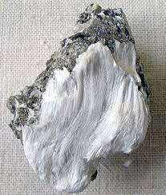
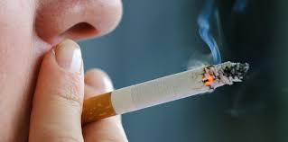
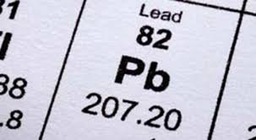
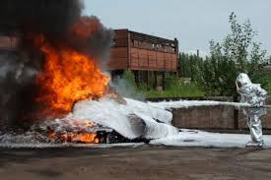
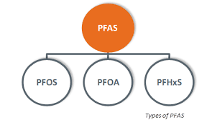
Notes:
In the US There has always been a long lag time between scientific evidence, accepted clinical practice and nation wide policy
First epi study on asbestos was in 1950’s but the plants were not shut down until late 1980’s.
First case of pediatric lead poisoning was first described in 1892 but lead was not outlawed in US until 1970’s

Slide 18
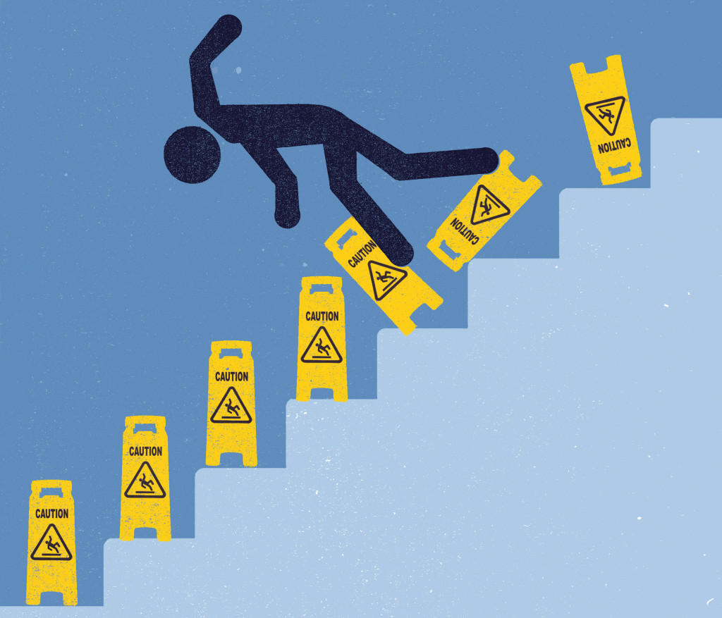
Notes:
We need to shift from a business culture that puts the burden on people to provide proof of harm to one where the onus is on the industry to provide initial robust and adequate proof of safety
Europe has shown that this will not retard growth and innovation

Slide 19
Notes:
What can all public health professionals do?
Educate themselves and be the information source for their local policy makers
Shine the light on scientific evidence and disseminate that information by doing things like Writing to their local newspapers
And most importantly vote

Slide 20
Is there adequate scientific evidence on dangers of fracking to health, safety and welfare?
Absolutely
Is it the responsibility of health care
provider and public health professional
to educate, document and speak up?
Yes, yes and yes

