Slide 1
Burning the Gas ‘Bridge Fuel’ Myth
Why Gas is NOT Clean, Cheap or Necessary
Download the report at www.priceofoil.org/gas
Lorne Stockman, Senior Research Analyst – Oil Change International - lorne@priceofoil.org
July 2019
Notes:
Oil Change in a non-profit organization, exposing the true cost of fossil fuels and facilitating the transition to clean energy. The report I’m going to present was published in May and will explain why gas is not a bridge fuel to a clean energy future. You can download it at the url shown here.

Slide 2
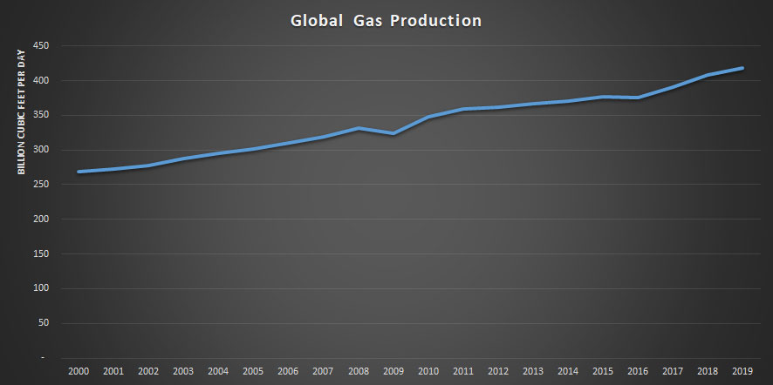
Source: Rystad Energy AS
Notes:
Global gas production has grown 55% since the beginning of this century. Today, the world produces around 420 billion cubic feet of gas a day, compared to about 270 billion cubic feet a day 19 years ago. Production is projected to grow a further 20-40% by the 2040s.

Slide 3
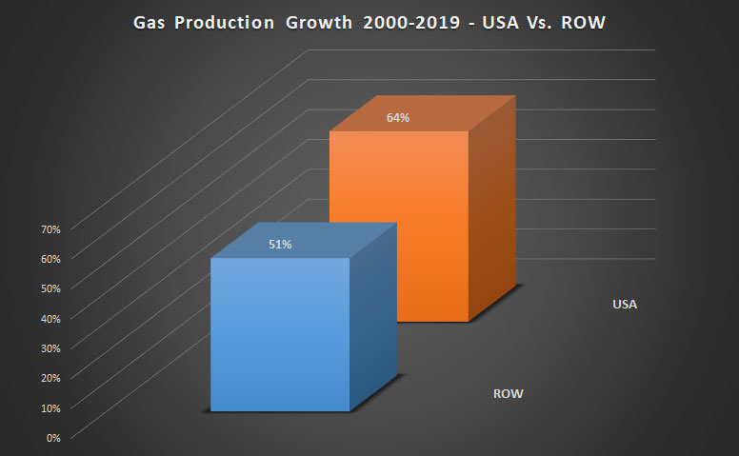
Source: Rystad Energy AS
Notes:
The US has led global gas production growth since 2000. US gas production grew 64%, while gas production in the rest of the world grew 51%. The advent of fracking has been primarily responsible for this boom in US gas production. Today, over 80% of US gas is produced by fracking.

Slide 4
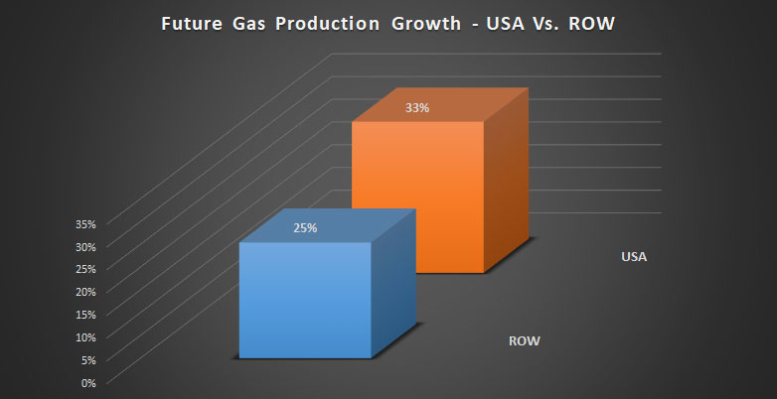
Source: Rystad Energy AS
Notes:
Looking forward, gas production in the US is projected to continue to grow more than the rest of the world. US production could grow by 33% in the next decade, while in the rest of the world, production may grow by about 25%. Again, the vast majority of US gas production growth will come from fracking.

Slide 5
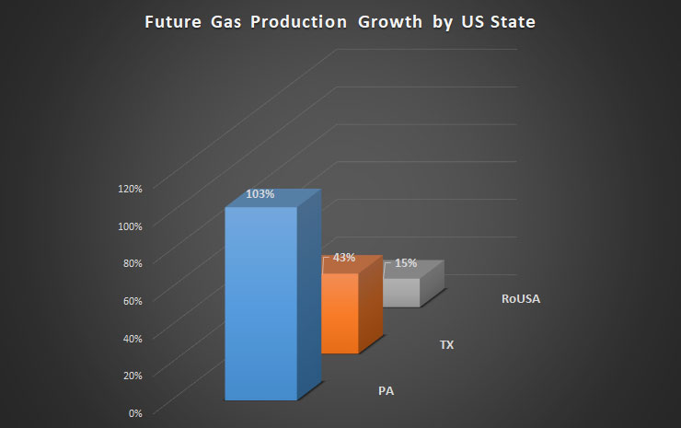
Source: Rystad Energy AS
Notes:
Pennsylvania is becoming the largest gas producer in the US. Currently Texas produces the most gas. But PA production could more than double in the next decade, while growth in the rest of the country other than Texas is far more modest at about 15%. 99% of PA gas comes from fracking.

Slide 6
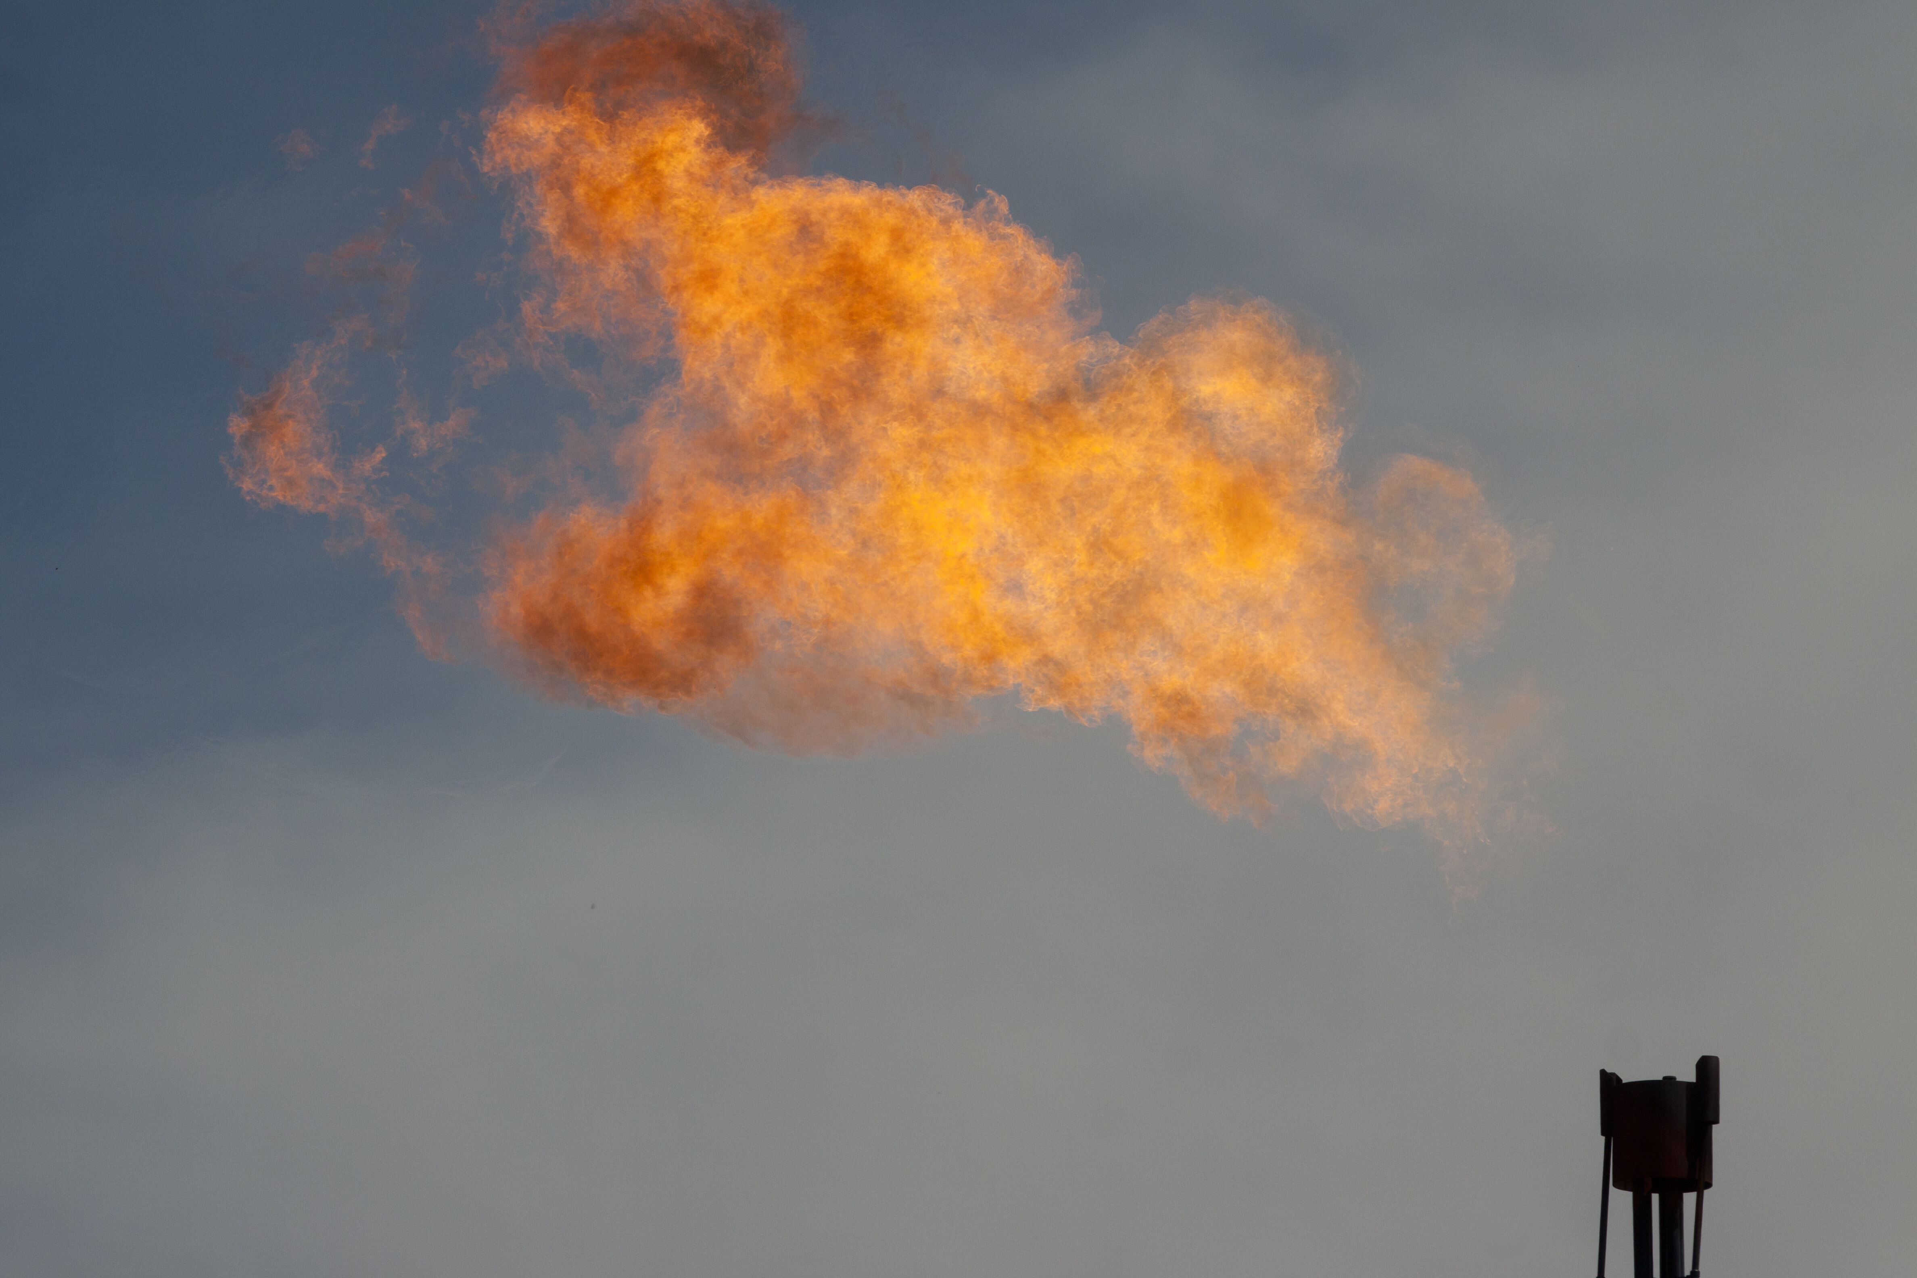
Notes:
Like all fossil fuels. Gas emits CO2 when it is burned. If these projections for gas production growth play out, by 2040, CO2 emissions just from burning gas could amount to over 11 billion tons annually. That is about a third of all energy related CO2 emissions today.

Slide 7
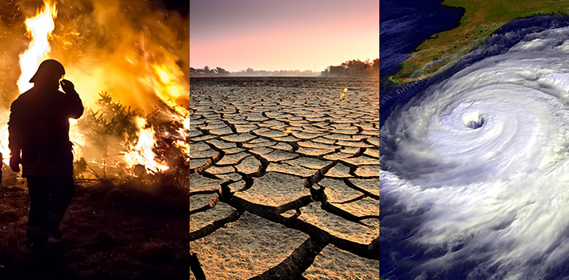
Notes:
Can we address the climate crisis while producing and burning all that gas? Is gas helping to reduce emissions, or is it making it harder to do that? Is gas really a bridge or transition fuel to a clean energy future? With the global climate crisis intensifying every day, it is crucial to understand the role of gas in the climate crisis.

Slide 8
Key Reasons why gas is NOT a bridge fuel.
Gas Breaks the Carbon Budget;
Coal-to-Gas Switching Doesn’t Cut It;
Low-Cost Renewables Can Displace Coal and Gas;
Gas Is Not Essential for Grid Reliability;
New Gas Infrastructure Locks In Emissions.
Notes:
In our report we list five Key Reasons why gas is not a bridge fuel.
Gas Breaks the Carbon Budget
Coal-to-Gas Switching Doesn’t Cut It
Low-Cost Renewables Can Displace Coal and Gas
Gas Is Not Essential for Grid Reliability
New Gas Infrastructure Locks In Emissions

Slide 9
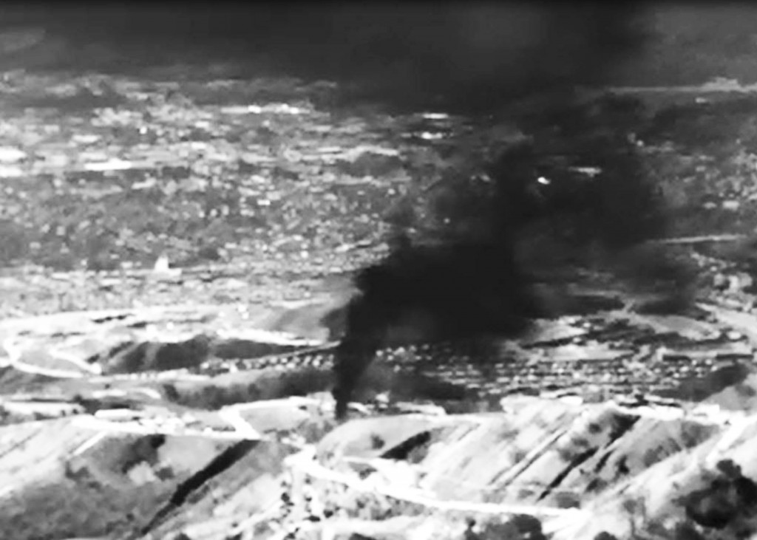
Methane: Accelerating Climate Change Today
Notes:
But first methane. Gas is mostly methane and methane is a potent GHG. Methane leaking along the entire gas supply chain is accelerating climate change today. But data shows that even if there were no leaking methane, gas would still not be a bridge fuel. A look at carbon budgets makes this issue crystal clear.

Slide 10
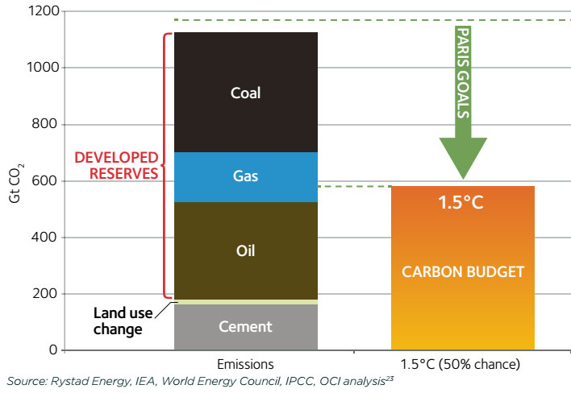
1. Gas breaks the carbon budget
Notes:
Existing fossil fuel extraction projects would already push us past the Paris goal of limiting climate change to 1.5C. The bar on the left shows the emissions that would result from burning the 30% of fossil fuel reserves in currently producing fields and mines. It is clear we'll overheat the planet well beyond 1.5 by burning these developed reserves alone.

Slide 11
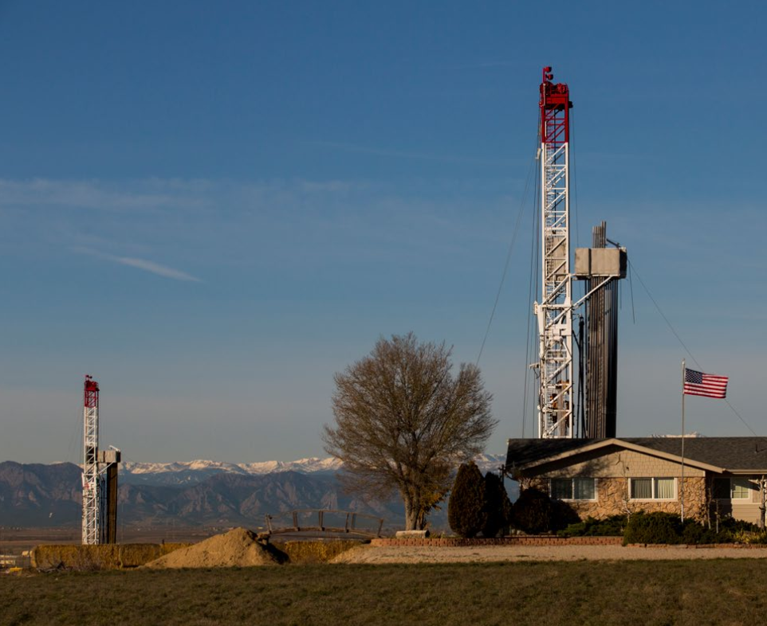
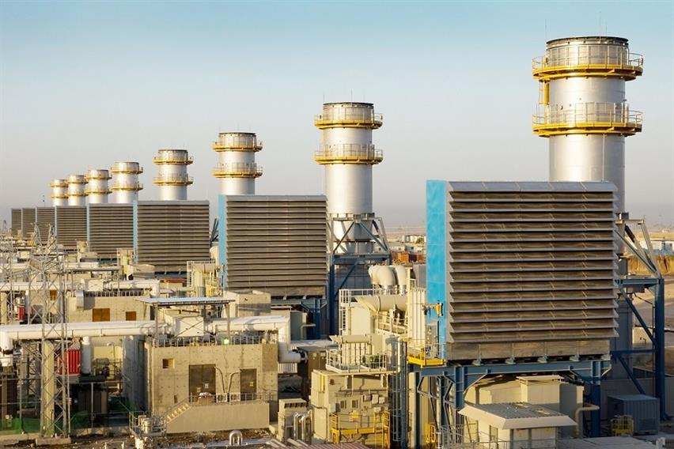
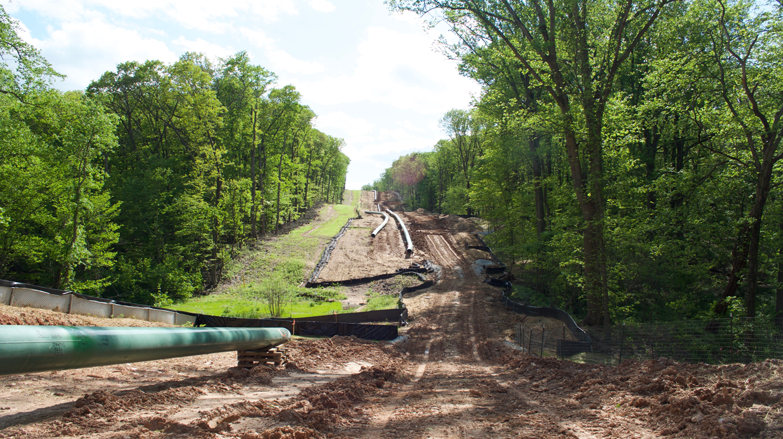
Notes:
So every new well that is drilled, every new pipeline, and every new gas plant, is adding to that column of developed reserves. We are already over budget. So with or without methane leakage, more gas wells and more infrastructure adds to the problem. Let’s look at it another way.

Slide 12
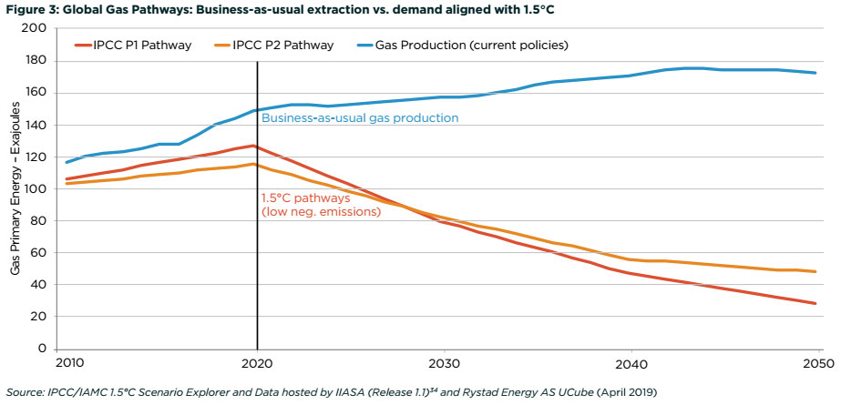
1. Gas Breaks the Carbon Budget
Notes:
This compares a BAU projection for gas production with pathways for gas use that get us to 1.5. Gas use needs to be dramatically in decline over the next decades. Clearly BAU is going in the opposite direction to where gas use needs to go. We must reduce not increase our consumption of gas.

Slide 13
Notes:
That should be it. Gas is not clean, and breaks the carbon budget. But the bridge fuel myth has been very effective in posing several caveats to the fact that gas is a fossil fuel that emits CO2 when you burn it. These caveats form the pillars of the bridge fuel myth, and we need to address these to understand why it is a myth.

Slide 14
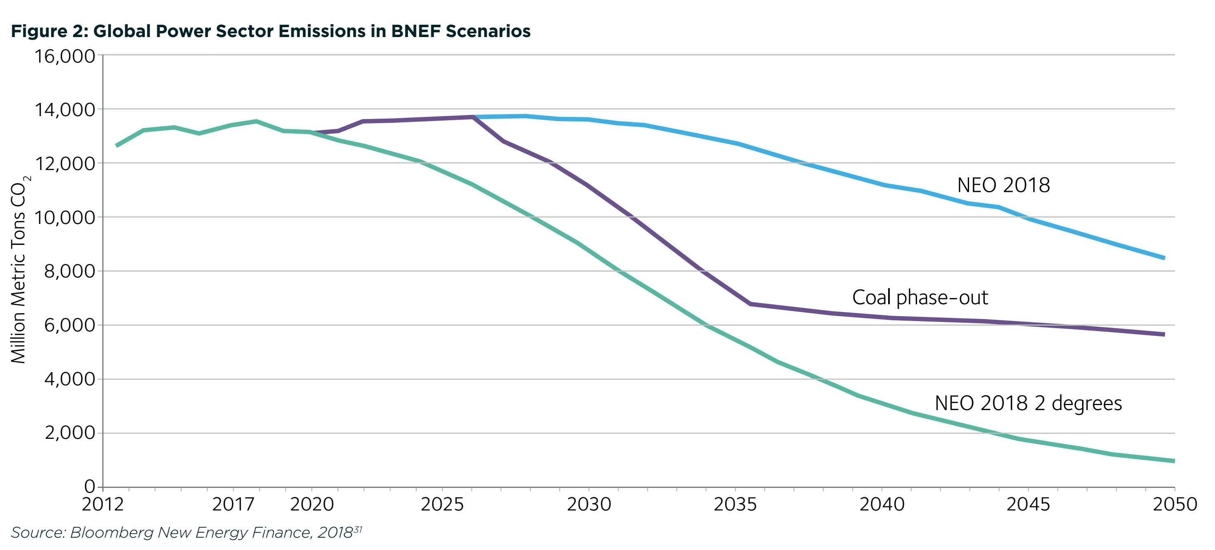
2. Coal-to-gas switching doesn’t cut it – Power Sector
Notes:
First of those is that switching coal for gas reduces emissions. But an analysis of global power sector emissions under a hypothetical 2035 global coal power phase out, in which coal is mostly replaced by gas, seen in the purple line on this chart, does not reduce emissions by far enough to hit even a weak 2 degree climate goal.

Slide 15
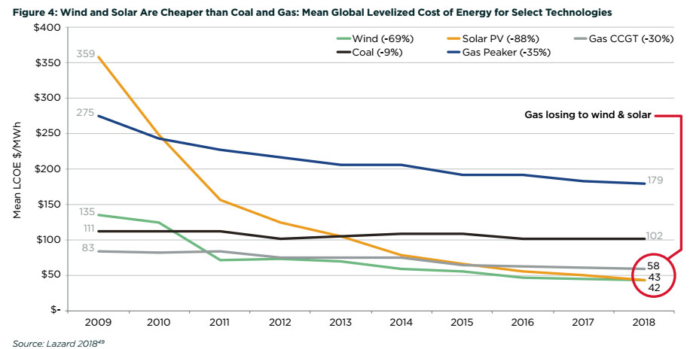
3. Low-cost renewables can displace coal and gas
Notes:
Another bridge fuel myth states that renewable energy is too expensive. But since 2016, the cost of building and operating solar and wind plants has fallen below that of building gas plants, and costs will only decline for wind and solar, while the cost of gas plants is set to rise. It is now clear that we can build an affordable energy system based on renewable energy.

Slide 16
4. Gas Is Not Essential for Grid Reliability
Notes:
The most common myth you hear today is that wind and solar are not reliable, and that gas is the “smart partner” to balance wind and solar variability. But gas is just one of many ways to balance renewable energy, and is the dumbest way to do it, given that there are zero emissions ways that are increasingly effective and affordable.

Slide 17
Notes:
We need to optimize the way we manage both the supply and demand for energy to take advantage of clean energy resources. Energy markets can be designed to value efficiency, demand response and energy storage to support the clean alternatives to gas that can balance an energy system based on wind and solar.

Slide 18
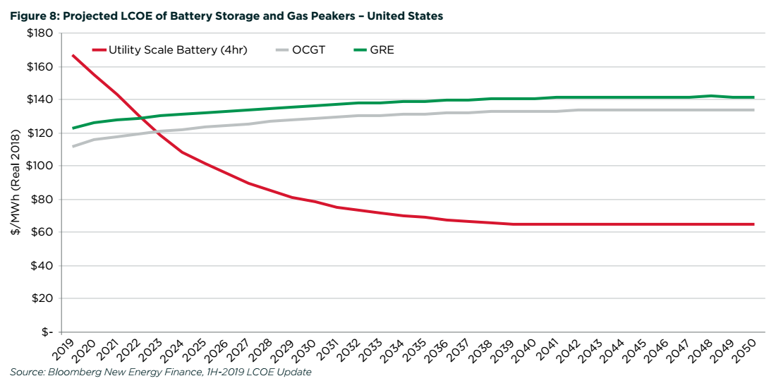
Notes:
The cost of utility scale batteries is dropping fast and will decline a further 60% in the next decade to become more cost effective than the leading gas technologies designed for responding to wind and solar variability. And this is in the US where gas is now cheaper than anywhere else. Batteries are competitive today in markets such as the UK, Germany, Australia and Japan.

Slide 19
Notes:
Our 5th and final issue, is that new gas infrastructure locks in emissions. The billions of dollars going into gas drilling, and the infrastructure to support gas will take decades to earn a return. Investors do not expect to shut their investments in before the end of their economic life. This is a big problem.

Slide 20
Notes:
It will be economically, legally and politically more difficult to shut down gas infrastructure that is already built than to stop it being built in the first place. We need to manage the decline of the fossil fuel industry now to enable a smooth and just transition to the clean energy future we need. Gas is no exception.

Slide 21
www.priceofoil.org/gas
Lorne Stockman – lorne@priceofoil.org

