Slide 1
The Environmental Health Project
Shale Gas & Oil Health Registry
& Resource Network
PA Health Check-Up
Health Impacts of Unconventional Gas Development Industry
Erie County Medical Society
July 13, 2019
Deborah Larson, Medical Outreach Coordinator
Notes:
EHP came into existence in 2012 given the need for a public health response to rapid shale gas development in PA.

Slide 2
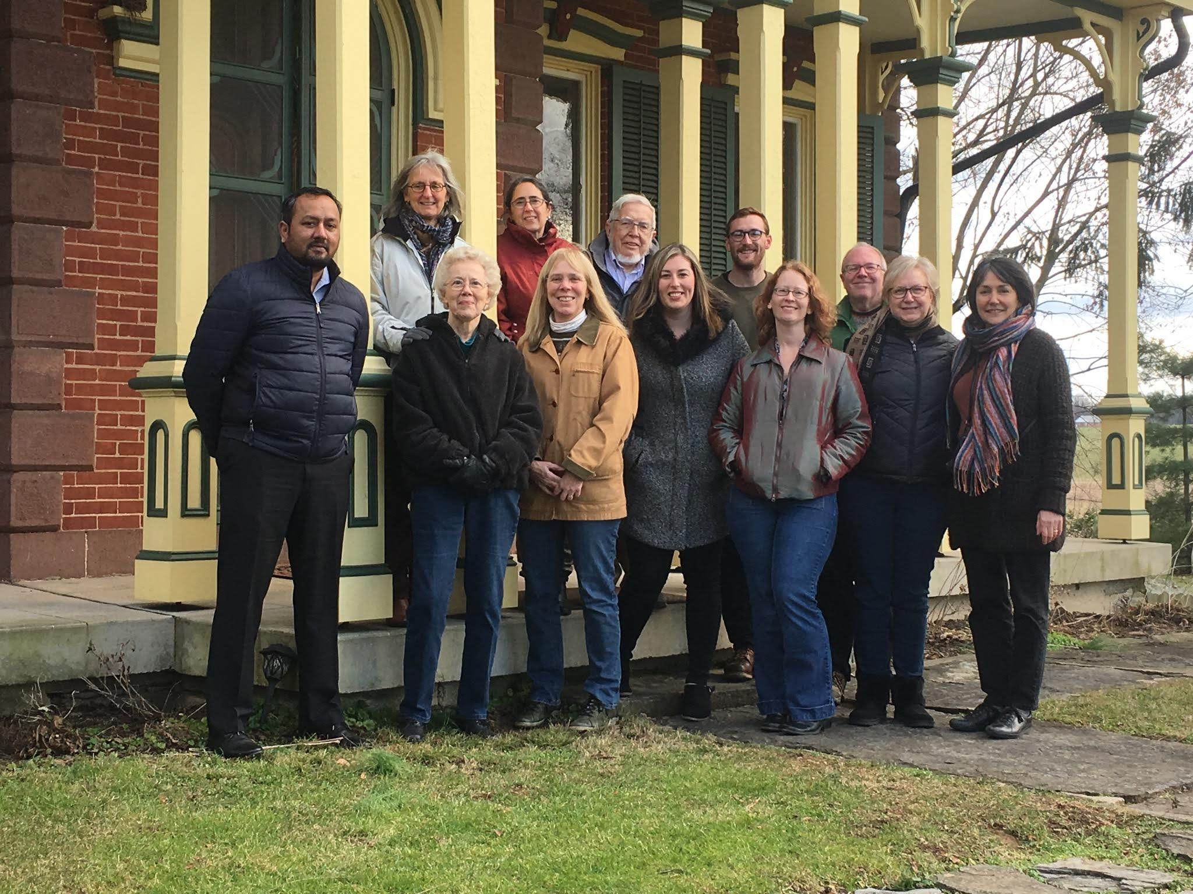
Notes:
We are a nonprofit public health organization that assists and supports residents who believe their health has been, or could be, impacted by shale gas development or “fracking”.
Our teams in SWPA and CT consist of:
Medical professionals, community service professionals, public health scientists, and graduate level interns.
EHP defends public health in the face of oil and gas development - Because knowledge protects health. ”

Slide 3
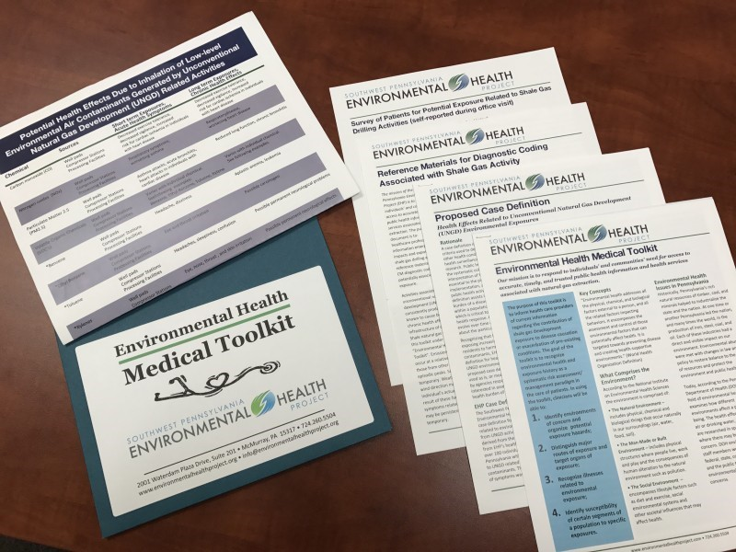
Notes:
EHP provides trusted peer-reviewed information to communities, including advice on how to monitor for and limit environmental exposure.
We provide information, education, and support to healthcare providers regarding recognition and diagnosis of symptoms related to environmental exposure.

Slide 4
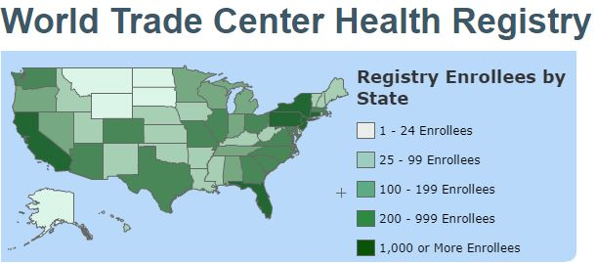
https://epi.grants.cancer.gov/registries.html#registries
https://www1.nyc.gov/site/911health/about/wtc-health-registry.page
Notes:
A vital part of our mission is to document the public health impacts of shale gas development. In 2017, EHP initiated a health registry to:
collect health information about a group of individuals who share a condition or experience or who are at risk of having the condition or experience.
And to
standardize health information so that data from one person can be easily compared with that of another.

Slide 5
Join EHP’s nationwide
Shale Oil & Gas Registry
and be counted!
Notes:
Our clients face conditions we believe are critical to having a registry.
Pathways of exposure may be through:
inhalation,
ingestion, or
skin contact.
Exposures may result in short term and long term health impacts depending on the magnitude of the exposure and the vulnerability of the individual.
The registry will:
Assist researchers in determining the scope and effects of the public health impact, and
inform policy makers and the public.

Slide 6
Notes:
EHP is using PEER developed by the non-profit organization Genetic Alliance which provides:
Security and data-gathering practices assured through IRB certification;
Individual data sharing and privacy settings options; and
Options for access to PEER portal sponsors and researchers.

Slide 7
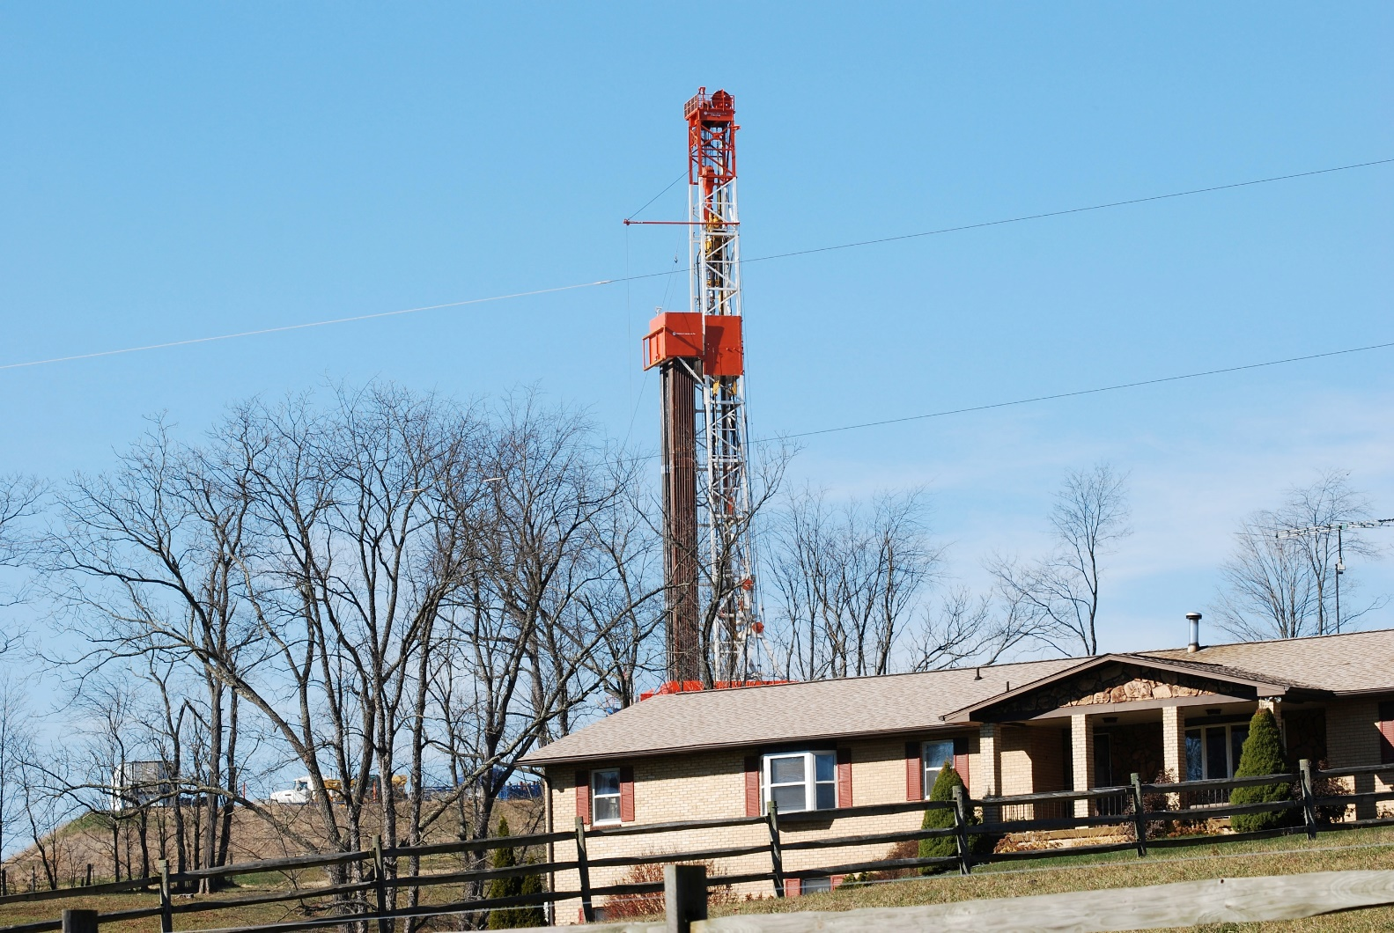
Robert M. Donnan
Notes:
Proximity matters. We ask that people living, playing, or working within 5 miles of gas infrastructure register.
We chose 5 miles given that documented health effects happen closer to sites, but we don’t yet know enough about the distance emissions travel and how far out exposures may occur.
Registrants are asked to estimate how close they are to sites

Slide 8
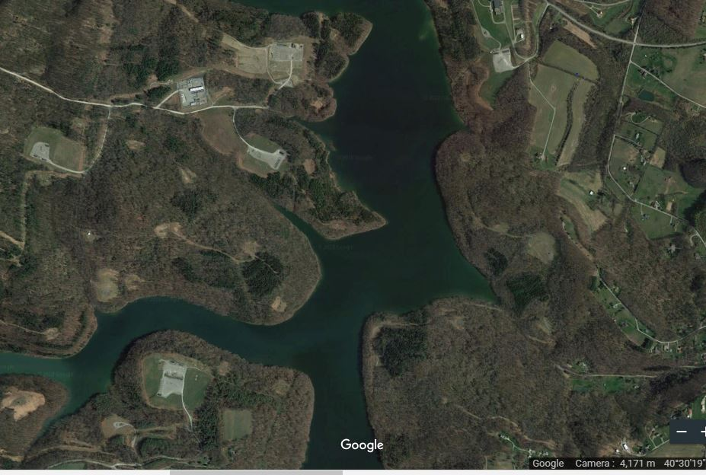
Beaver Run Reservoir, Westmoreland County
Notes:
Exposures due to water contamination is also of serious concern and may occur due to:
accidents,
leaks,
casing failures
Or dumping of waste
Both private and public water supplies may be at risk

Slide 9
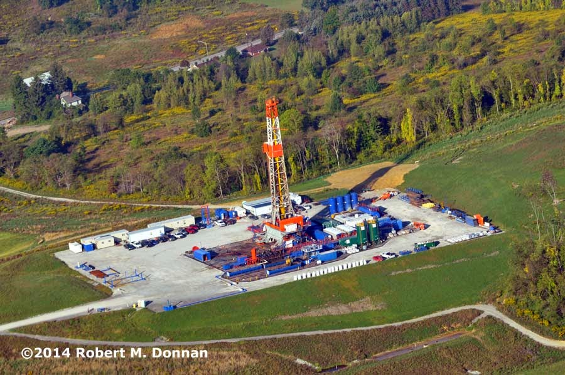
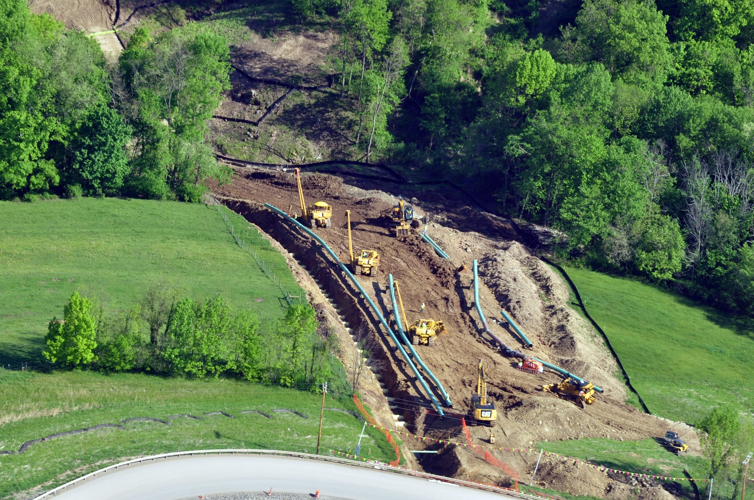
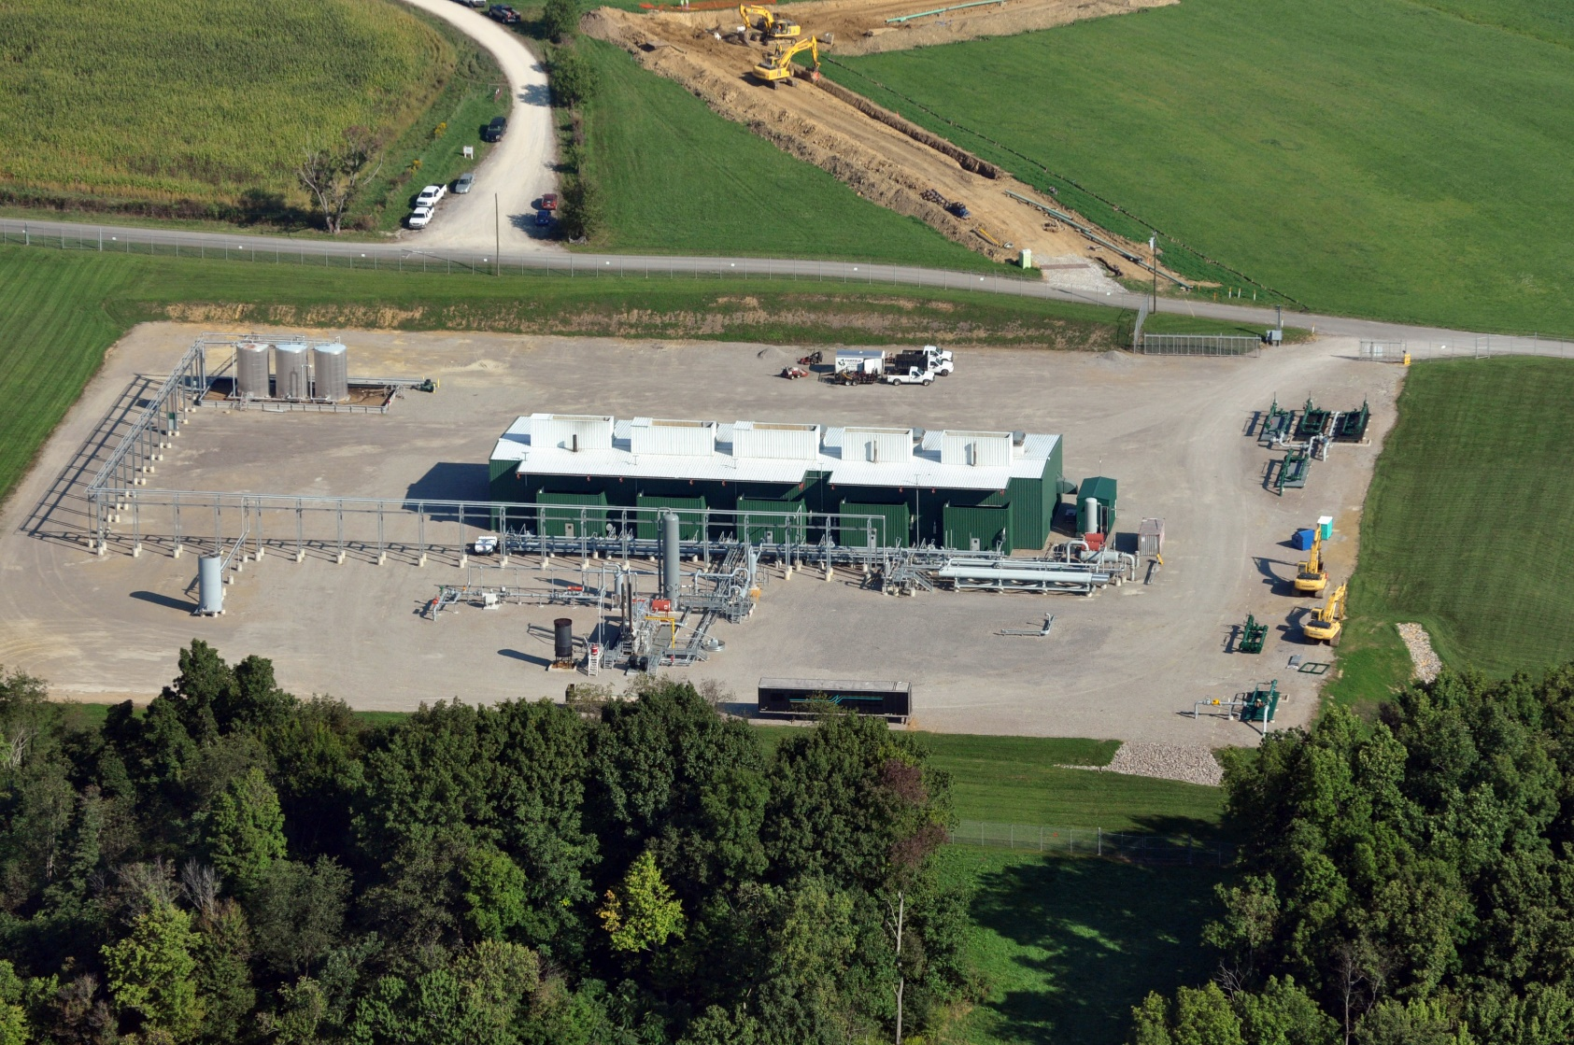
2014 Robert M. Donnan. FracTracker Alliance
Notes:
People should be encouraged to take part in the registry whether or not they are currently experiencing symptoms, because:
All gas facilities may leak
Emissions are episodic so symptoms may also be.
Water sources may be at risk
Exposures may cause health effects later in life.

Slide 10
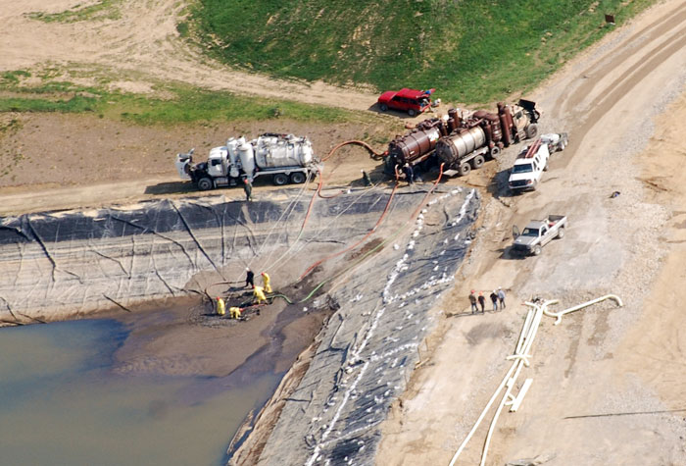
FracTracker Alliance
Notes:
So - Who should join the Registry?
Adults
Children, and
Workers in the industry.
There are separate surveys for each of these categories.
We ask that parents fill out individual surveys for their children.
Currently, most registrants are adult men and women.

Slide 11
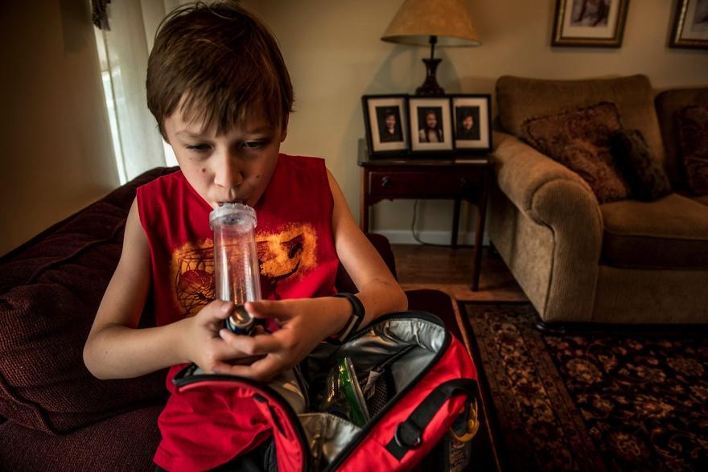
Karen Kasmauski , iLCP
Notes:
Vulnerable populations have a higher risk of particular health effects.
Children, for example:
Do not clear toxins as efficiently as adults
Are still developing
Have higher breathing rates
Engage in more vigorous outdoor activity
Run around in bare feet and put hands in mouths.
It is important that vulnerable populations participate in the registry.

Slide 12
Quality of Life
Immediate Environment
Symptoms
Demographics
Notes:
The registry takes a minimum of 20 minutes to complete. Questions pertain to:
Quality of Life: such as Fatigue, Depression, Anxiety
Immediate Environment: such as Air and Water Pollution and Nearby Industrial Sources
Symptoms by system: such as Respiratory, Reproductive, Psychological
Demographics: such as Age, Gender

Slide 13
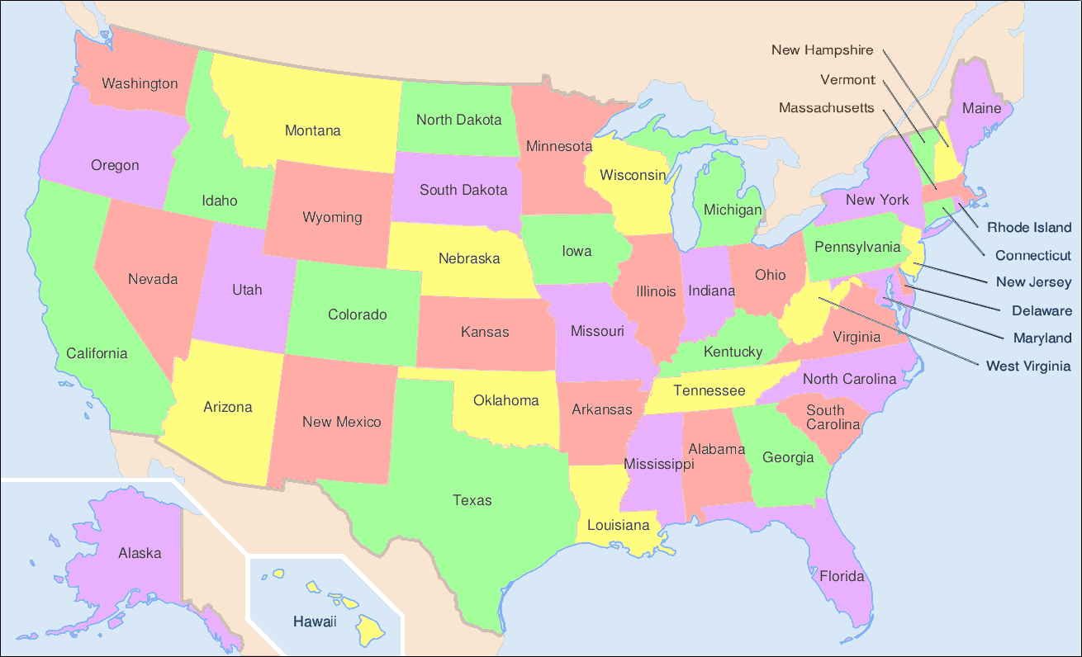
States represented in the Registry
Notes:
Registry has been growing slowly with 12 states now represented
Information gathered is based on self-assessment.
Self-assessment has been shown to be a reliable tool in evaluation of the status of patients with chronic disease.
We focus on exposures and symptoms that began after nearby development or that worsened since development began.

Slide 14
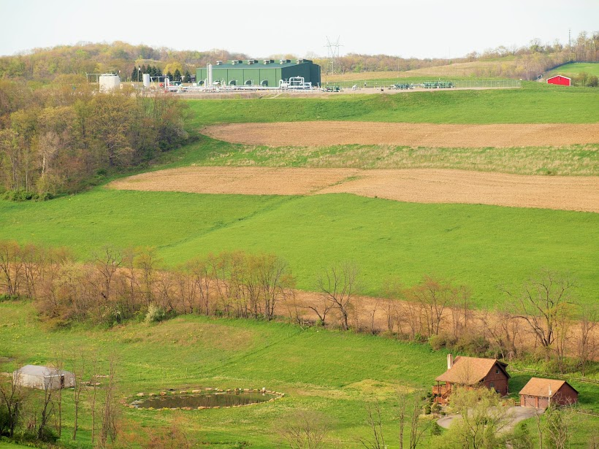
2017 Leann Leiter, FracTracker Alliance
Notes:
The registry now has well over 100 registrants
Data shows trends consistent with published peer reviewed studies
Compressors, well pads and processing plants are the leading sources of exposure. Residents may be exposed to multiple sources.
Registry strongly suggests proximity matters. For example, symptoms are reported by more participants under a ¼ mile than over a mile

Slide 15
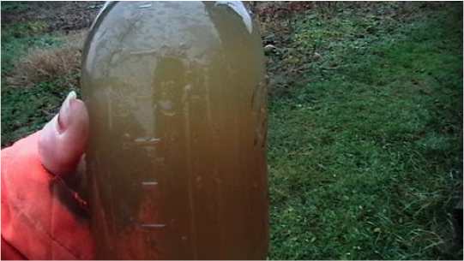
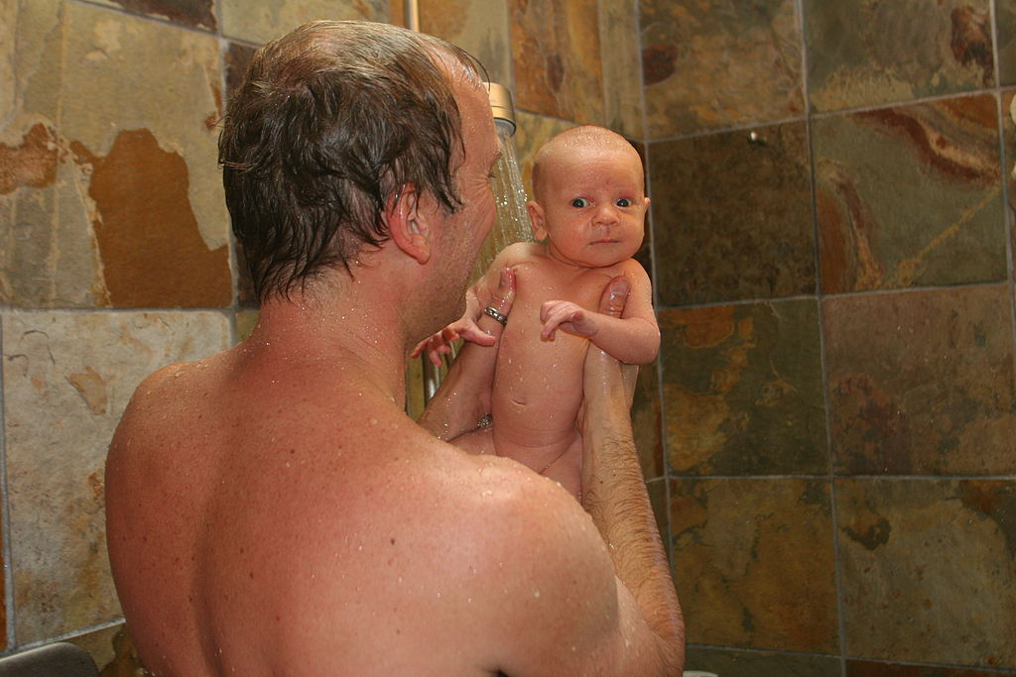
FracTracker Alliance
Notes:
Over half of registrants use private water sources for some uses in home.
32 of 68 report showering and bathing in private ground water.
Water is an important potential source of exposure. Patients may have health impacts related to skin contact, ingestion, or inhalation of released volatile organic compounds.

Slide 16
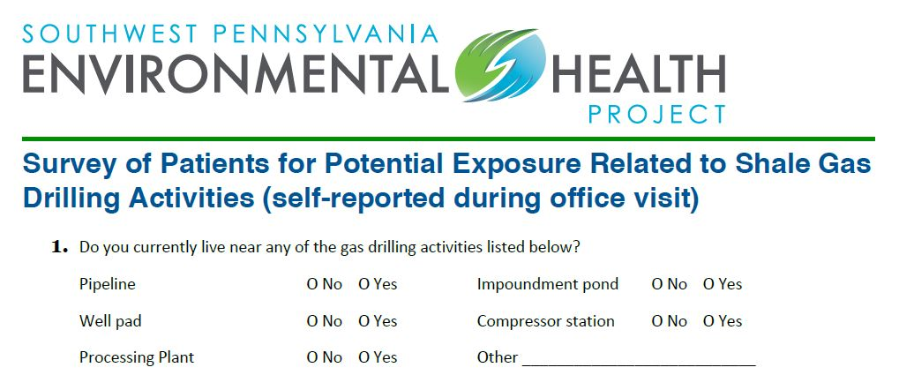
Notes:
EHP’s medical toolkit has a patient survey available for your use to help ascertain the possibility of the patient experiencing environmental exposure related to shale gas development.
There are 5 simple questions related to:
Changes in the patient’s environment
Symptoms that they are experiencing, and
If they are on public or well water.

Slide 17
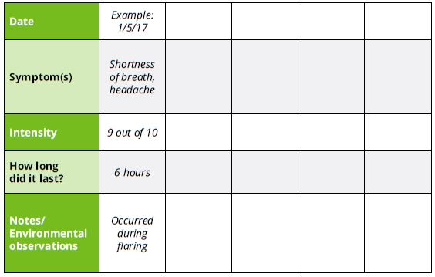
Notes:
If you suspect that your patients’ symptoms may be related to environmental exposure, ask your patients to record their symptoms daily.
EHP can provide symptom tracking charts to record relevant information such as:
What are the symptoms
Symptom intensity and duration
Changes in nearby industrial activity
Changes in the air or water

Slide 18
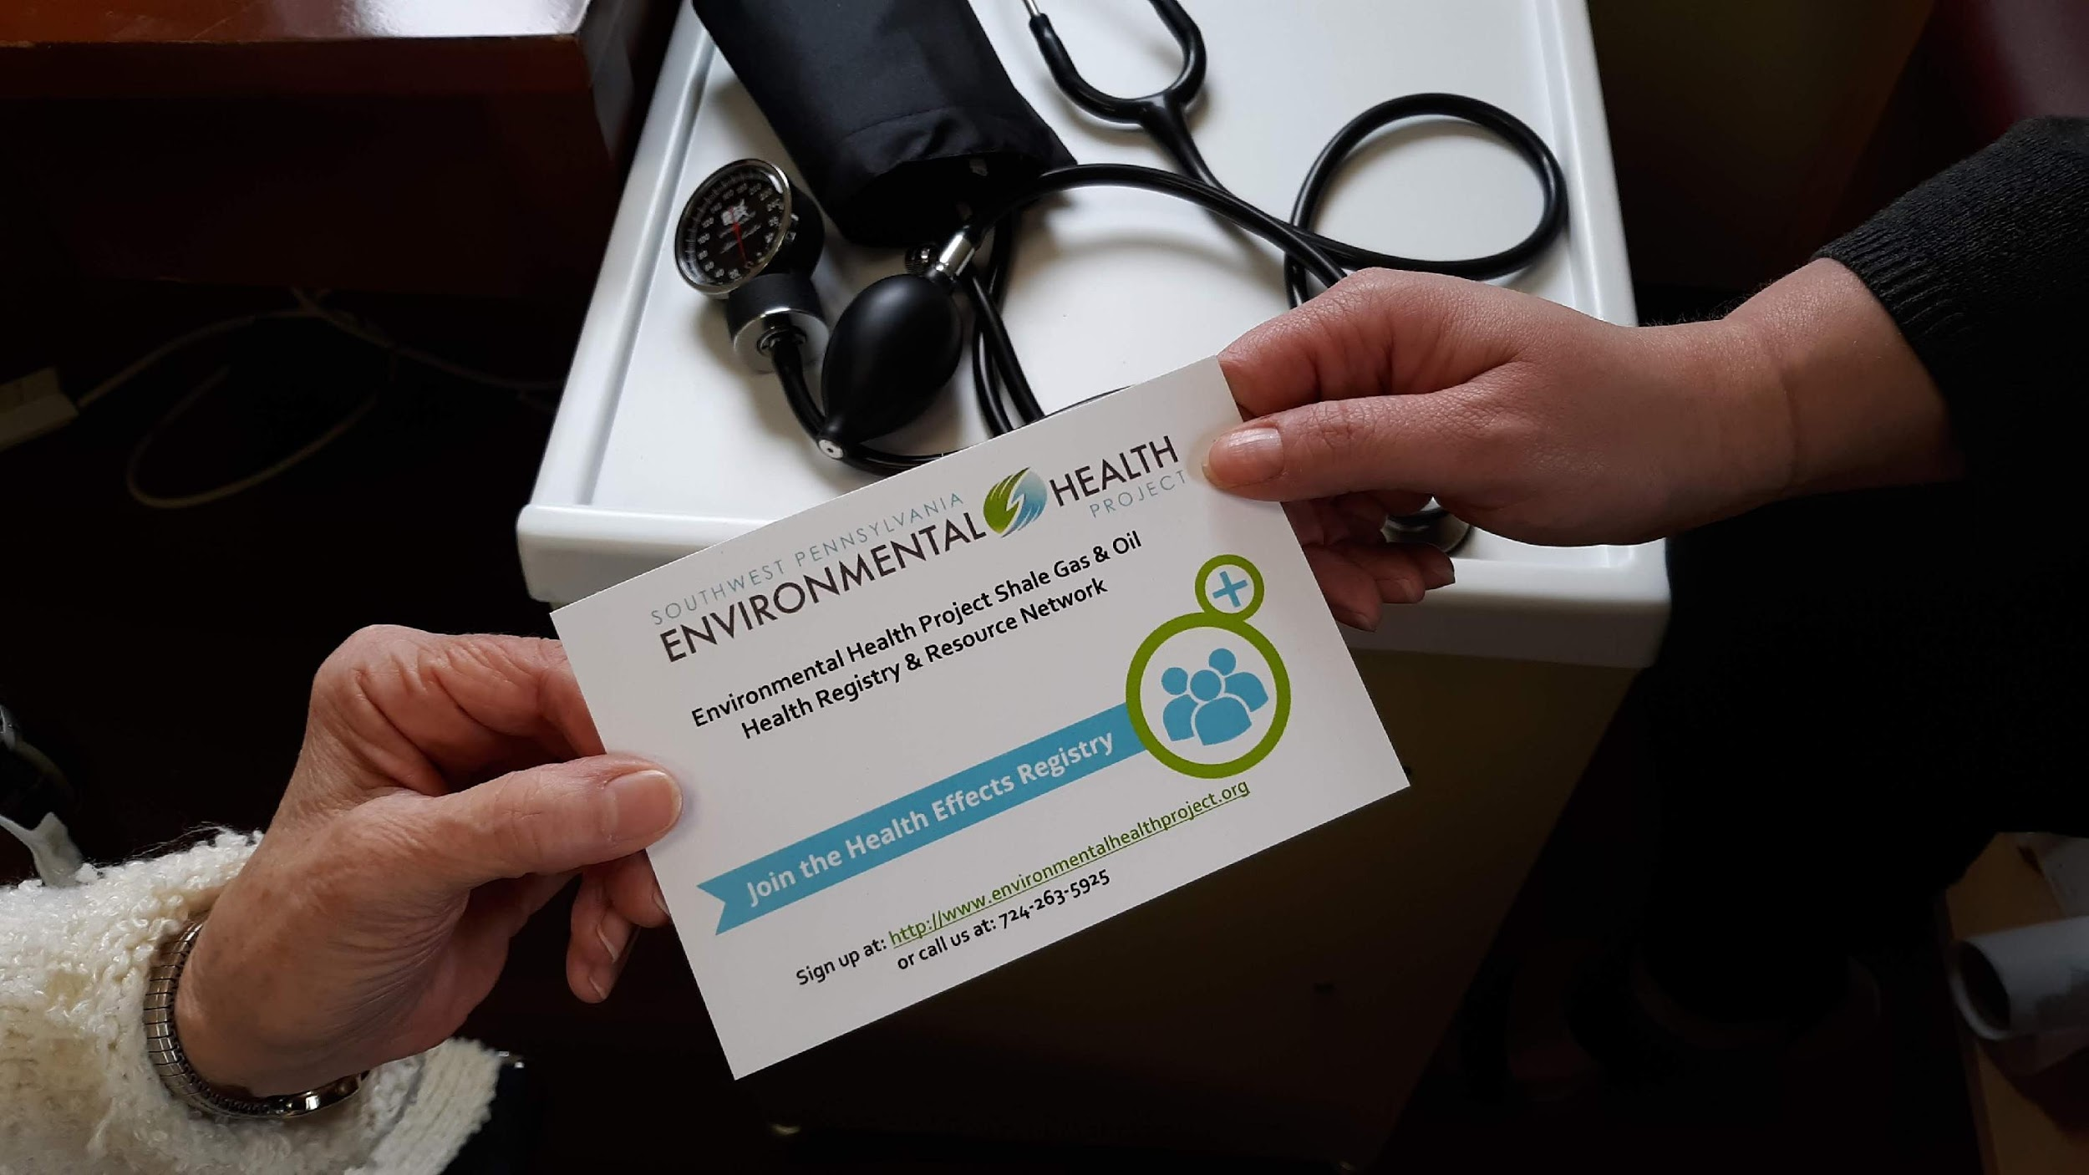
Notes:
Encourage patients to take part in the Shale Oil and Gas Health Registry.
They would need:
Access to a computer with internet
An email account.
Then:
They can update their information at any time
will receive periodic updates on the registry, and
can see if others answered in the same manner.
EHP can provide direct assistance in signing up.

Slide 19
Notes:
Researchers need data to understand the size and scope of public health impacts.
We have a screening process for who can make use of the registry.
Physician and researchers could request to look at de-identified data.
Public officials could apply for access to de-identified data.
Researchers might use the data for hypothesis-generation or case studies.

Slide 20
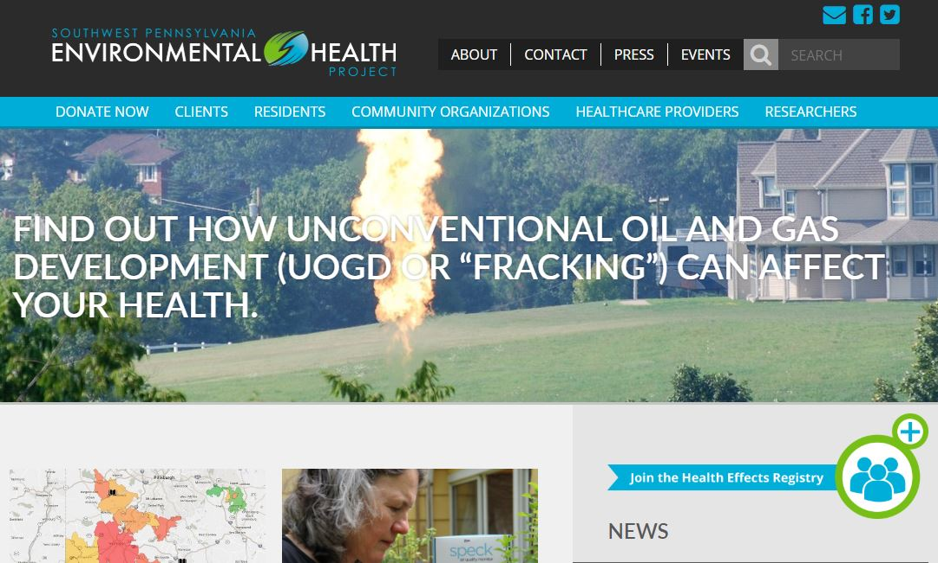
environmentalhealthproject.org
Notes:
Currently 2 states collect data in systematic ways – PA and CO, but they aren’t advertising their registries.
In states like MD and NY where fracking is banned, individuals may experience impacts from compressors and pipelines.
To date, no other organization is doing this work in a comprehensive manner.
EHP’s national Shale Oil and Gas Health Registry aims to improve understanding of the long term public health impacts of this industry.

