Slide 1
FracTracker Alliance info@fractracker.org October 13, 2018 ● Chatham University
www.fractracker.org
Notes:
Hi everyone, I’d like to first say a quick thanks to Chatham, Drexel, and Physicians for Social Responsibility for inviting me here and hosting this event today. My name is Erica Jackson and I am the Community Outreach and Communications Specialist with FracTracker Alliance. And I am based here in Pittsburgh.

Slide 2
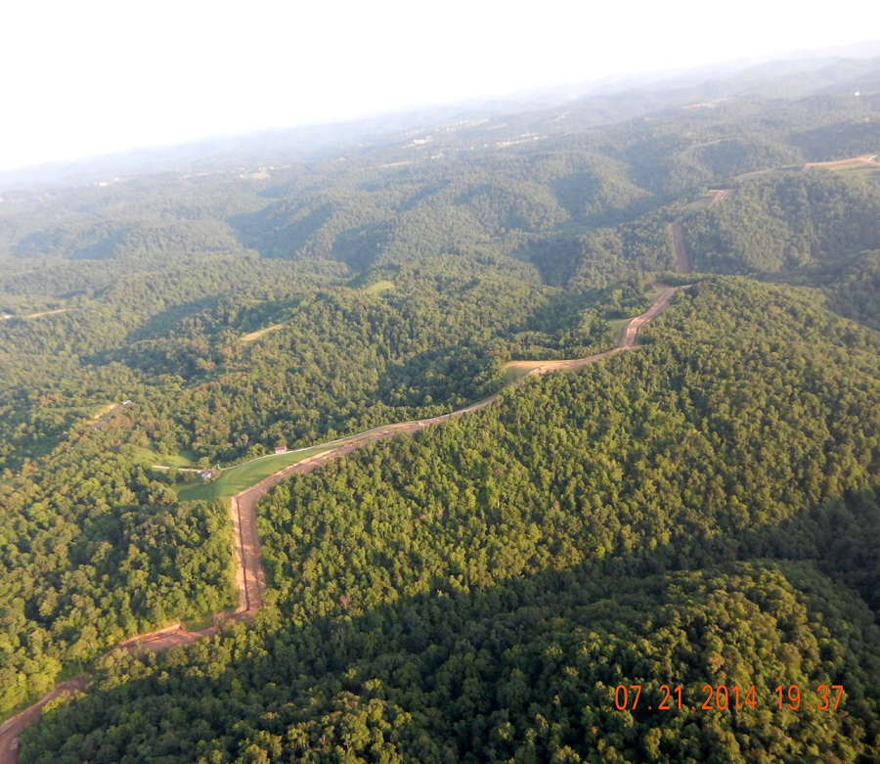
Notes:
FracTracker is a leading resource on oil and gas issues. We study, map and communicate the risk of this industry to protect our planet and support the renewable energy transformation. We also provide resources for partner organizations to support advocacy and research.

Slide 3
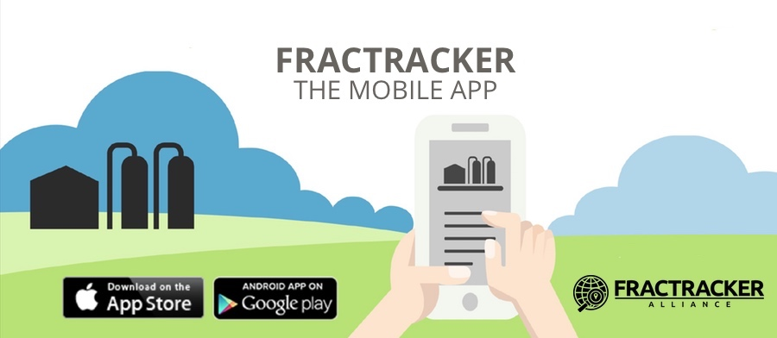
Notes:
Another aspect of FracTracker’s work is providing tools for people in areas affected by oil and gas so they can take action on a local level. One of the tools we provide is the FracTracker Mobile App, which is what I am here to share with you today. The app is free and a great way for people to learn about fracking in their neighborhood and across the US.

Slide 4
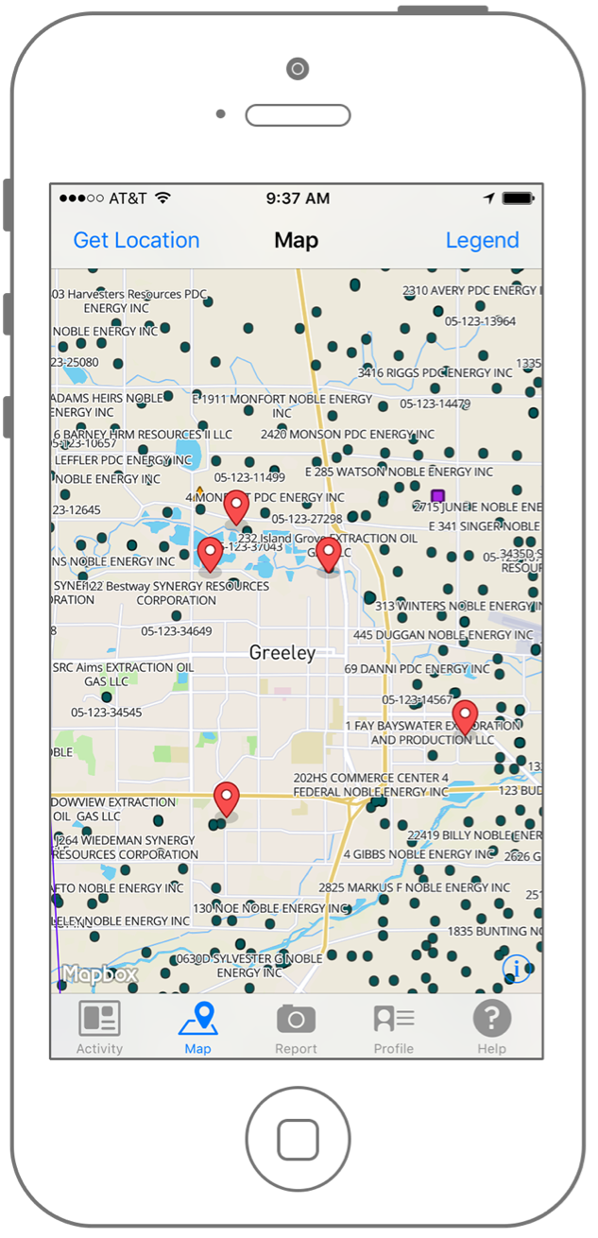
Notes:
There are 2 main features of the FracTracker App. The first is a map. When you click on the map icon on the bottom tool bar, a map will appear. It’s similar to google maps or apple maps, except that it includes the location of fracking infrastructure. Each green dot on the screen here represents a drilled unconventional (or fracked) well

Slide 5
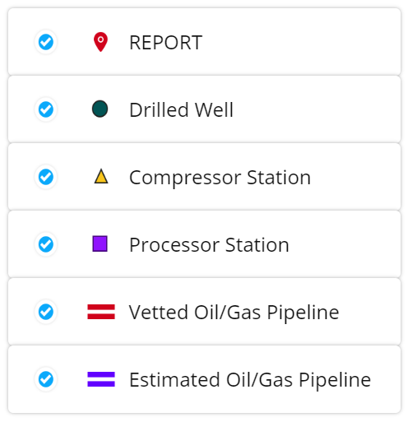
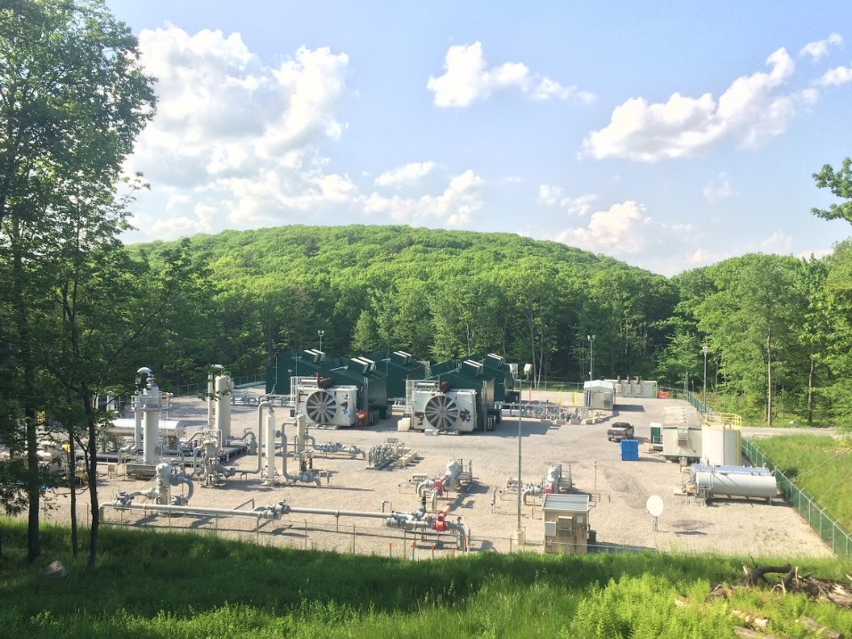
Brook Lenker, Loyalsock State Forest, PA, June 2016
Notes:
In addition to wells, the app also includes other aspects of oil and gas development, which you can see here in the legend. For example, there are triangles which represent compressor stations. Compressor stations are facilities along a pipeline route which compress natural gas and help it flow efficiently through a pipeline. They also produce a lot of air pollution in the process.

Slide 6
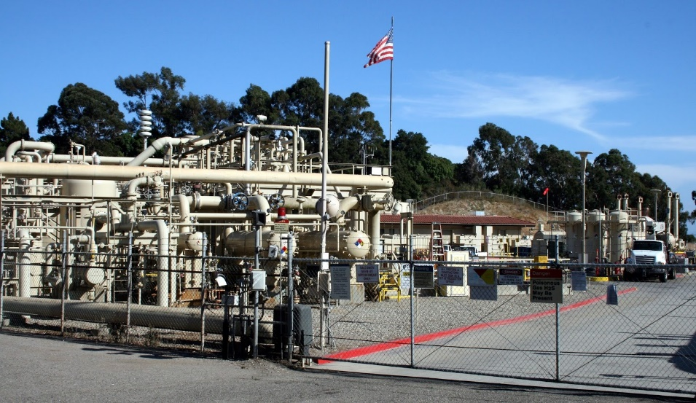
Linda Krop, Environmental Defense Center
Notes:
There are also processor stations on the map. This is a broad term used to describe different facilities and equipment that separate impurities, contaminants, and components of natural gas. Natural gas is mainly methane, but it can also contain water, ethane, butane, and other substances that are separated out. Processor stations can also be major polluters.

Slide 7
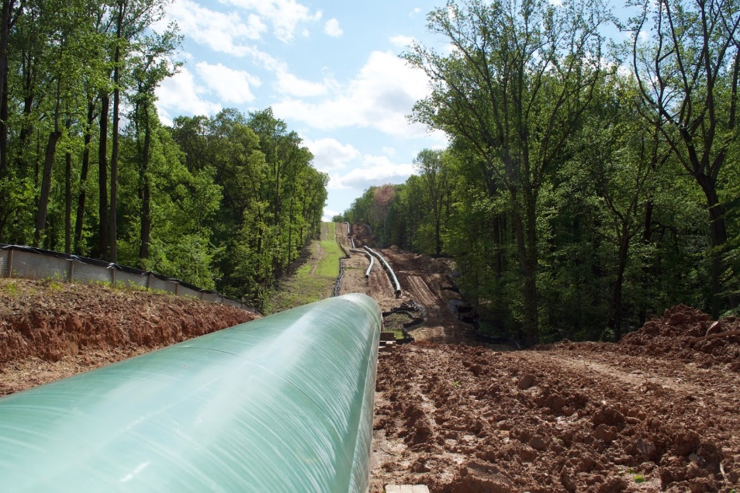
Sierra Shamer, May 2016, Harford & Baltimore Counties.
Notes:
Then there are pipelines on the map. There’s a real lack of data transparency when it comes to oil and gas pipelines. In fact, after the natural gas pipeline exploded last month in Beaver County, it was difficult to find an accurate map of it. FracTracker is working to fill this gap. The app contains vetted pipelines that we have gone through and checked for accuracy, and estimated pipelines.

Slide 8
Notes:
Finally, you also see these small red flags on the map. Each one is a report of oil and gas activity made by an app user. This brings me to the second feature of the FracTracker app. Anyone who has the app can report development that they see. If you touch one of the red flags, the report will pop up. You can also click on the “Activity” Icon at the bottom to scroll through a feed of these reports. (may run over to next slide)

Slide 9
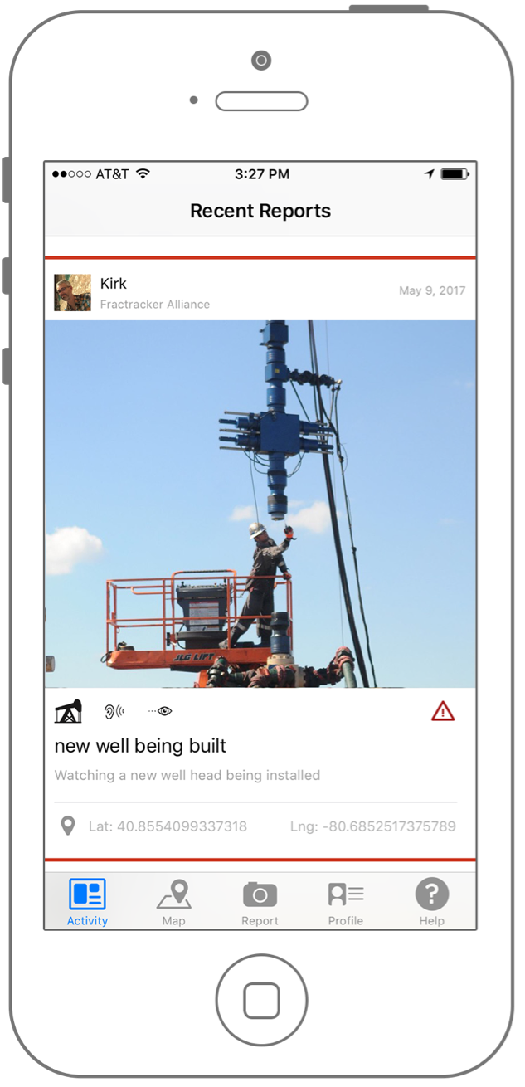
Notes:
Here is an image of the reports in the activity feed. Most reports include a photo, a brief explanation of what is happening, and the location where the photo was taken. You can see here that the report is of a well being constructed.

Slide 10
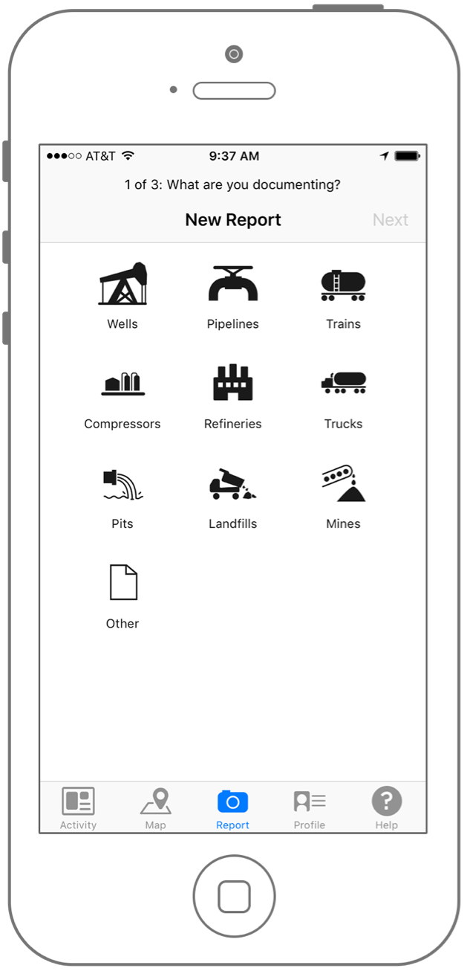
Notes:
Filing a report is easy. You click the report button on the bottom and you will be prompted through a series of steps. The first step is to choose from this list of things to report. The activity feature includes a broader range of fossil fuel activity to report than what is displayed on the map.

Slide 11
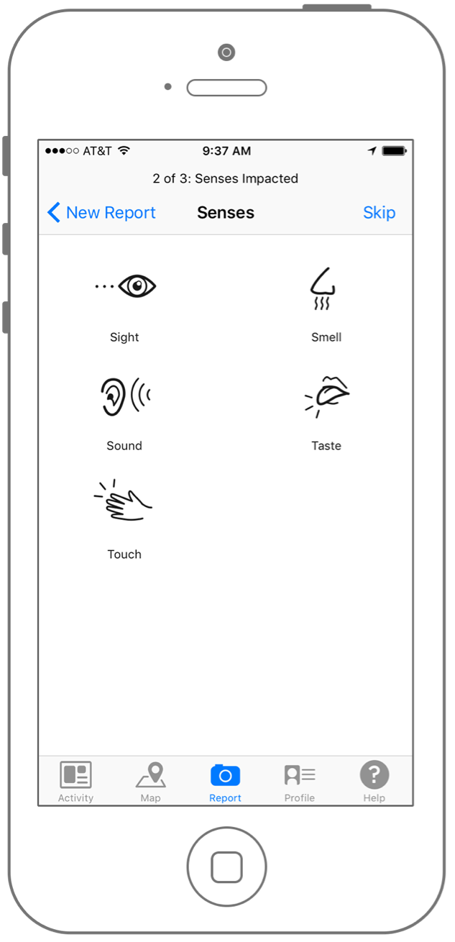
Notes:
After you select what you are reporting, you will be prompted to select what senses were impacted. For example, you could report noise pollution from oil trains, or seeing a lot of truck traffic in your neighborhood. There was recently a leak at a well site and neighbors reported a smell of rotten egg, indicative of hydrogen sulfide.

Slide 12
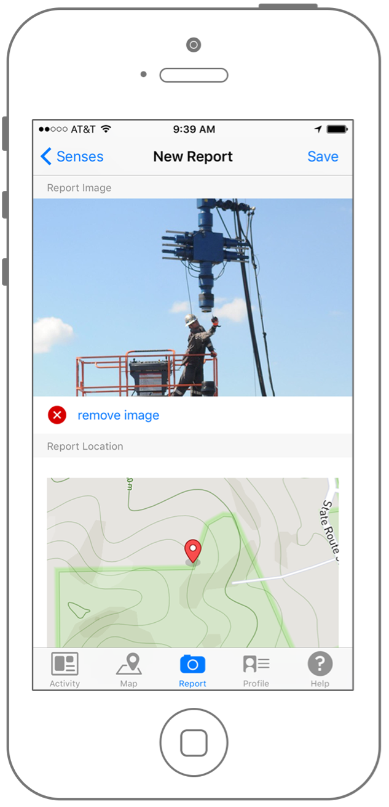
Notes:
Then you will be asked to write a title, short description, and add a photo. Finally, you can pick the location of the event. You can also leave one of these features out. For example, we’ve received emails from people saying they’ve experienced headaches since development began occurring, and that could be something that you report without a photo.

Slide 13
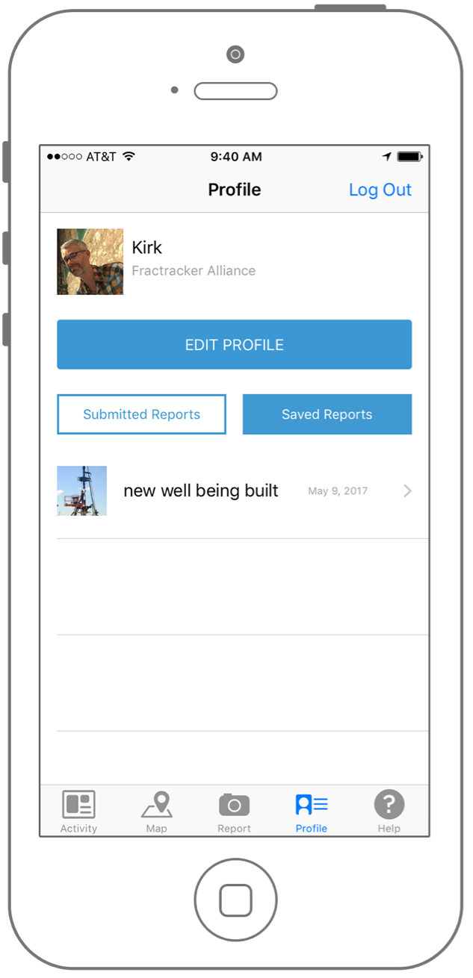
Notes:
Everything you report will be stored under your user profile so you can go back and modify or delete them later. You can also make a report, save a draft of it, and then submit it later, which is helpful if you’re ever having connectivity issues.

Slide 14
Notes:
That’s a basic intro to the FracTracker App. It’s very user-friendly and can teach you a lot about development in your area. You can download it for free on the App Store and on Google Play. But why should you use it?

Slide 15
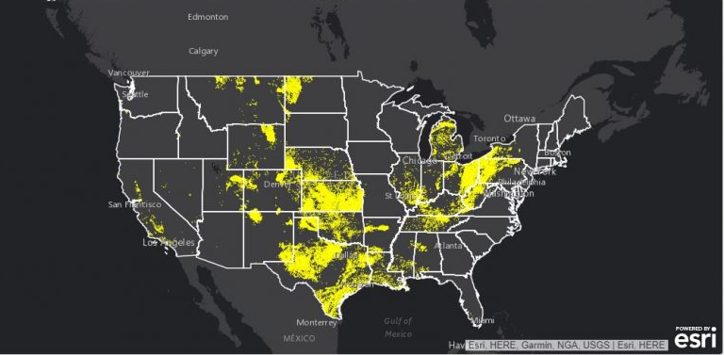
Populations within the threat radius
Notes:
In the U.S., 12.4 million people live with a half mile of an active well, pipeline, or compressor station. Yet industry provides us with little easy-to-read data about where this infrastructure is and a very limited, biased idea of how it will affect our neighborhoods.

Slide 16
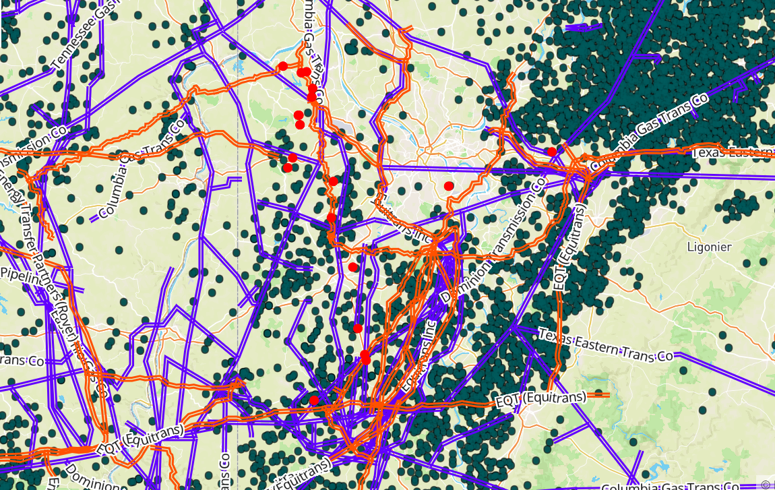
Notes:
The FracTracker App is the first step towards becoming more aware of the development in your town. This awareness can also be a bit overwhelming at first. Looking at this map of Pittsburgh (The blue dot is Chatham University) you can see that we’re surrounded by development. You may think there’s not much that an individual can do to affect this.

Slide 17
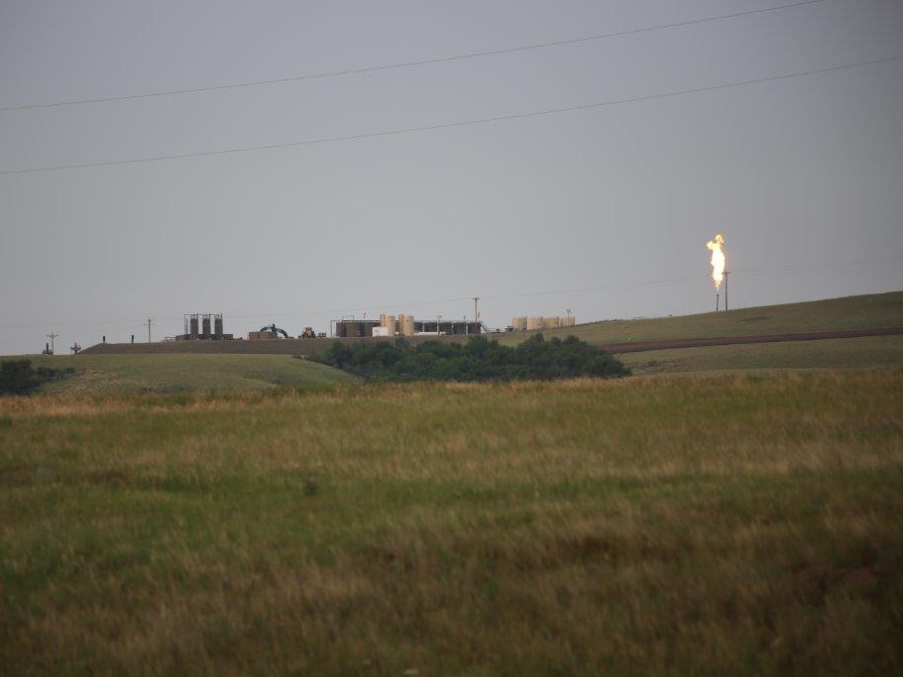
“Excessive Flaring”
“emissions & induced
headache ”
“A strong scent of propane …people in our group reported feeling dizzy”
Trudy E. Bell, Flaring in Bakken field, North Dakota, July 2015
Notes:
But with the reporting feature, individuals can contribute meaningful insight into potential impacts that would otherwise go unreported. People living in areas where fracking occurs have the best idea about what streams are being polluted with drilling mud, where flaring is occurring, and what health symptoms they are experiencing.

Slide 18
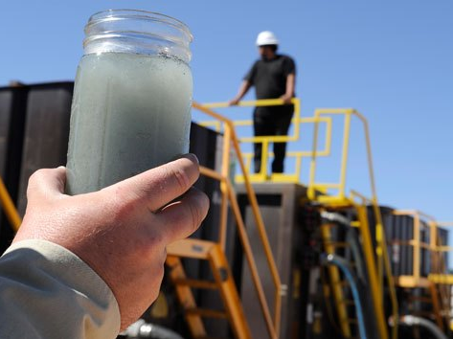
Photo by Pat Sullivan/AP
https://www.motherjones.com/environment/2014/07/california-halts-injection-fracking-waste-warning-may-contaminate-aquifers/
Notes:
These reports can be used as evidence of the risks of fracking in meetings with local and state officials. They can verify the accuracy of pipeline and well maps. They also can be used by health care professionals to identify where people are experiencing symptoms that could be caused by fracking.

Slide 19
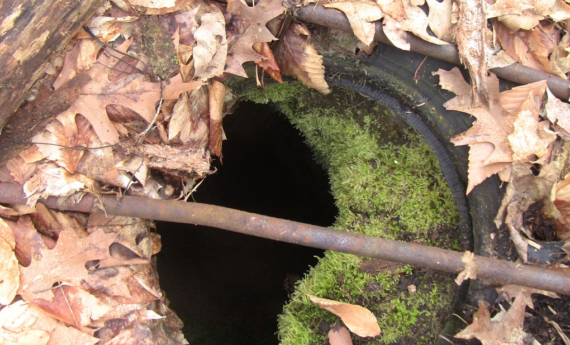
Case Study
Notes:
For our collaborators, FracTracker can extract reports and make them into a separate map for you to use in your campaigns. We have partnered with other organizations to map out abandoned wells in Pennsylvania, like the one in the photo. We could create maps of health concerns, working with reports of symptoms, air pollution, flaring, or contaminated water.

Slide 20
FracTracker Alliance info@fractracker.org www.fractracker.org
Download the app: fractracker.org/apps
Notes:
I encourage you all to download the app and learn a little more about the oil and gas industry in your state or around the US. Thank you everyone for your time, and also for the work you do to protect the health of our environment and communities. If you have any follow up questions or comments, please feel to contact us.

