Slide 1
Out of Sight:
The Role of Health Care Professionals in Pipeline Disaster Planning, Response, and Recovery
Simona L. Perry, Ph.D.
c.a.s.e. Consulting Services & Pipeline Safety Coalition
Notes:
I am Simona Perry, an applied social and environmental scientist and public safety advocate. Since 2012, our community-based research into risk perceptions, disaster planning, and recovery from pipeline disasters has led to one clear conclusion: health care professionals must play an expanded role in all aspects of pipeline disaster planning, response, and recovery.

Slide 2
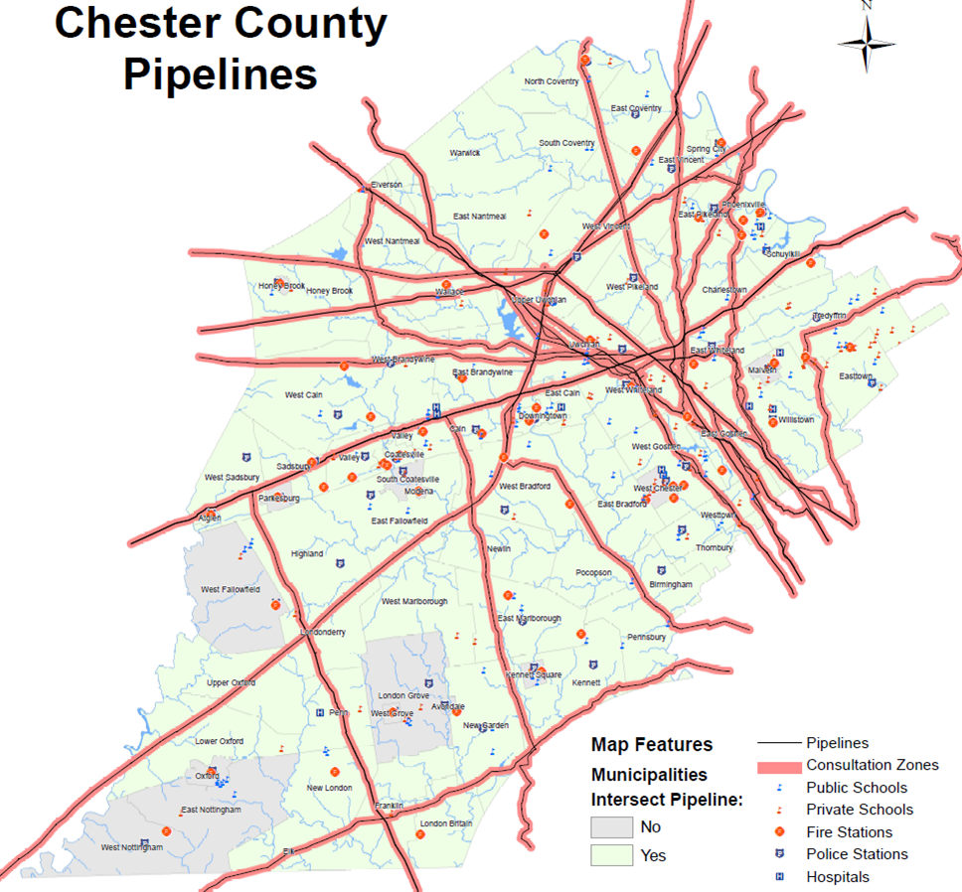
What we don’t see CAN injure and kill us!
Notes:
Currently there are almost 3 million miles of pipelines carrying gases and hazardous liquids all over the US. The number of pipeline disasters reported to result in death or hospitalization has fluctuated between 30 and 60 a year over the past decade.

Slide 3
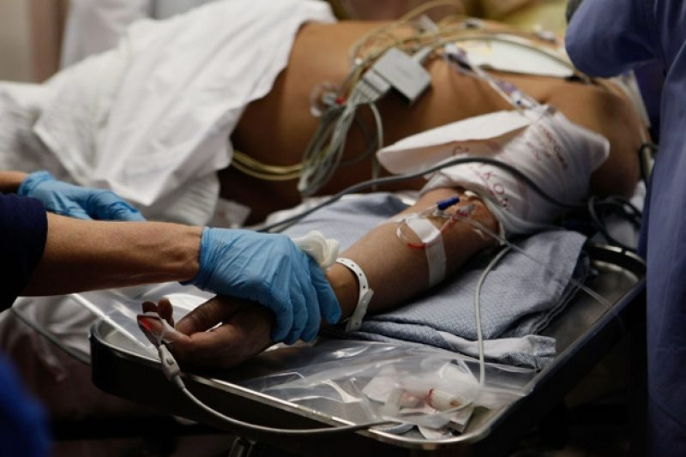
Notes:
These 30 to 60 events/year have resulted in 133 public and 42 industry fatalities in the past 13 years. And 590 public and 205 industry injuries in that same time period.

Slide 4
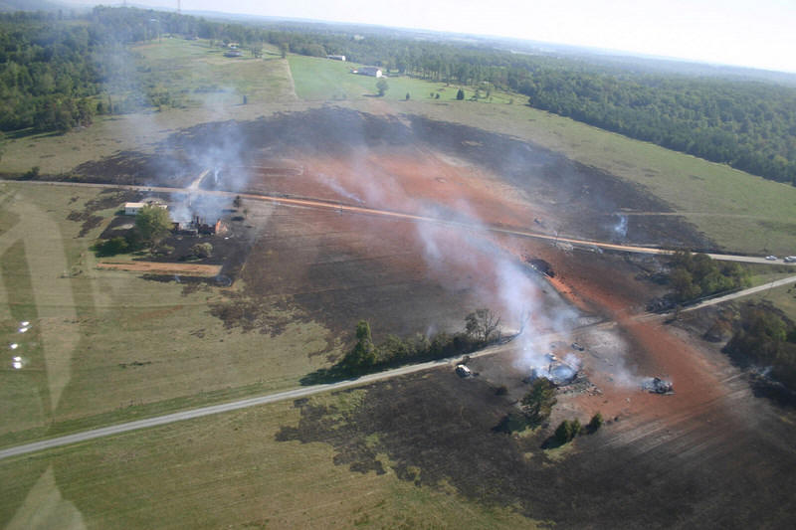
Notes:
What is a pipeline disaster?
A type of technological disaster.
Regulators in Department of Transportation & industry define as “significant incidents.” Does not include cases in which the original cause of a gas explosion is some other outside force damage or fire first events.

Slide 5
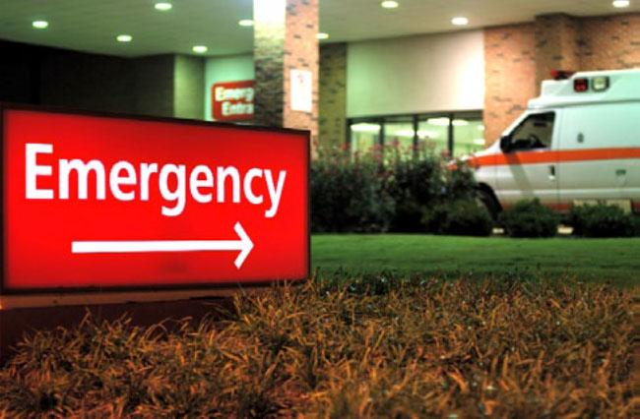
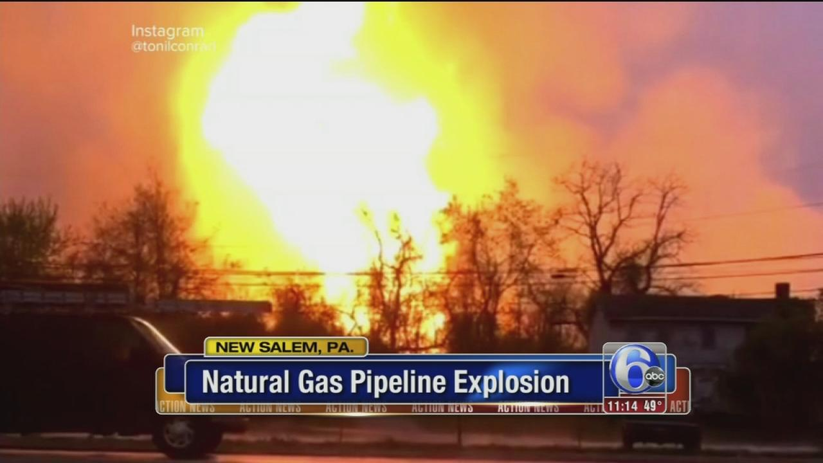
Notes:
What is a pipeline disaster?
Does include: Fatality or injury requiring in-patient hospitalization, $50,000 or more in total costs, Highly volatile or other liquid releases of 5 barrels or more, Liquid releases resulting in an unintentional fire or explosion

Slide 6
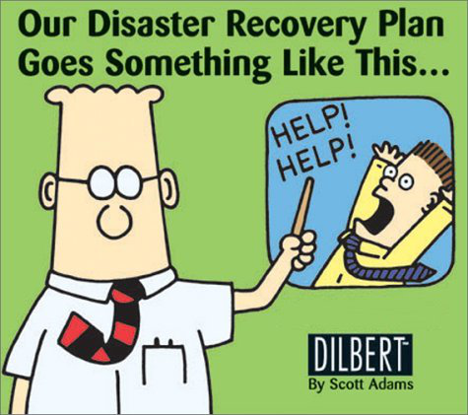
Notes:
At Pipeline Safety Coalition we assessed the self-reported preparedness of local Pennsylvania emergency first responders to a pipeline disaster in their communities. Some of what we uncovered was troubling. A fire chief who had served in a county for 30 years told us that pipeline disasters were similar to a large house fire, and he was confident they knew how to respond to those.

Slide 7
Notes:
Yet, in interviews with local officials who had found themselves actually responding to a pipeline disaster they described the event as something they were inadequately prepared for in several ways. They expressed it as a completely different type of disaster.

Slide 8
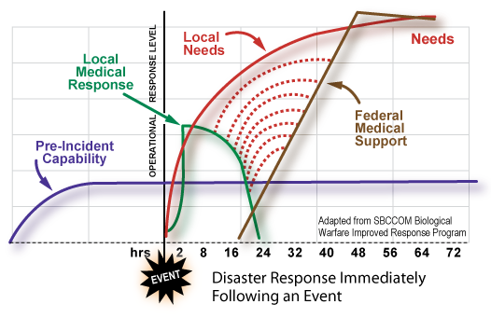
Notes:
Most notable: the urgent and long-term local needs among those impacted for social and logistical services such as relocation, and delayed medical needs, both physical and psychological, particularly Post-Traumatic Stress and grief counseling.

Slide 9
Notes:
The hopeful news is that some of us are hard at work on designing better ways to prevent such technological disasters under the best cases, and under the worst case to adequately prepare communities for pipeline disasters.

Slide 10
Notes:
In pipeline disaster preparation and response it is essential that health care providers be close partners in all trainings, incident command structures, and communications to account for not only the acute but also longer-term care needs of local communities.

Slide 11
Notes:
One example of such partnerships are with NIH’s development of WISER, a digital app and toolkit for emergency responders and health care professionals, available from any internet-enabled device.

Slide 12
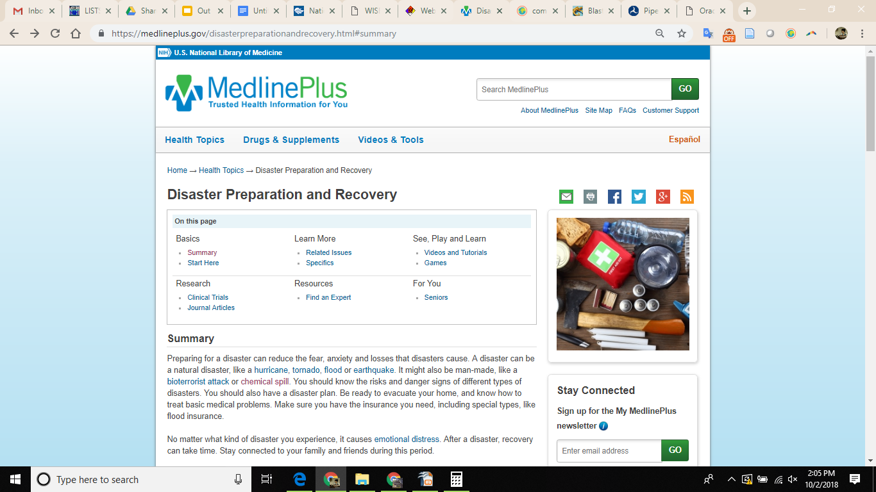
Notes:
Another example is the more public facing MedLine Plus Disaster Preparedness & Recovery page with its pipeline relevant information on Chemical Emergencies and a section on Coping with Disasters and the psychological consequences of disasters.

Slide 13
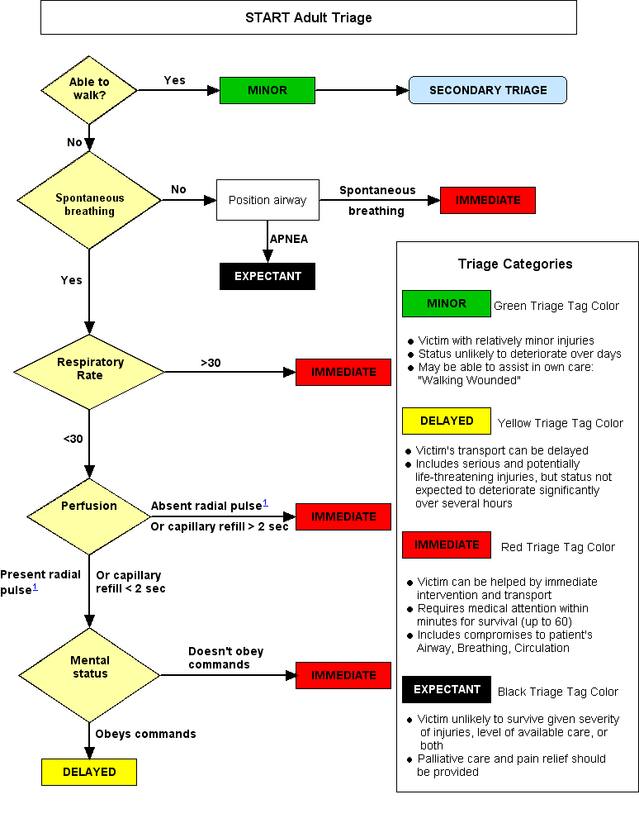
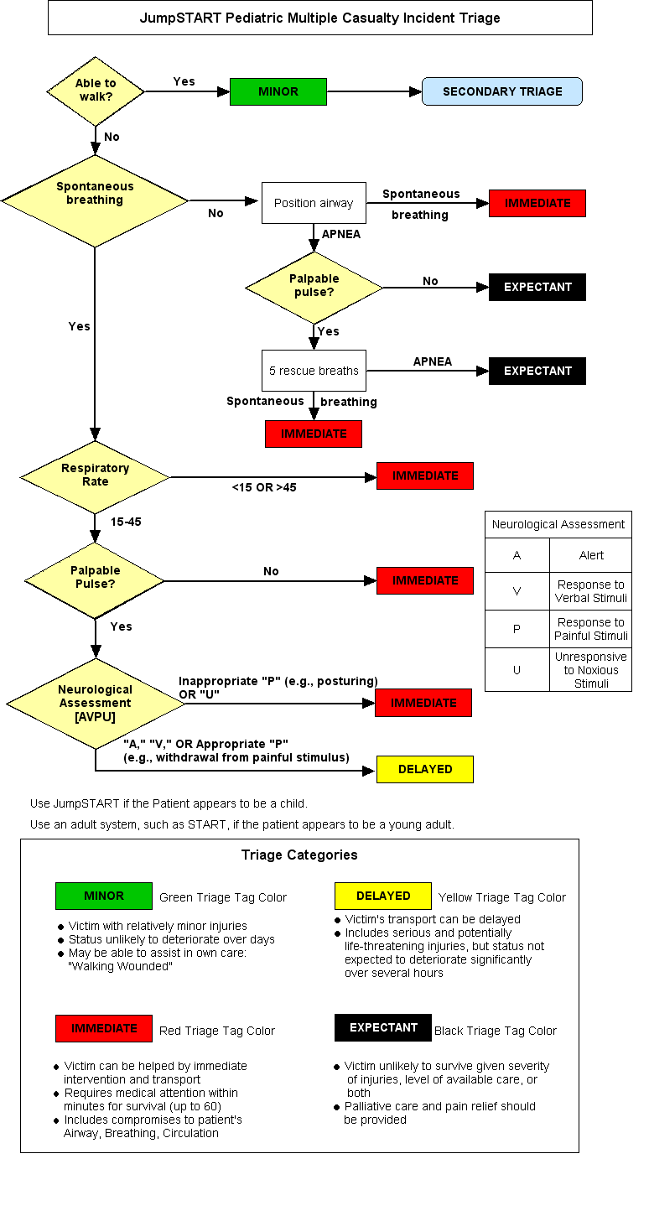
Notes:
In many ways, pipeline disasters are like other disasters. To appropriately prepare and respond health care professionals should be familiar with basic triage for mass casualty events, chemical emergencies of air, land, and water with HAZMAT releases, large industrial-scale fires and explosions.

Slide 14
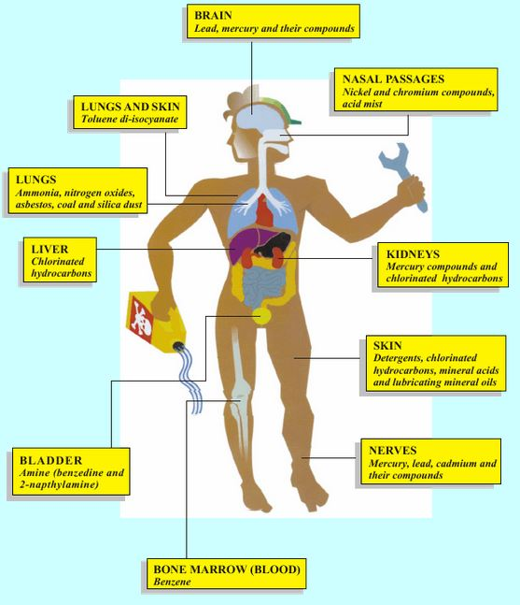
Notes:
On the other hand, pipeline disasters are unique. For all pipeline disasters it is safest to assume that there was a release of chemicals, and look for signs of Toxic Syndromes (Toxidromes).

Slide 15
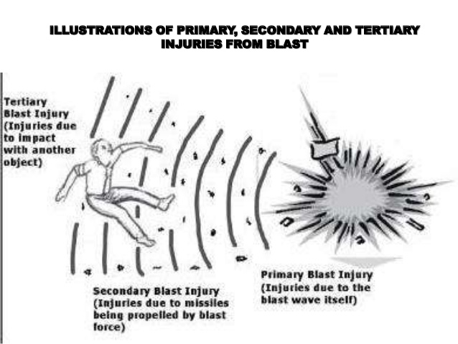
Notes:
Burns - heat and/or chemical
Blast Injuries - delayed symptoms
Toxidromes (beta CHEMM-IST tool for basic life support, advanced life support, emergency rooms)
Mental Trauma/Shock

Slide 16
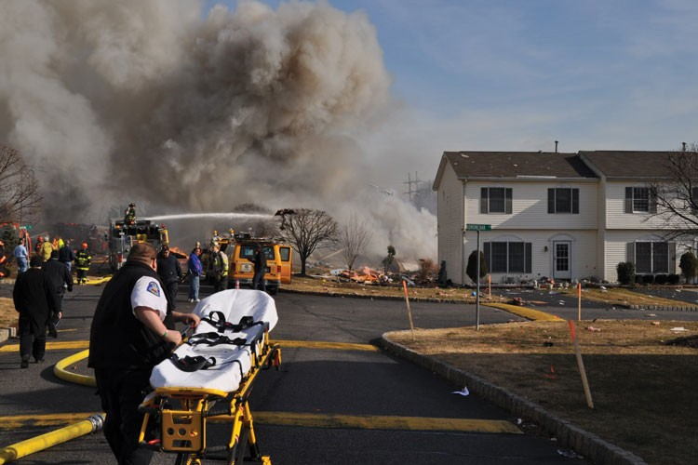
Notes:
Similar to battlefield or terrorist scenarios, pipeline disasters are unpredictable with regards to occurence, length of time and spatial extent. In a pipeline disaster health care workers must exercise situational and safety awareness while responding in order to be most effective at saving lives.

Slide 17
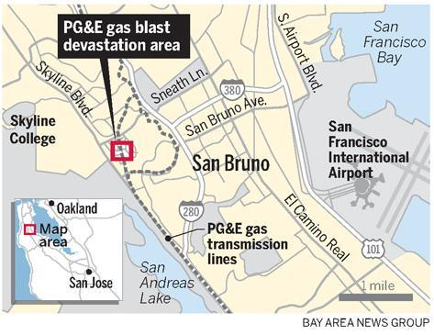
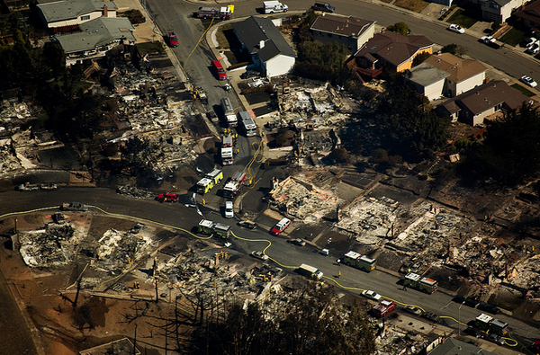
Notes:
San Bruno, California 2010.

Slide 18
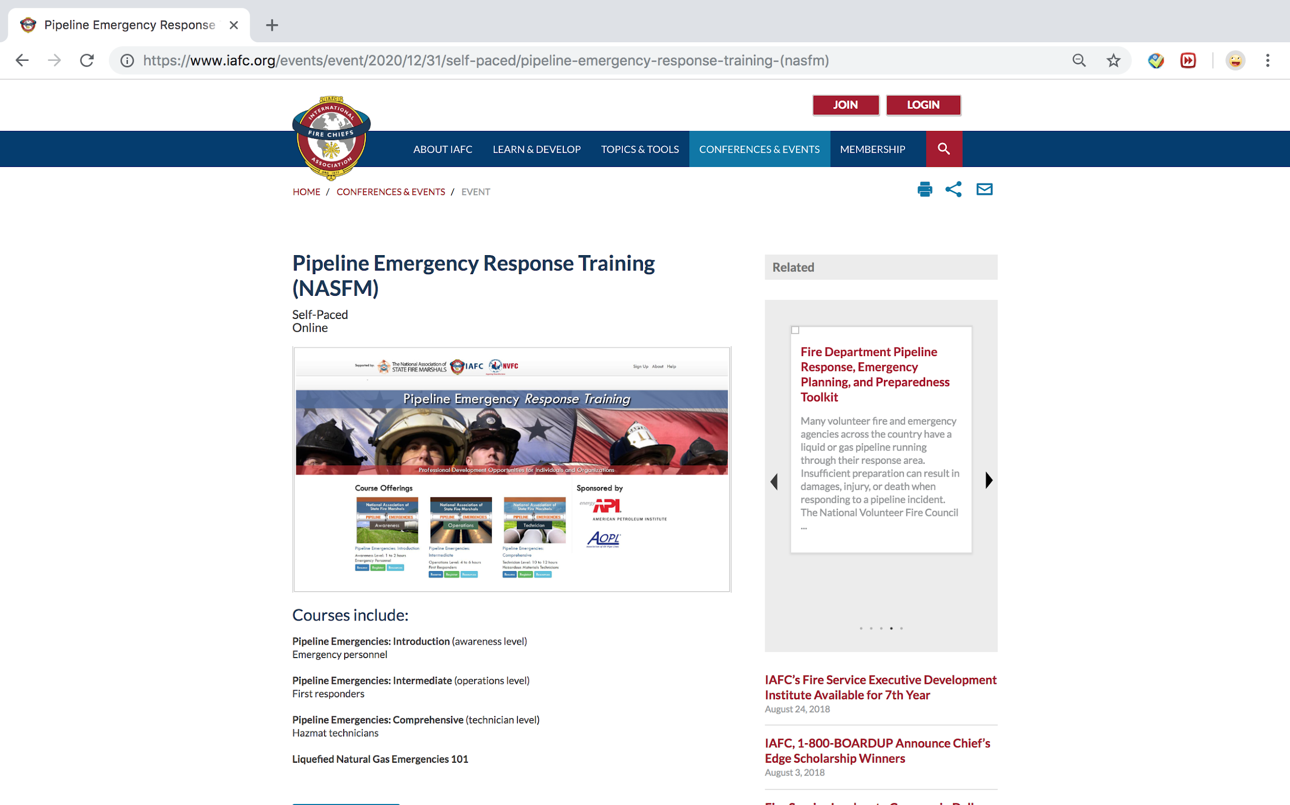
Notes:
Medical responders and those treating casualties from pipeline disasters should have proper training in assessing for toxic syndromes that may not be immediately obvious. In areas of high consequence, pipeline disaster training exercises should be conducted at least twice per year.

Slide 19
Notes:
There is also urgent need for trauma-informed practitioners in psychology, psychiatry, and the integrated health disciplines who can address the well-being of pipeline disaster victims in the short, intermediate, and long-term, and work in interdisciplinary teams to assist communities prior to, during, and post-disaster.

Slide 20
Thank You!
Simona L. Perry, Ph.D.
c.a.s.e. Consulting Services
Building Community. Raising Awareness.
Creating Solutions. Nurturing Empowerment.
www.casesolutions.org
communitypower.slp@gmail.com
Pipeline Safety Coalition
To gather and serve as a clearinghouse for factual, unbiased information; to increase public awareness and participation through education; to build partnerships with residents, safety advocates, government and industry; and to improve public, personal and environmental safety in pipeline issues.
www.pscoalition.org
Notes:
Thank you!

